Slide 17
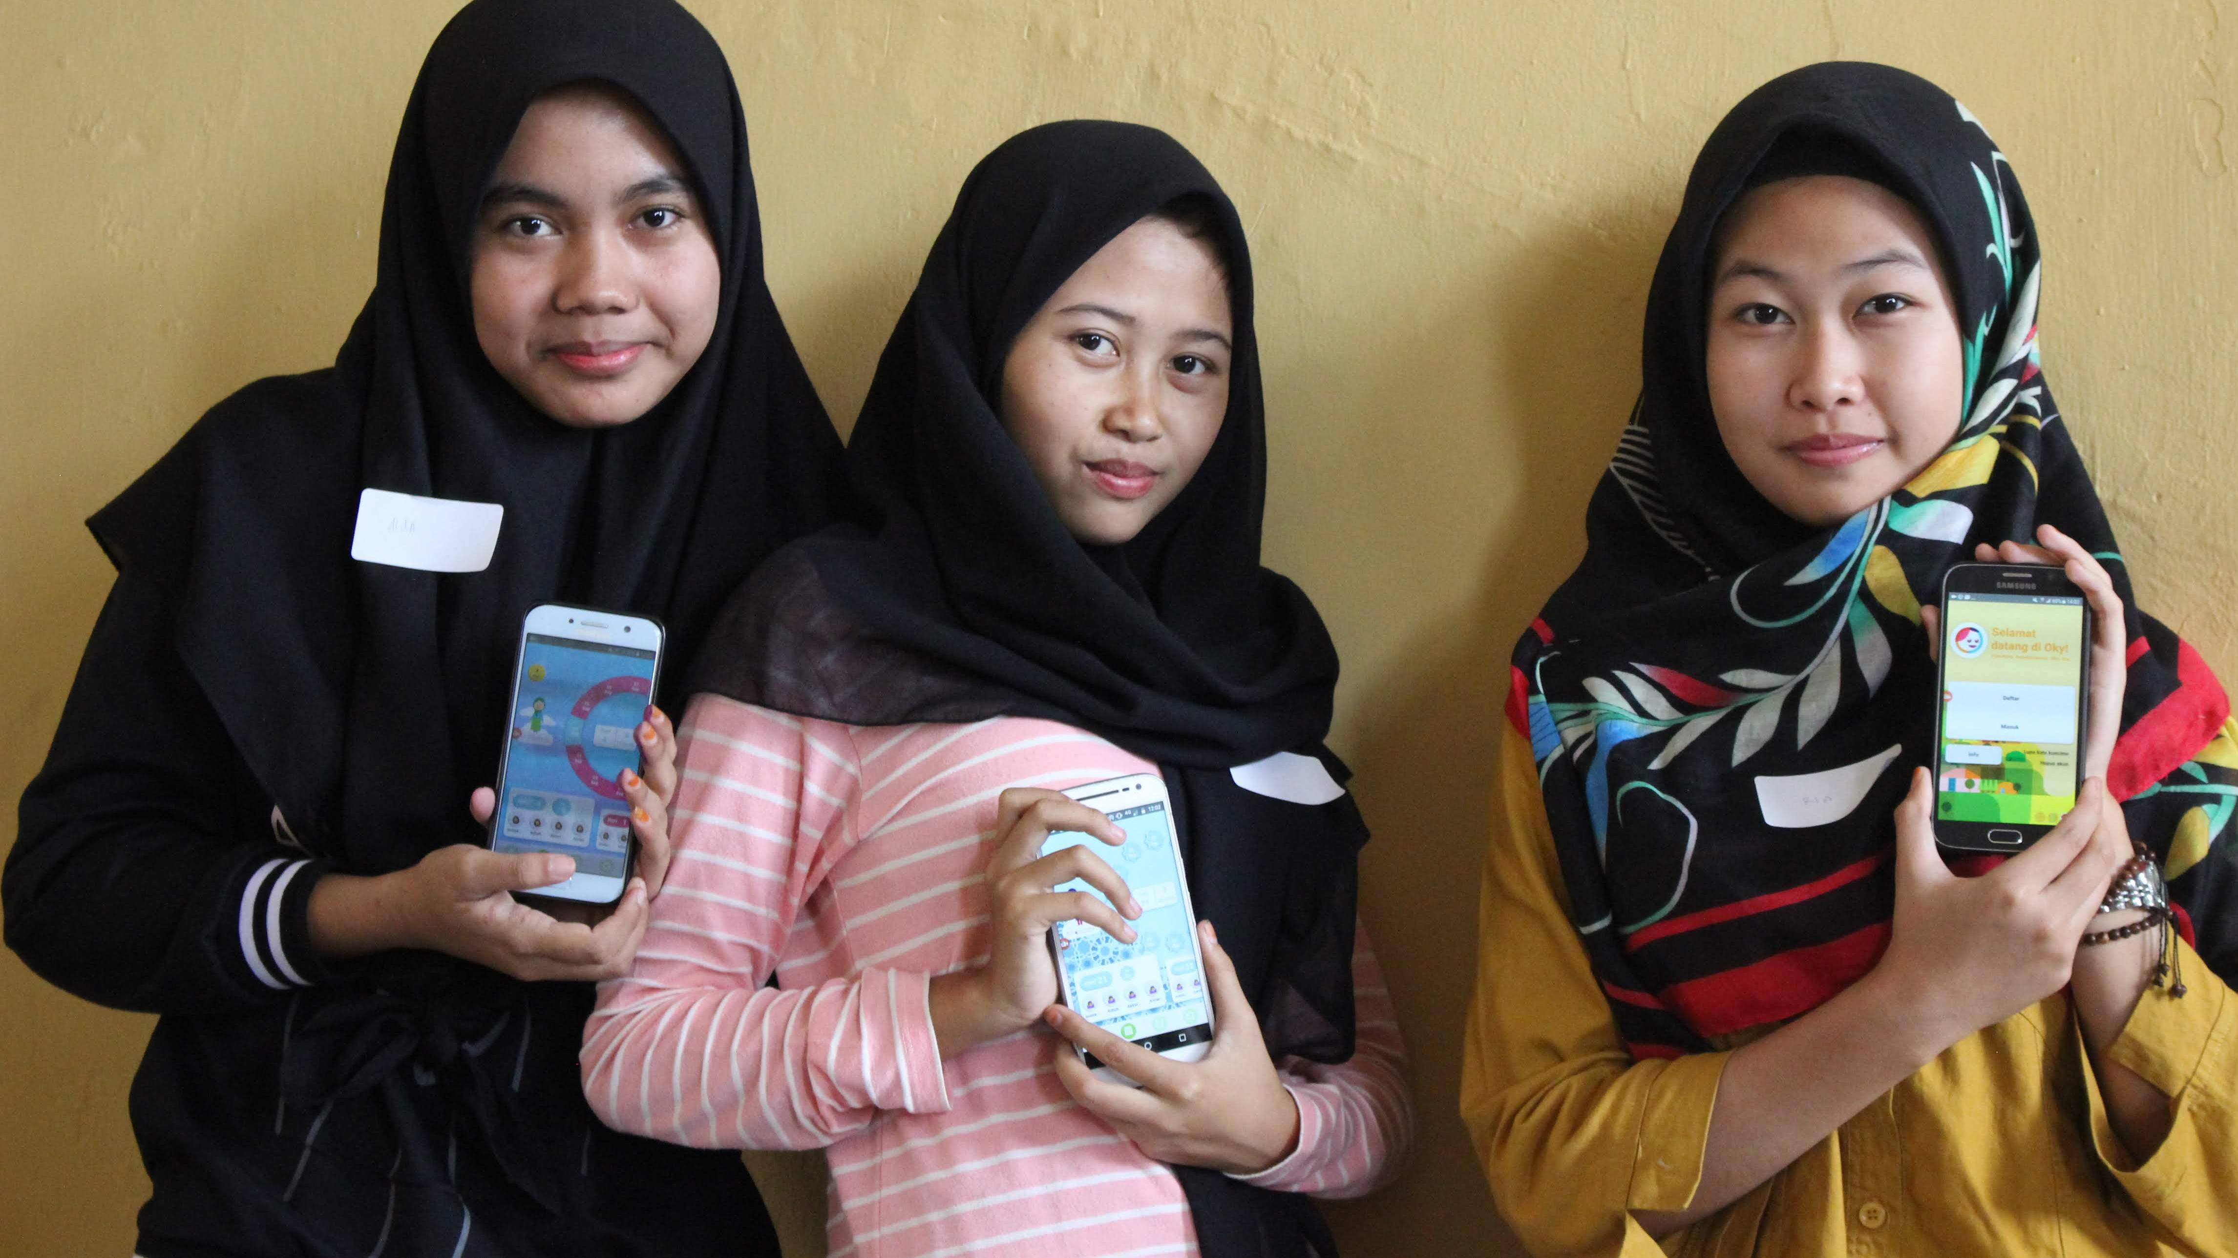
The period tracker app for girls Alex Tyers-Chowdhury, UNICEF

Slide 18
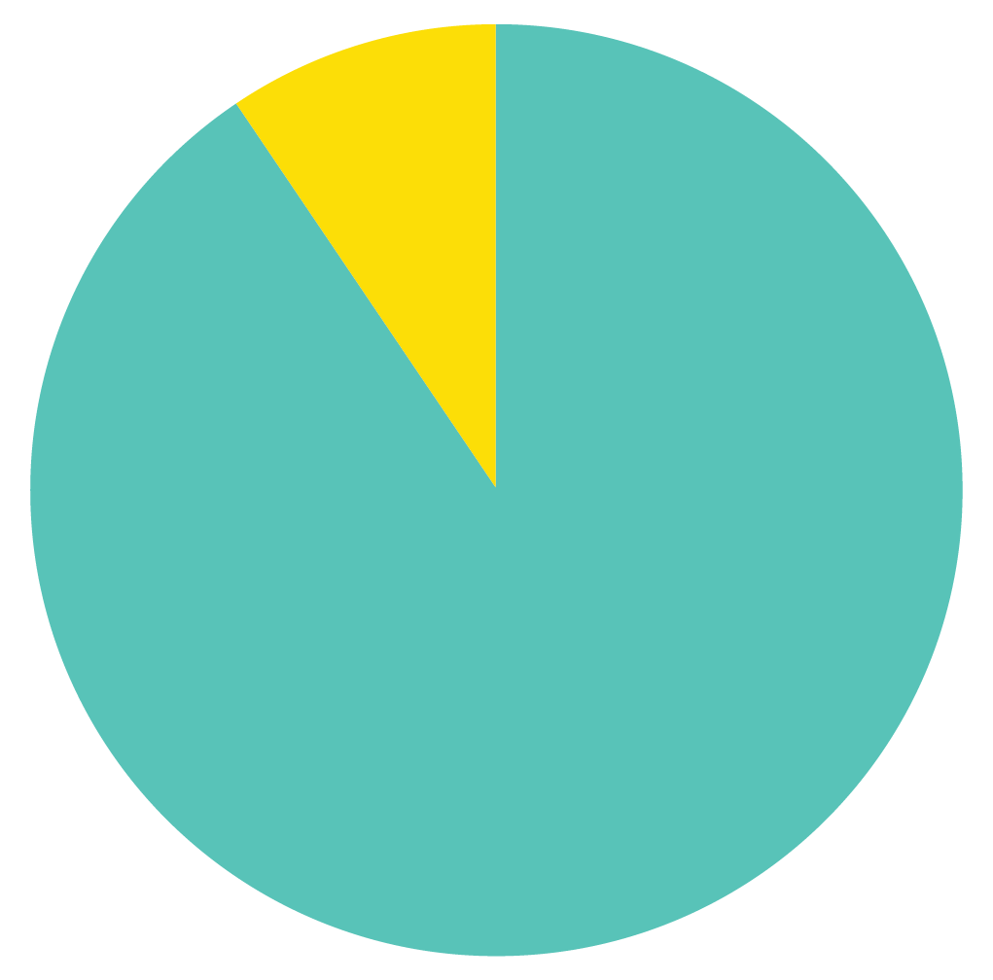
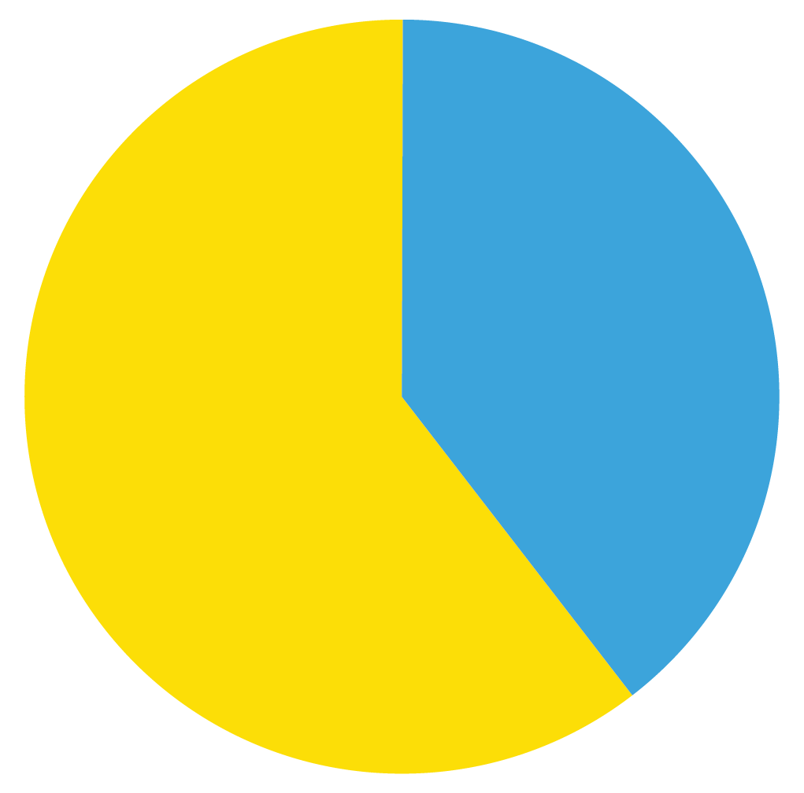
Girls lack menstruation information
Menstruation is an outdated yet prevalent taboo.
Girls globally lack information and are still shamed and penalized for having periods.
75% of girls in Vanuatu, and 45% in Cambodia report missing school due to menstruation.
45%
97%
Lao PDR
Indonesia
Girls with little or no knowledge prior to menarche

Slide 19
Menstruation education programmes
Menstrual health and hygiene programmes exist but are mostly paper-based with top-down information, or delivered by teachers and adults who often have little or no training, resources, or time.
Digital solutions can complement and deliver girl-centered menstruation education and individualized period tracking directly into the hands of girls, in the way they want.

Slide 20
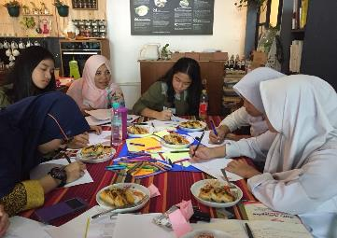
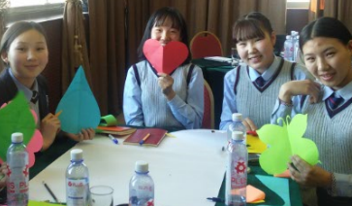
Designing a digital solution with girls for girls
Girls determined ‘look and feel’ and name of the app, and desired features to meet their wants and needs.
User-centered design and co-creation with 400 girls and their close social circles in pilot countries Indonesia and Mongolia.

Slide 22
Building to girls’ digital realities
Low end phones
Light-weight app
Limited connectivity/data costs
Offline functionality
Low (digital) literacy
Text-to-speech; tutorials; easy to navigate by design
Phone sharing (family or peers)
Multiple user login; password protection
No access to google play store
Downloadable via link; via QR code
Discretion, privacy & security
No personal identifiable information; high data protection
Parental permission / support
External facing website for parents, teachers, communities

Slide 23
Building to girls’ preferences and interests
Fun, games, colourful, positive
Calendar
Cycle tracker
Diary
Data summary
Accurate, trustworthy info
Games, quizzes, tips

Slide 24
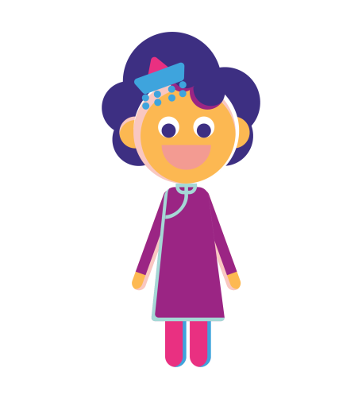
Personalized experience with avatars and themes
Friendly characters guide girls through the app. Girls can change Oky’s style whenever they like!

Slide 25
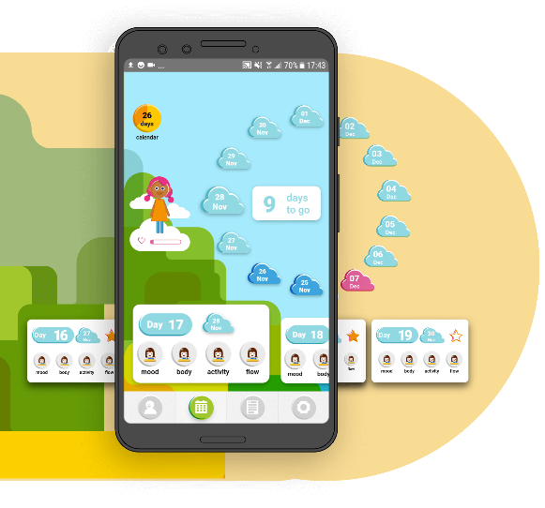
Individualized cycle tracker
Oky provides individualized cycle tracking with period predictions, reminders, and notifications.
Oky applies algorithms and machine learning to improve accuracy.
Oky does not overpromise and pauses predictions if periods are irregular.

Slide 26
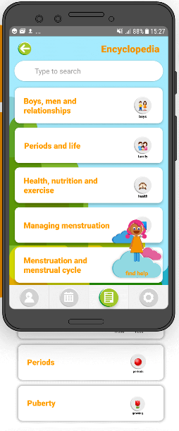
Evidence-based information
Oky provides evidence-based information about menstruation, puberty, and reproductive health
in girl-friendly language.
Menstruation information delivered in different formats:
factual content (Encyclopedia)
gamified content (Quizzes, Reminders, Pop-ups).
There is also referral information directing girls to online and offline SRH advice or services.

Slide 27
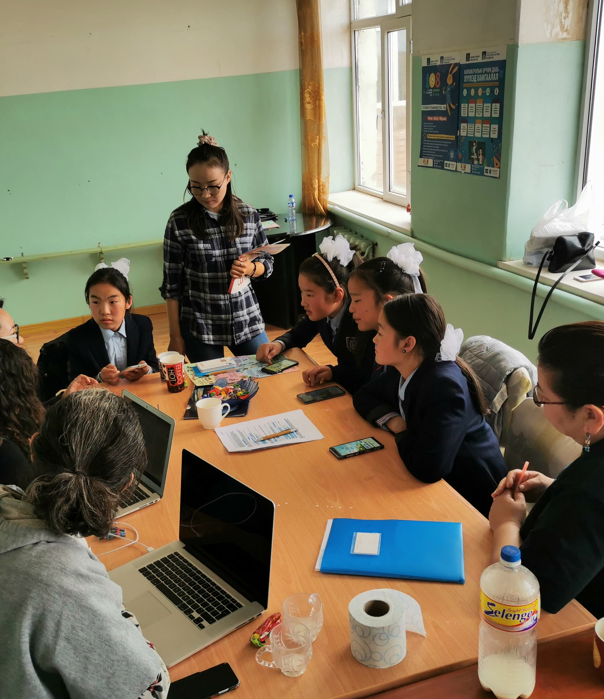
Open source for scaling
Oky’s code and content is open source.
Oky’s white-labelled code on GitHub has already been used by Kosovo’s SHNET app to include a cycle tracking function.
The vision for Oky scaling is for partners and girls themselves to write, amend, and improve the app’s code, design, features, and content, and bring Oky to new markets.

Slide 28
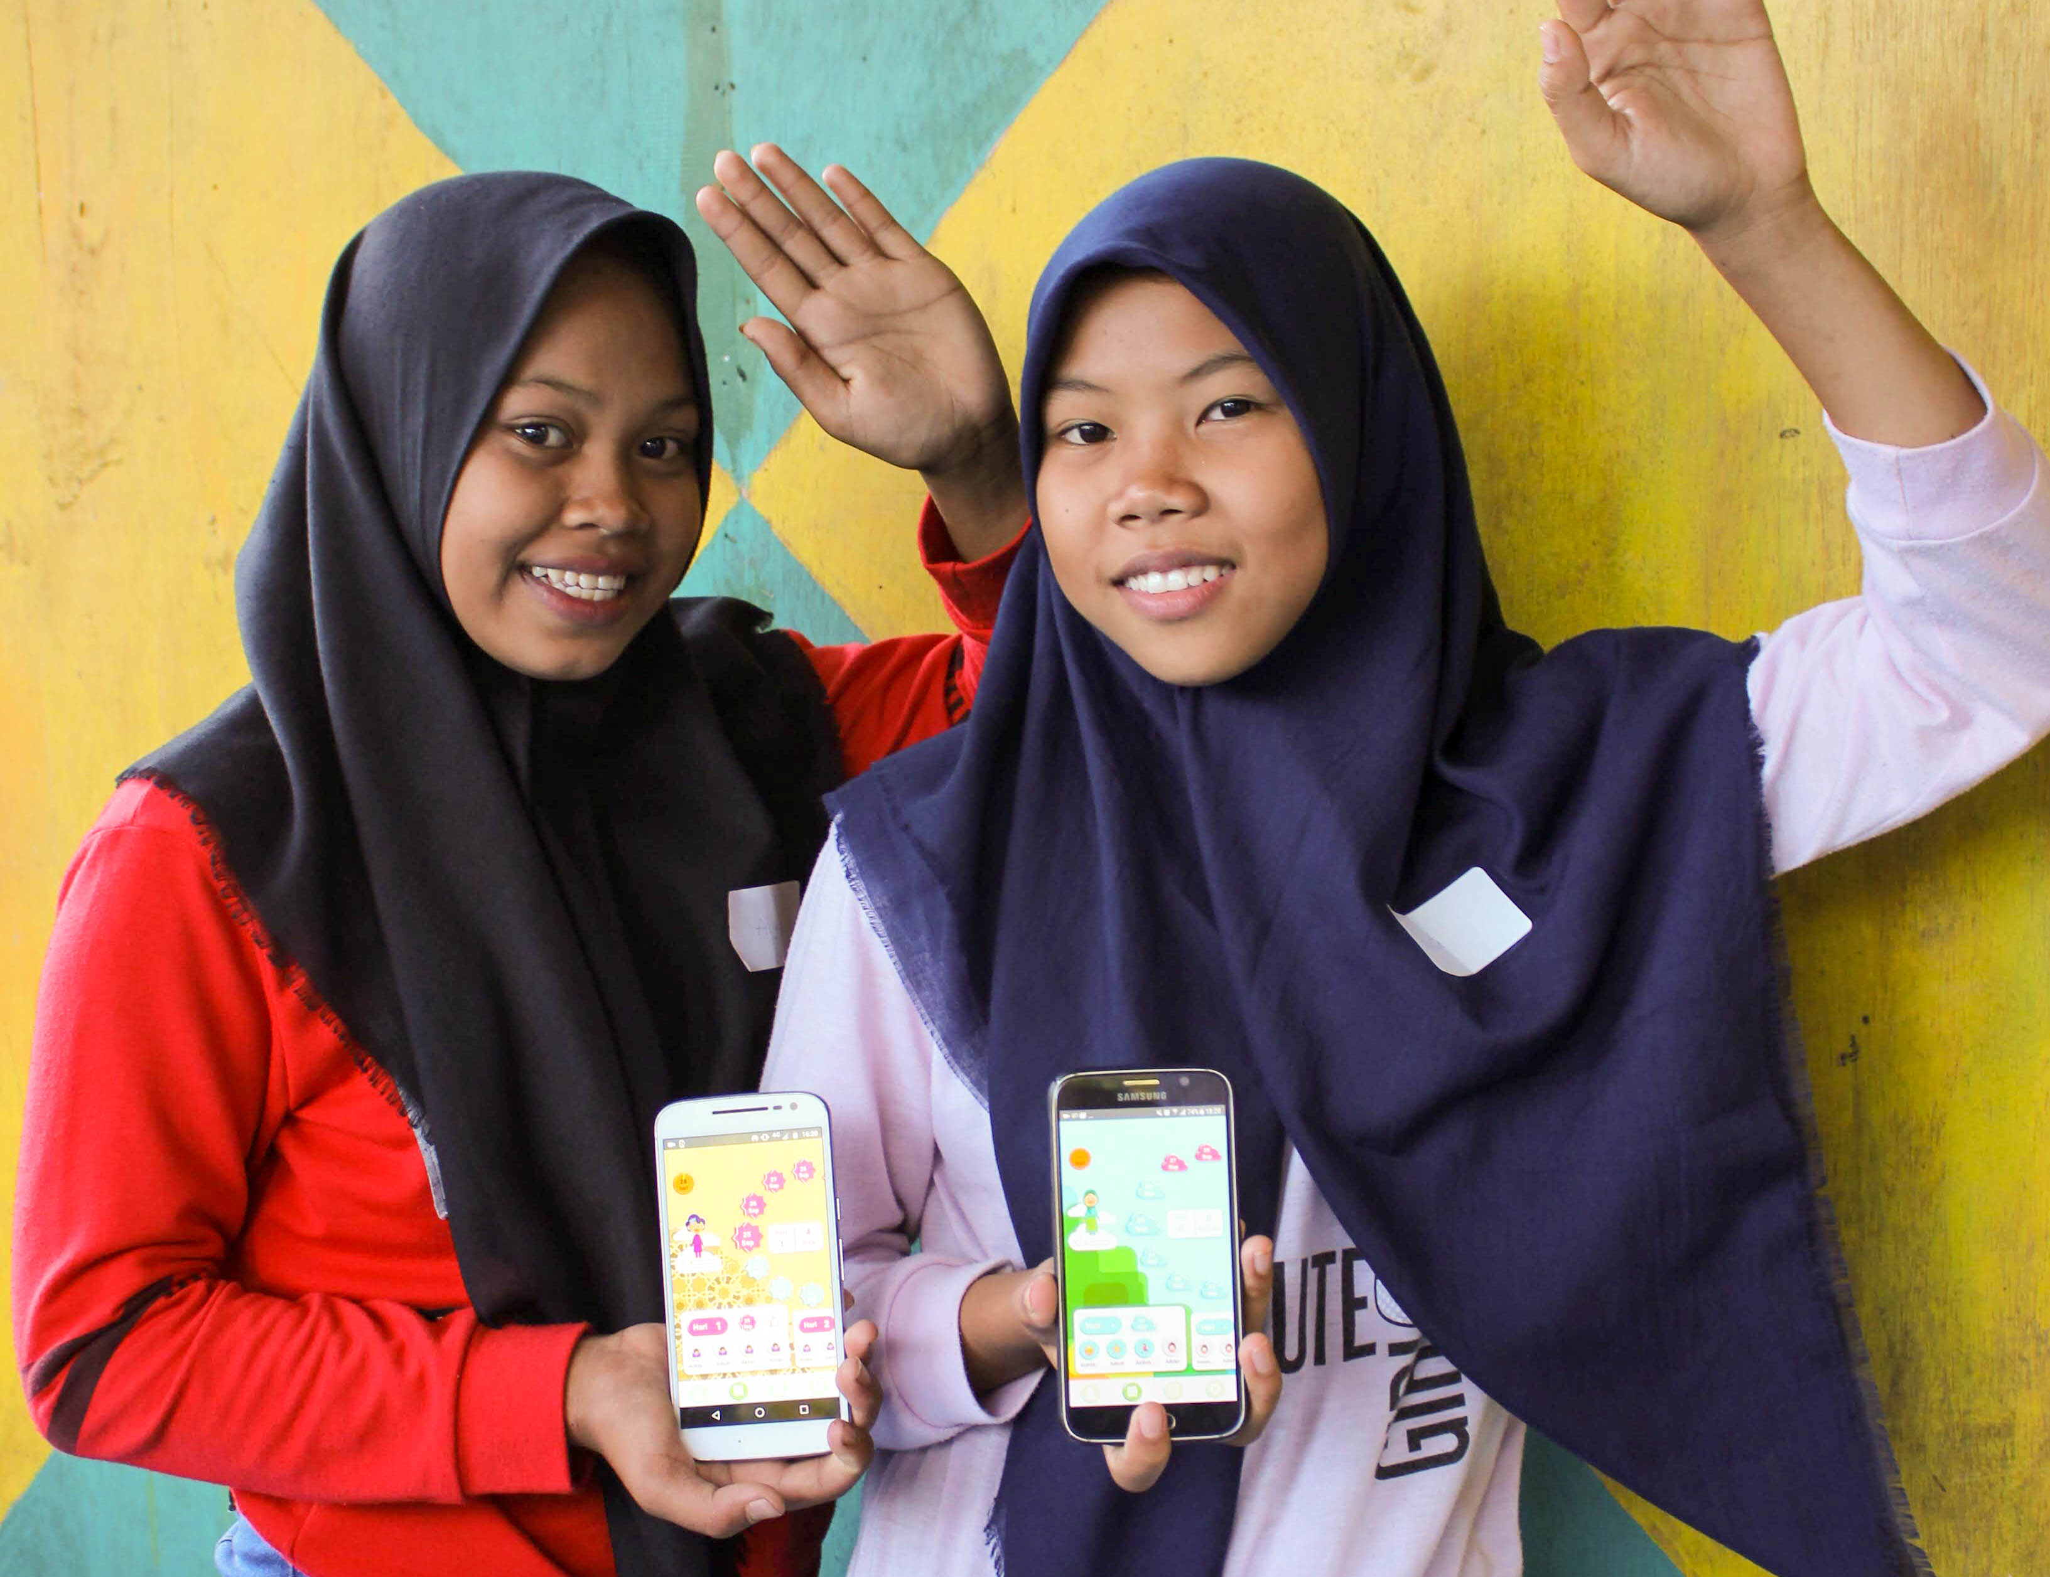
Oky partnership and franchise model
Key implementing partners will lead localization and deployment of Oky in their market.
These partners, such as LVCT in Kenya, will host and build out localized Oky versions as part of their services and programmes for girls.
And receive support from the Oky community and contributing partners.
MONGOLIA
Contributing partners can be from all sectors:
technology, design, marketing, mobile operators, content, communications, research, UX/UI, accessibility, girls engagement
INDONESIA

Slide 29
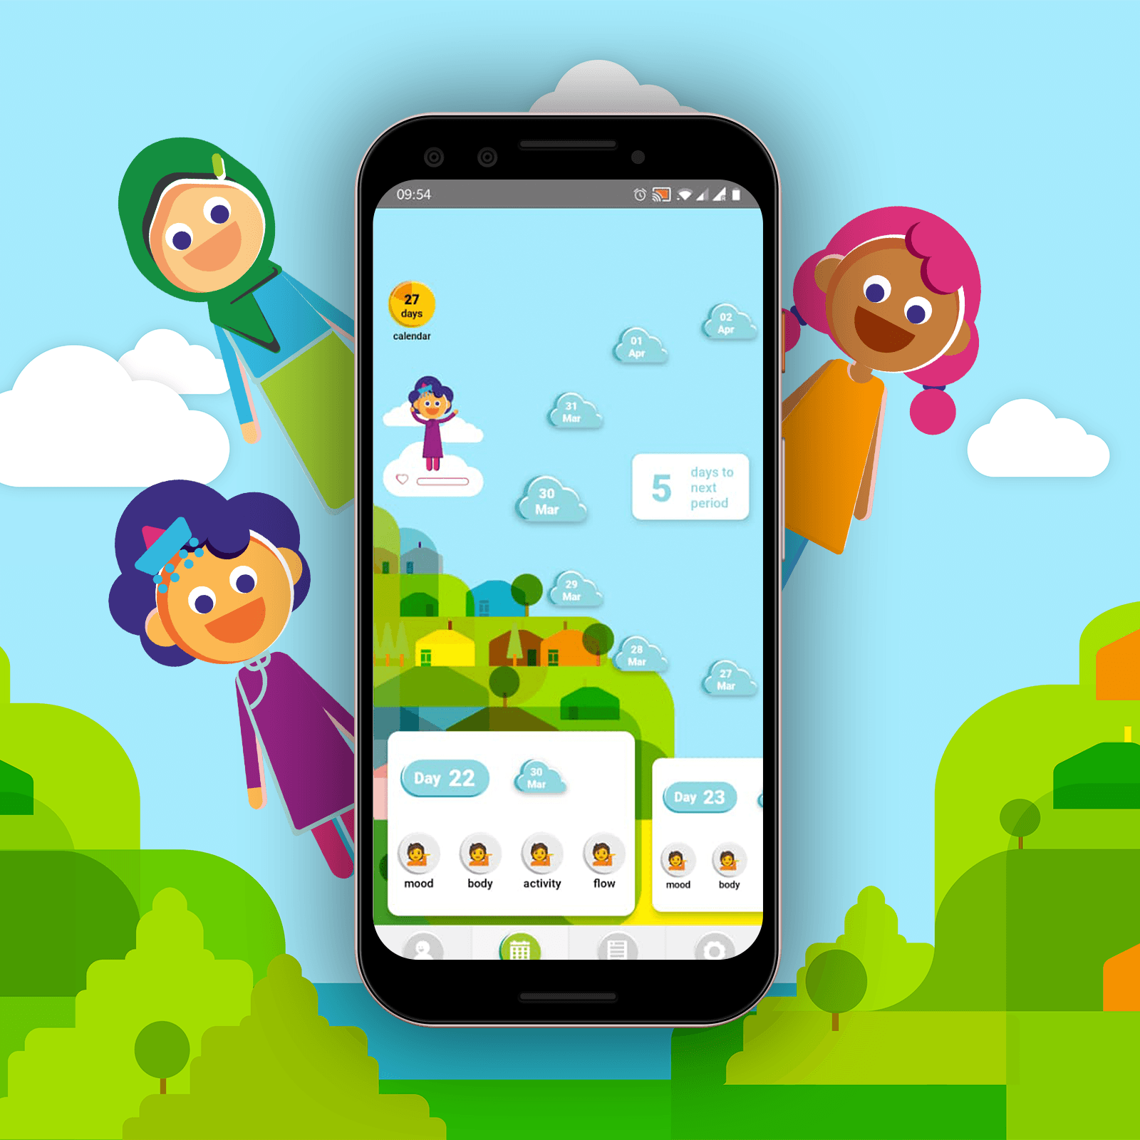
The Oky ecosystem to date
Technology
Therapy Box, Grey Chain, Portonics, ThoughtWorks, Big Blue Communications…
Co-creation and localisation
UNICEF country offices: Indonesia, Mongolia, Kenya, Mexico, Papua New Guinea, Philippines, India (West Bengal)…
Private sector
Essity, Softex…
Resources
Gucci, UNICEF Venture Fund, Duke-UNICEF WASH Accelerator, TheCaseForHer, DFAT…
Content
CSE experts, UNFPA, USAID, Girl Effect…
Implementing franchise partners
Kopernik, WASH Action NGO, PixFrame, LVCT Health, Splash….
Promotion
UNICEF country offices, ministries of health, local NGO partners, TheCaseForHer, DFAT, UNICEF Innovation…
Mobile operators
Safaricom, Digicel…

Slide 30
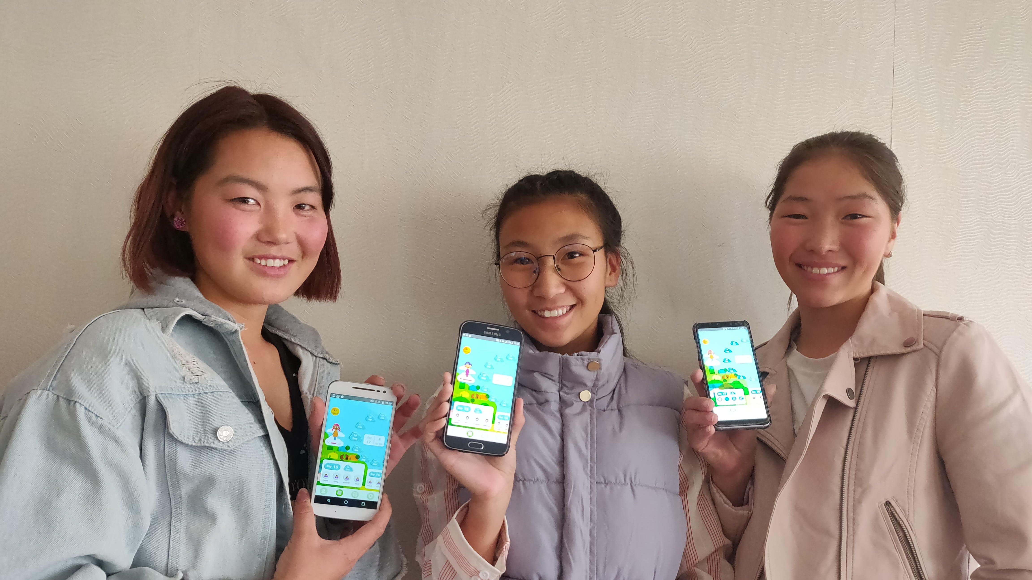
For Girls. By Girls. Period.

Slide 32
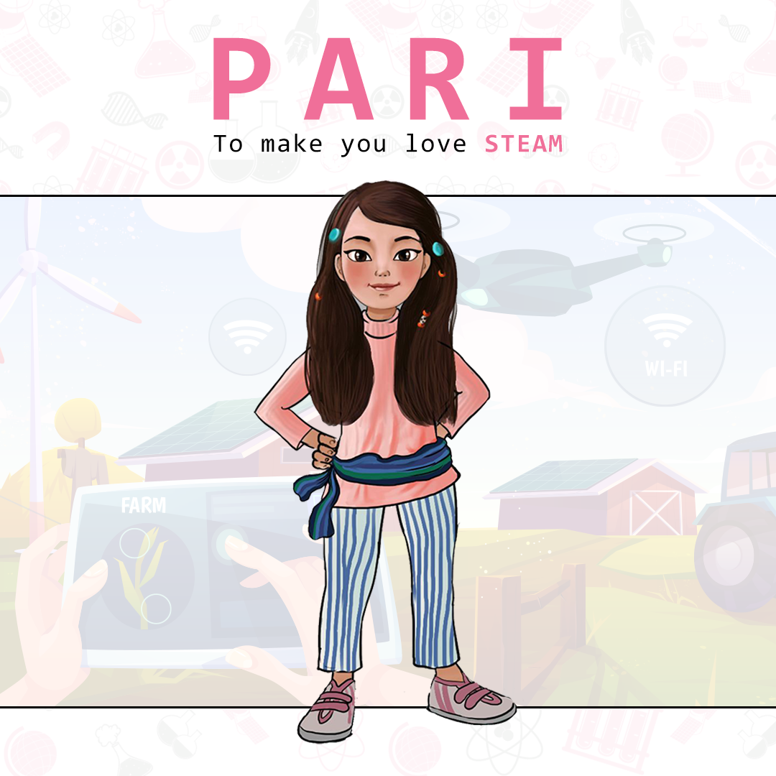
Presented by : Binita Shrestha, Founder & MD at Women in STEAM
Notes:
Might replace this poster with the thematic color of organization. It’s little fade one.
My introduction, background of my studies, works at WiSTEAM and involvement at Unicef COA group.

Slide 33
Pari; Animated Series Project
3D animated series of 13 year old protagonist to take you guide through science activities and experiments
Connects education with STEAM interdisciplinary approach, challenges the existing stereotypes about computing/engineering careers for girls/women
Prototyping up to three episodes of 4-5 minutes in each
Contains up to 4 science, arts and engineering experiments in each episodes

Slide 34
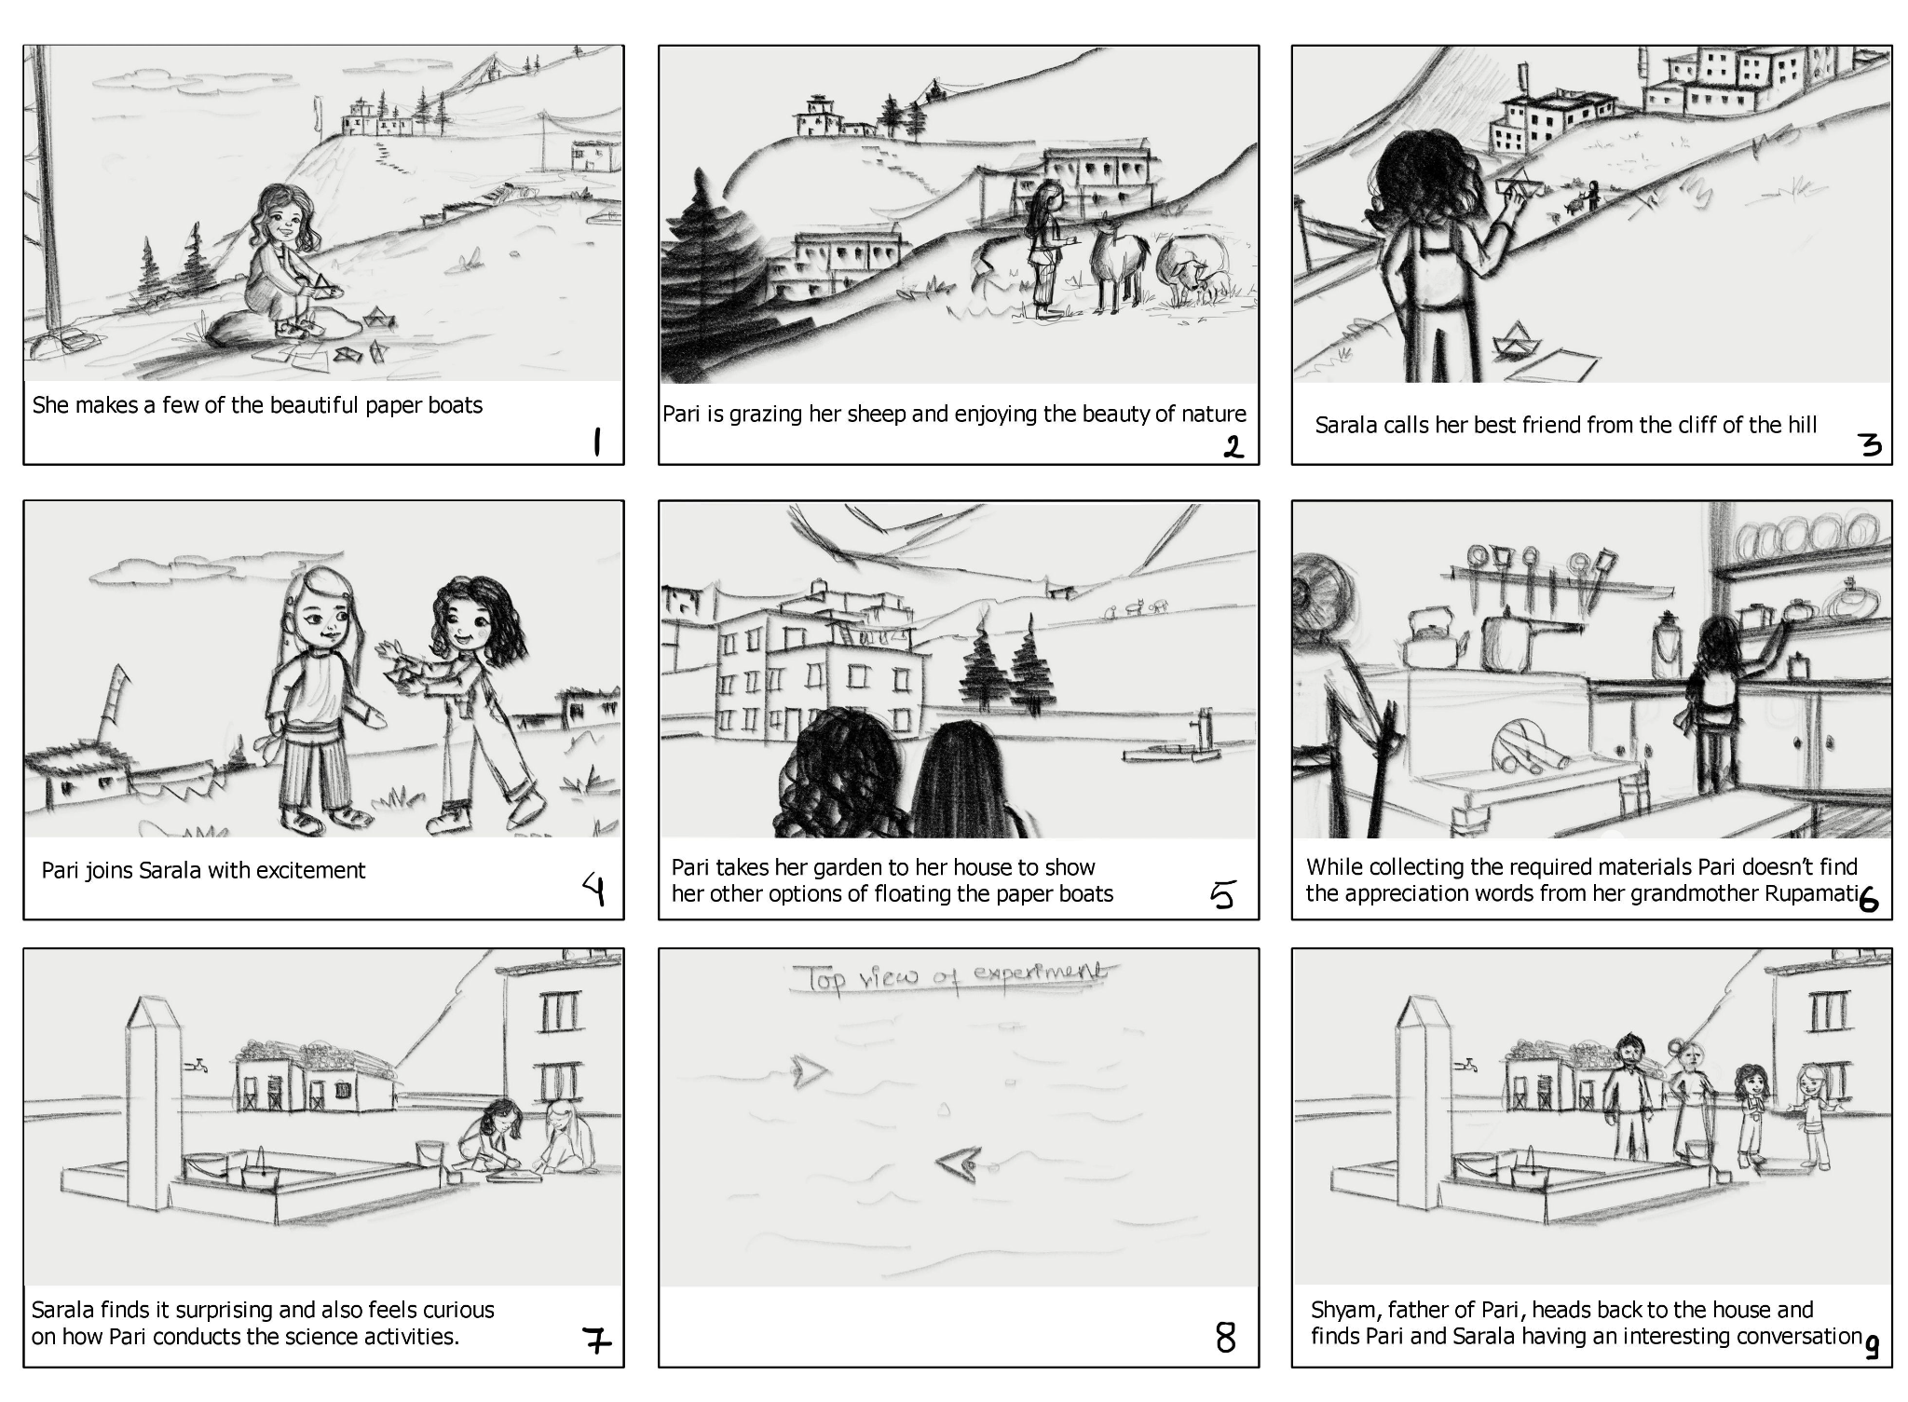
Storyboard designs

Slide 35
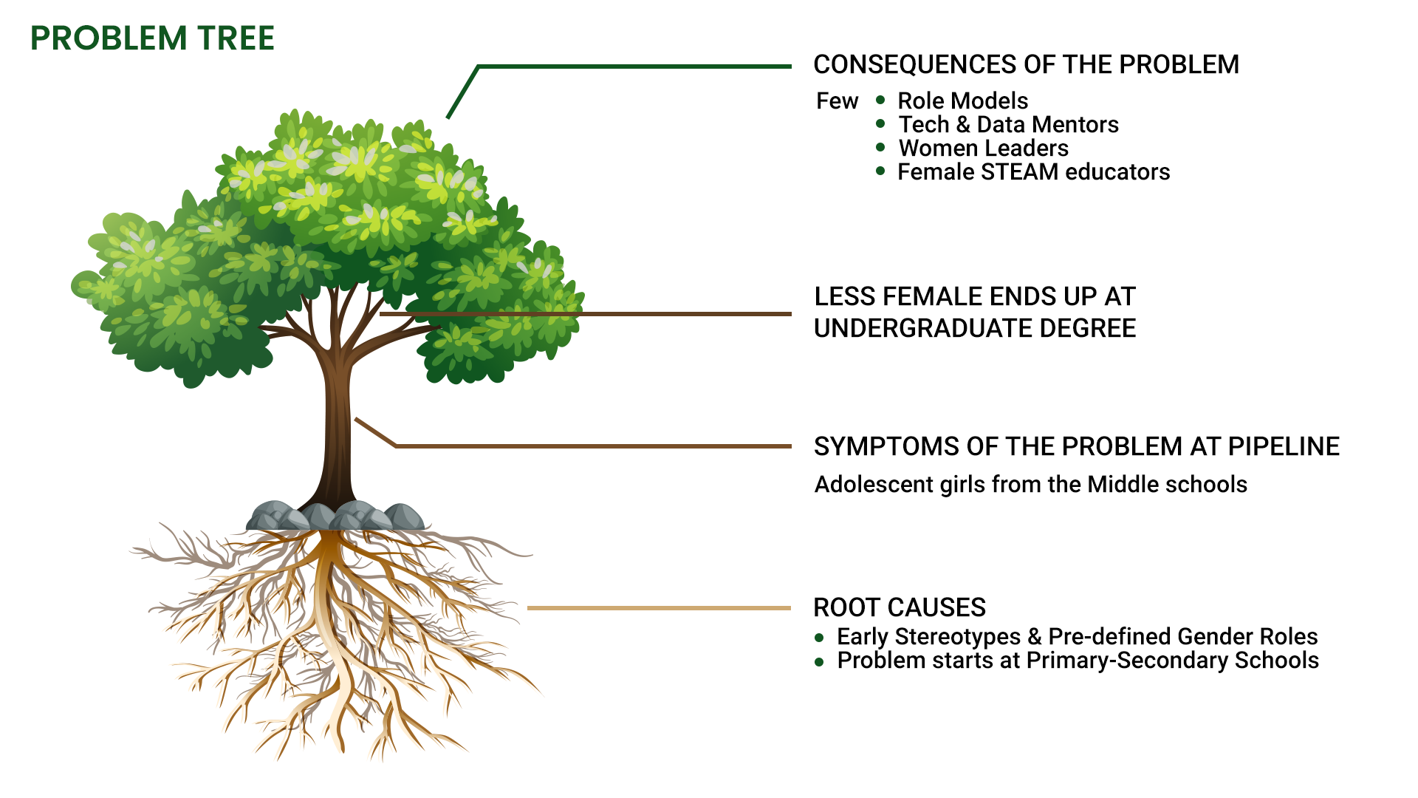
Why we are doing this ?

Slide 37
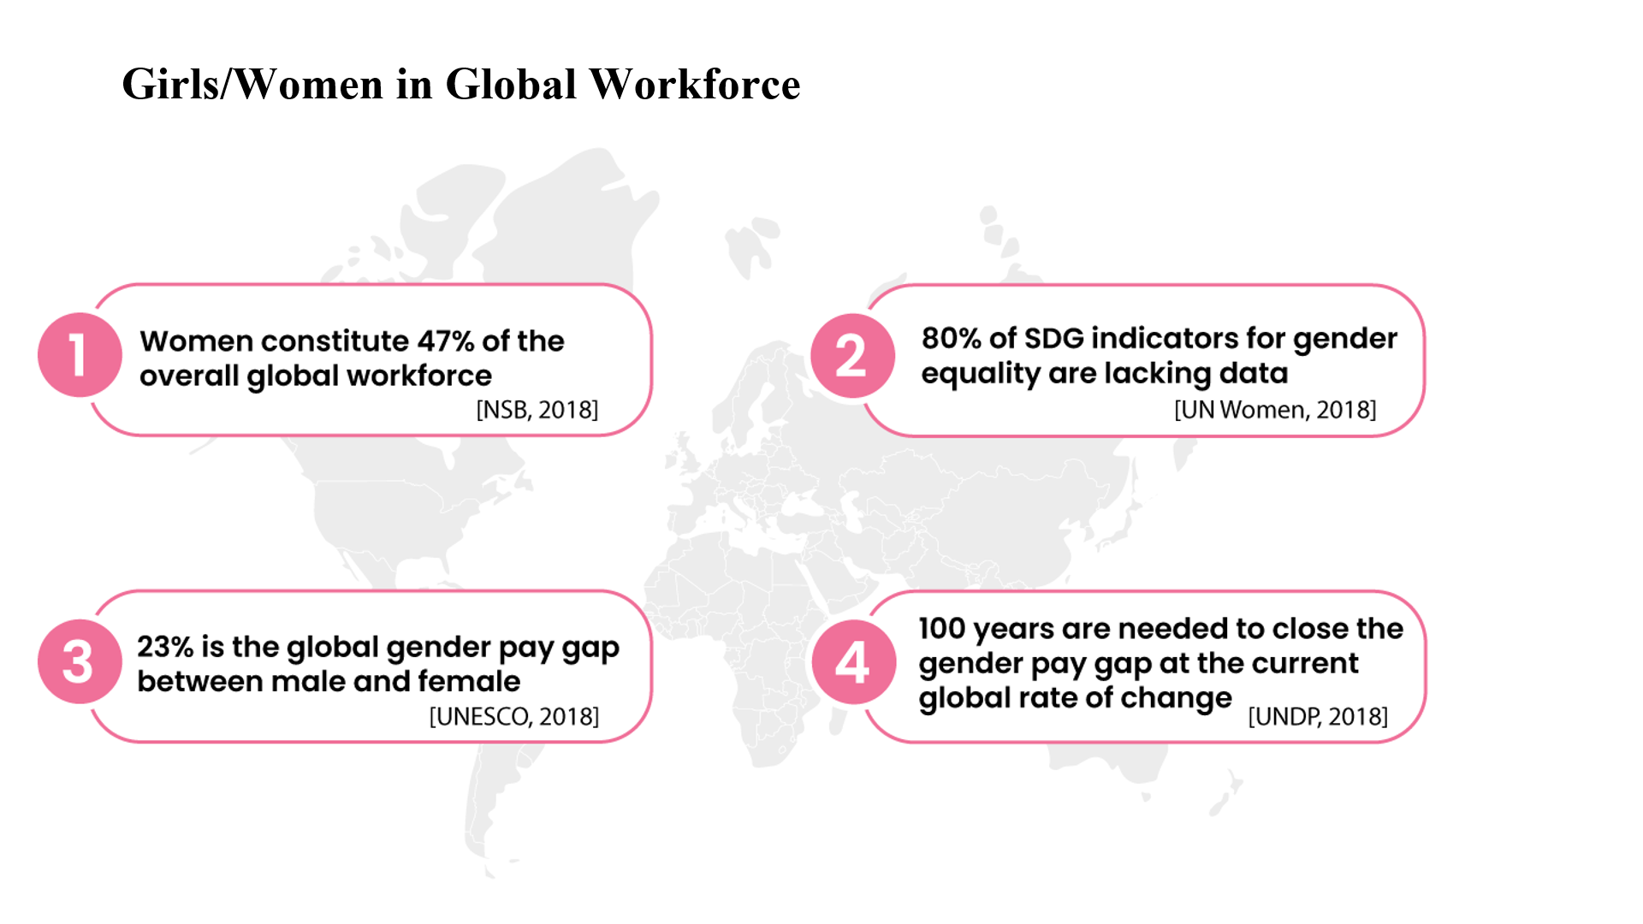

Slide 39
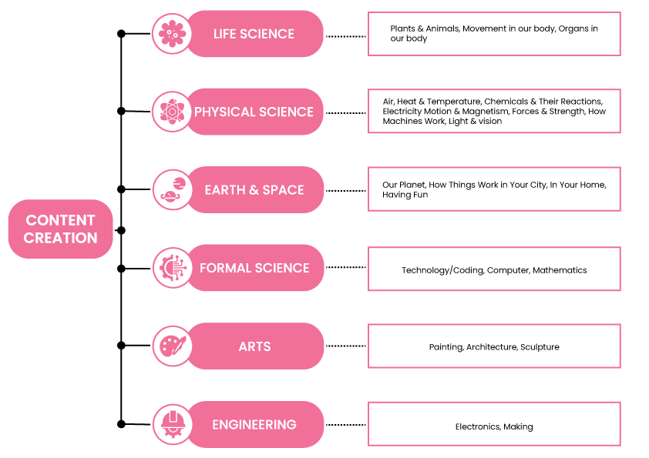
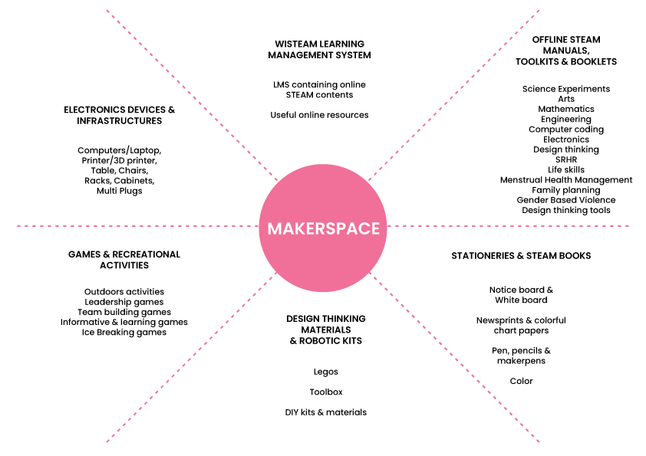
Content creation and dissemination plans
Mainstream TV Channels to air series-based, OTT platforms, Local and provincial tv, radios and media partnerships, Social networking sites, Youtube and STEAM शिक्षा Learning management system and Offline STEAM शिक्षा makerspaces
Notes:
NGOs and INGOs
Local CSO organization working for cause of children and adolescent girls
Corporates working for education and girls causes

Slide 41
Thank you.
Contact Details:
Email: info@wistemnepal.org
Contact: +977 9849215337
We are available at:
Twitter, Facebook and Linkedin: @wisteam2016
Instagram: @wisteam2016_
Websites: www.wistemnepal.org, www.wisteamnepal.org and www.steamsikshya.org

Slide 43
Youth and Governments working together
for an inclusive, prosperous, resilient and sustainable Asia and the Pacific

