Slide 2
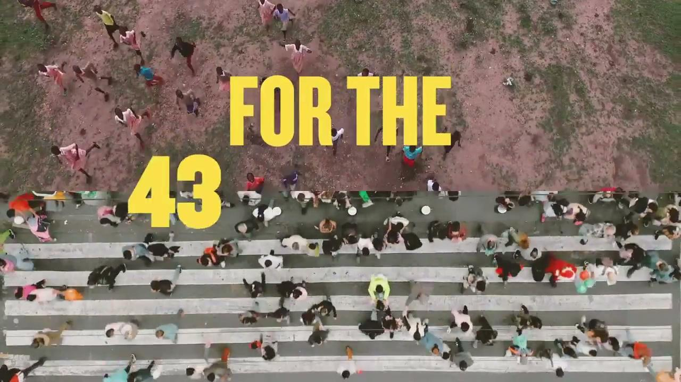

Slide 3
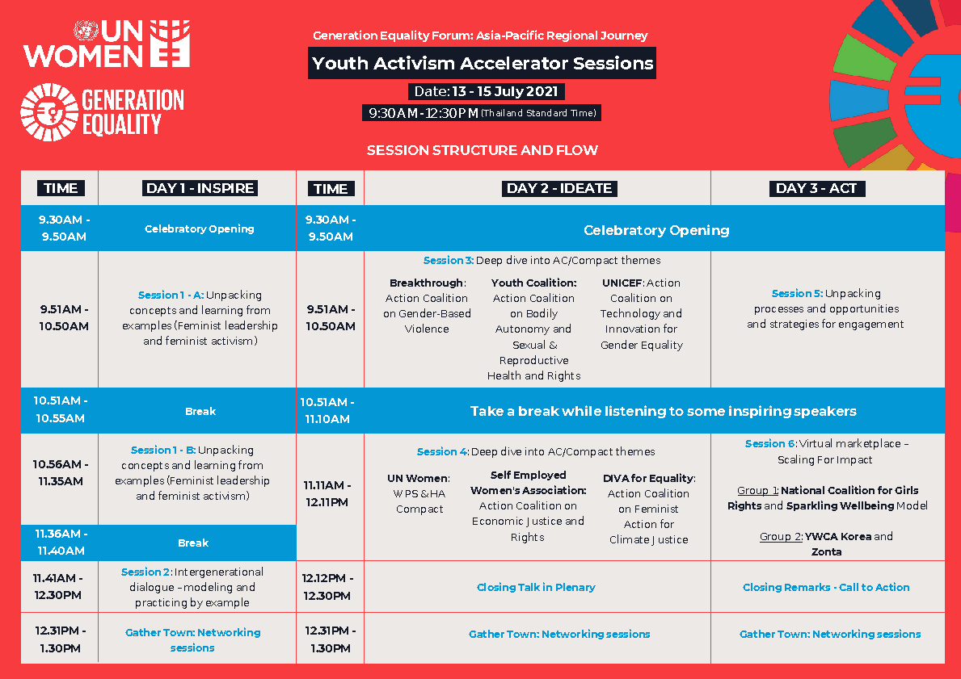

Slide 10
The session focus :
Head
Knowledge
Ideas
Values
Participants deepen their understanding of the origins, uses and power of feminist principles.
Feel more connected, confident, curious
Participants can articulate their principles that guide their purpose, power, practice and partnerships
Heart
Attitudes
Feelings
Emotions
Hands-Feet
Behaviours
Skills
Actions

Slide 11
What is Feminist Leadership?
People of all genders with a feminist vision of social justice- individually and collectively transforming themselves, their organizations, their movements and societal norms
To pay close attention to gender power structures and discriminatory practices – both formal and informal – in order to advance gender equality and women’s human rights within their organizations and social movements as well as in the communities and constituencies they serve.
Credit: Srilatha Batliwala

Slide 12
What are the principles that guide your actions at work and other aspects of life?
Think of an incident/ experience/ personal story that had an impact on you and helped form some of the principles that you follow in your work now.
What are those principles? Do they guide your actions, through your work or in your life? The way you live, the way you interact with yourself, others around you, the planet etc.
Notes:
USE mentimeter to write their principles/ statements that came up

Slide 13
What Do We Talk About When We Talk About Intersectionality
Religion Safety Gender Traditions Representation
Sex Race Family Customs Values Caste Emotions
Queerness Violence Body
Consent Power Dynamics
Aesthetics Language Social Obligations
Economics Power Rights LGBTQIA+ Sexuality
History Duties Privilege Entitlements
Caste/Gender/Race Privileges Politics Resources

Slide 14
Intersectionality: What does it mean?
Kimberlé Crenshaw defines Intersectionality as,
“Intersectionality is a lens through which you can see where power comes and collides, where it interlocks and intersects. It’s not simply that there’s a race problem here, a gender problem here, and a class or LBGTQ problem there. Many times that framework erases what happens to people who are subject to all of these things.
If someone is trying to think about how to explain to the courts why they should not dismiss a case made by black women, just because the employer did hire blacks who were men and women who were white, well, that's what the tool was designed to do. If it works, great. If it doesn’t work, it’s not like you have to use this concept.”

Slide 15
How intersectionality operates?
Innermost
Unique Circumstances
Second
Aspects of identiy
Third
Types of discriminations that impact identity
Fourth
Larger forces and structures reinforcing exclusion

Slide 16
Politics Globalization Capitalism
War Social Forces Historical Forces
Immigration System Education System
Economy Legal System Colonisation
Racism Discrimination Heterosexism
Sexism Classism Casteism
Transphobia Ageism Homophobia
Ableism
Age Education Indigeneity Gender
Occupation Geographic Location Income Life experience
Skin colour Family status Refugee status Disability
Experience of radicalization Religion Citizenship status
Work history Housing Situation HIV status Sexuality
Spirituality Social Status Class background Caste
Unique Circumstances of Power Privilege and Identity

Slide 17
Power
Dimensions of Power
Public (government, organizations, etc.)
Private (family, friendships, etc.)
Intimate (self-esteem, body image, etc.)
Expresssions of power
Power to…
Power over…
Power with…
Power within…
Power under…
Sources of power
Intrinsic (Personality, knowledge, etc.) Extrinsic (assigned power, positional power, earned power
You?
Three faces of power:
Visible/direct power (police, presidents, etc)
Agenda-setting power (lobbyists, influencers)
Idea-shaping power (media, religion, etc.)
Adapted by Joanne Sandler from Batliwala, Gaventa & Veneklasen

Slide 18
Power and challenges!
Think about the challenges one faces while managing / practising our feminist principles with power around us.
What are those principles? Do they guide your actions, through your work or in your life? The way you live, the way you interact with yourself, others around you, the planet etc.
Notes:
USE mentimeter to write how you have seen power manifesting around them.

Slide 19
Examples of Further Refining Principles
For example, to make this principle actionable: “grow a community of solidarity, care should be rooted in all processes”.
What specifically we could do to translate these principles into actionable points?
Check in with colleagues,
Respect other people’s boundaries,
Help create communities of solidarity by
Checking in and
Sharing resources,
How I frame my emails,
How to foster collaboration,
Support each other with work, how can we support, collaborate.

Slide 20
Feminist principles Adapted from Catherine O’Ignazio and Lauren F Klein, Feminist Data Visualisation
Rethink Binaries
Embrace pluralism
Examine power
Male and female
Nature and culture
Reason and emotion
Body and gender
Include all voices
Who is being thought of as ideal person?
How would additional perspectives be accommodated however marginal?
Challenging patriarchy and hierarchy, ability/disability, access, who has power to consent/ dissent
How is power distributed?
Privilege/ class/ caste
Consider context
Legitimise experience as a way of knowing
Make contributions of people visible
All knowledge comes from somewhere and it is important to deconstruct the ”somewhere”
Cultural/ social/ religious
How do we leverage that?
For example, the contributions of individuals within organizations are never acknowledged. E.g. ‘Oxfam’ did this. How to bring to like people’s contributions.

Slide 21
Listening Circle

Slide 22
How intersectionality operates?
Fourth
Larger forces and structures reinforcing exclusion
Third
Types of discriminations that impact identity
Second
Aspects of identiy
Innermost
Unique Circumstances

Slide 24
Five essential practices for Feminist Leadership
1 Map & analyze the gender & Deep structure dynamic in the organization
2 Analyze & work on the self, support others to do so
3 Create transparent, accessible processes & accountability for internal gender equality – name the “Non Negotiables”
4 Create transparent, accessible mechanisms & accountability for addressing deep structure dynamics
5 Celebrate & reward feminist leadership practices, make visible their results
Adapted from
Shawna Wakefield

Slide 25
Gender at Work Analytical Framework
One of many good gender analysis frameworks
“It travels well”
“It’s scalable” – you can zoom in (to household) or out (to country or the world)
Used in analysis, planning, reporting and evaluation
Carry it in your head – play with it.
Notes:
Insert source: Evaluation Masterclass March, 2018 Michael Quinn Patton & Mark Cabaj Source:
https://cdn2.hubspot.net/hubfs/316071/Events/Multi-Day%20Events/Evaluation%20Masterclass/MQPFinalPPT.pdf

Slide 26
Oxfam’s Feminist Principles
7. I champion diversity
8. I value safety
9. I want a supportive environment
10. I believe in freedom of expression
11. Eliminate gender-based violence
1. I share power
2. I challenge my behaviour
3. I support the feminist movement
4. Nothing about us without us
5. Feminism is for everyone
6. There is no justice without gender justice

Slide 27
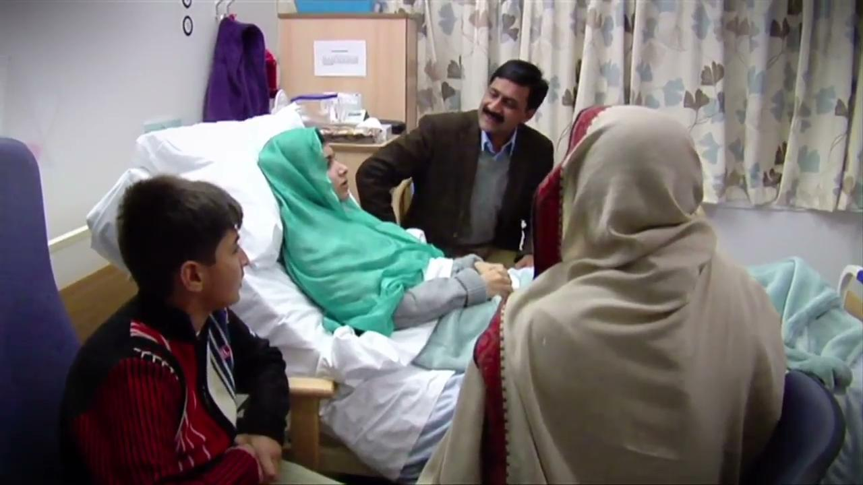

Slide 30
Intersectionality & Identity
Intersectionality – a key principle informing (young) feminist activism
Each individual can have many identities that impact on how they interact with and are viewed in society
Intersectionality emerged as a critique of the false universalist identity of ‘womanhood’ or the experience of racism (e.g. Black women experience racism differently from Black men)
We, as individuals, might stand a the ‘crossroads’ of various intersecting oppressions; however, these oppressions are inextricably interlinked at the structural level.

Slide 31
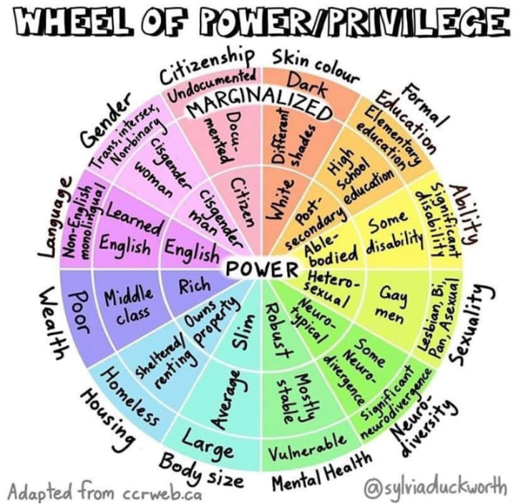
Categories of identities + structural locations 🡪 accurate representation of people’s complex experiences and ways in which hierarchical social relations shape our daily realities.
Identities are a social and political category – they are created or socially constructed under oppressive conditions.
They function only because they are supported by particular structures of power.

Slide 32
Identity and Young Feminist Activism
If we are truly committed to ‘leaving no one behind’ we should pay attention to identity
Individualisation of identity vs. the link between identity and power
Centring historically marginalised groups/communities – elevating and amplifying their agency, resistance, voices, experiences, knowledge

Slide 33
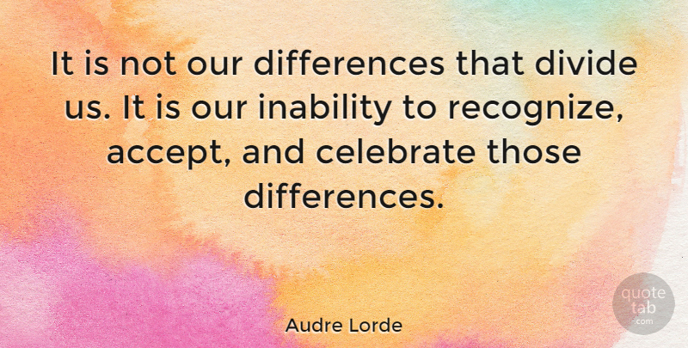
Suppression of difference (along identity lines) - rather than difference itself- is what often hinders movements for progressive change
A collective identity as intersectional young feminists that acknowledge, accept, respect and celebrate and our differences
Recognition and accommodation of the needs of historically marginalised/oppressed groups promotes social justice
Coalitions in which differences are acknowledged are likely to seek greater equality – but we must be ready and willing to put the work into it!

Slide 34
This understanding of identity can provide us with a political basis for feminist action against harmful constructions of the patriarchy, misogyny, heterosexism, racism, ableism, ageism, capitalism…
Let’s reimagine ‘identity’ and its relationship to our feminist politics to make it valuable to our young feminist activism, movement building and social justice aims! ☺

Slide 36
Lessons learned about feminist leadership
BY SRILATHA BATLIWALA
SENIOR ADVISOR, KNOWLEDGE BUILDING, CREA (WWW.CREAWORLD.ORG)
SENIOR ASSOCIATE, GENDER AT WORK (WWW.GENDERATWORK.ORG )
HON. PROFESSOR OF PRACTICE, SOAS, LONDON UNIVERSITY

Slide 37
KEY LESSONS:
The more you share power, the more powerful you became. The act of sharing power is very empowering, even intoxicating! – not just formal positional power, but also the ”Power Within” – the power of ideas, of past experience and insight, the power of love and solidarity and belief in others.
Recognize and confront your biases, social power and privilege – but also strengths – and interrogate this always in your interactions with colleagues and others. Does your response, in any situation, come from a place of unconscious power and privilege?

Slide 38
KEY LESSONS:
Becaming a grandmother helped me gain a new perspective on power and leadership… I discovered the joy of”leading from the back”, ceding space, supporting others to take the lead, and learning new ways of doing things.
I became more powerful AFTER I gave up positions of formal leadership, in many ways - BECAUSE of the things I was able to do by giving up formal leadership roles!

Slide 39
KEY LESSONS:
None of this is possible if we feel powerless inside – so we have to find ways of reconnecting with our POWER WITHIN, which each of us has.
Looking within, understanding your own history and relationship with power is critical to practicing power in a feminist way… i.e., to being a feminist leader.
You can’t change the world without first recognizing yourself as a site of change has led to huge abuses of power within the world of feminist and social justice organizations and movements – we are still doing badly in this respect!

Slide 40
MOST CRITICAL LESSON OF ALL: Commit to a cause - not a “career” not to becoming a “leader”!
Grassroots activism / movement building
Research / writing / theory building
MY CAUSE:
Movement building of the most excluded people, supporting young feminist activists to do the same, and building theory from practice. Working for the cause from different locations & roles!
Feminist grandmothering – working under young leaders
Grant-making

Slide 41
LEADERSHIP MYTHS TO CHALLENGE & DISMANTLE:
Myth No.1: Because I lead a feminist organization, I am a feminist leader; because I lead a social justice organization, I am a socially just leader.
Myth No.2: leading social change means changing “them,” not us
Myth No. 3: Leadership is about authority and control & requires a position of formal power
Hope Chigudu says: “Leadership is not about positional power…. It’s about creating a domain in which human beings continually deepen their understanding of reality and become more capable of ….. creating new realities.”

Slide 42
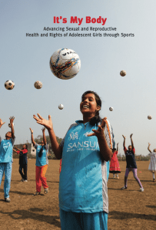
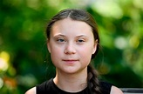
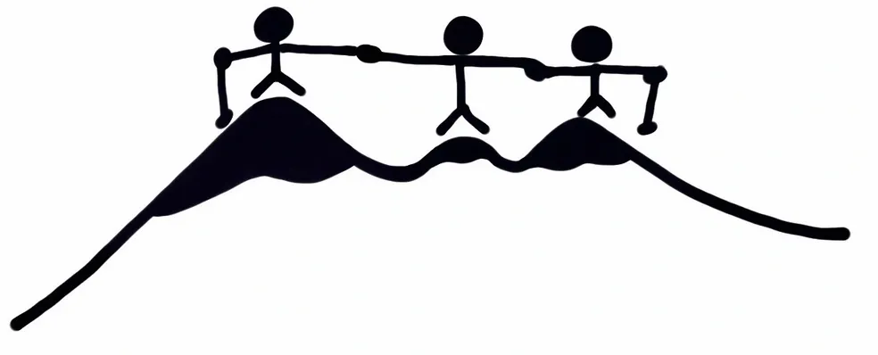
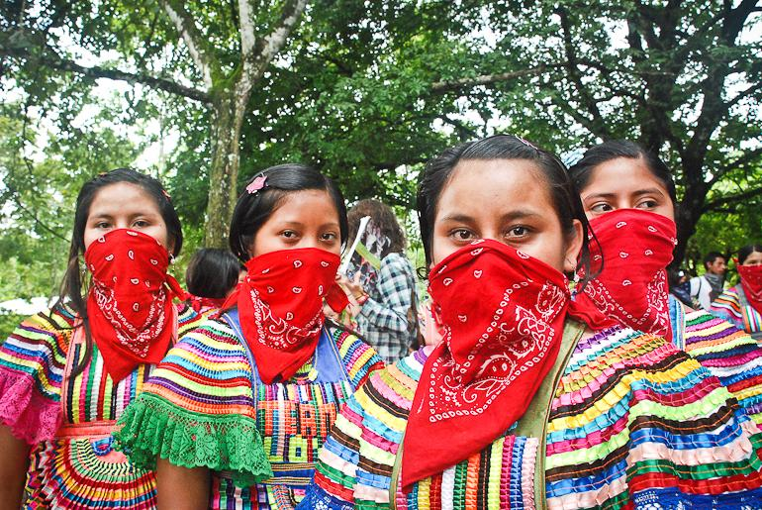
LEADERSHIP MYTHS TO CHALLENGE & DISMANTLE:
Myth No.4: I am powerless, how can I lead?
Myth No.5 – Leadership requires age & experience
Feminist Hiking Collective

Slide 43
THANK YOU!

Slide 44
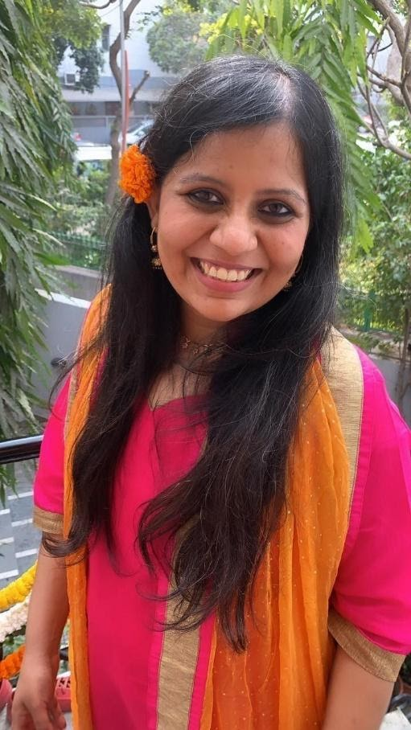
Jeevika Shiv UN Women, Youth Taskforce Member

Slide 45
Jyotsna Siddarth

Slide 46
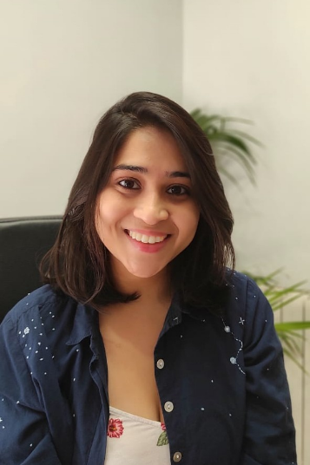
Aayushi Aggarwal

Slide 47
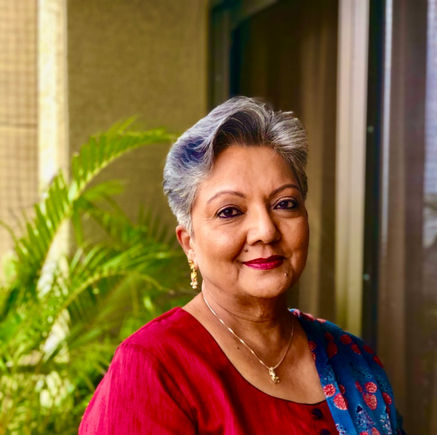
Srilatha Batliwala

Slide 48
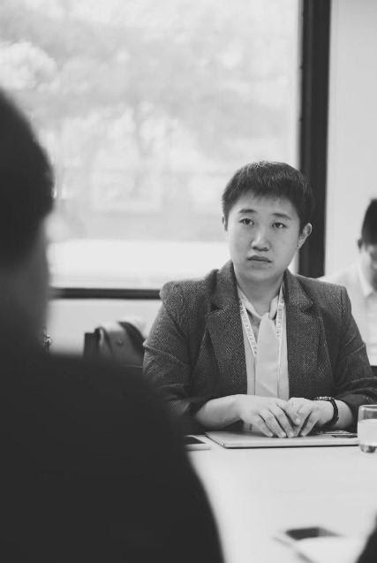
Wangshu Lian

Slide 49
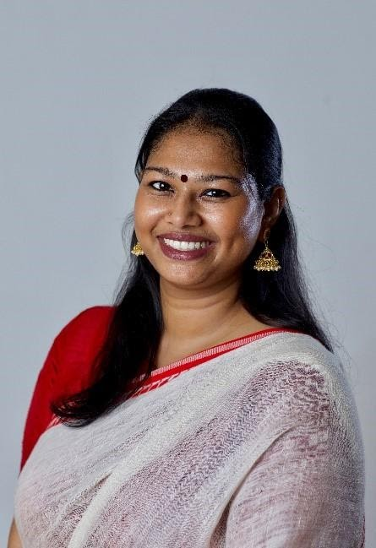
Sharanya Sekaram

Slide 50
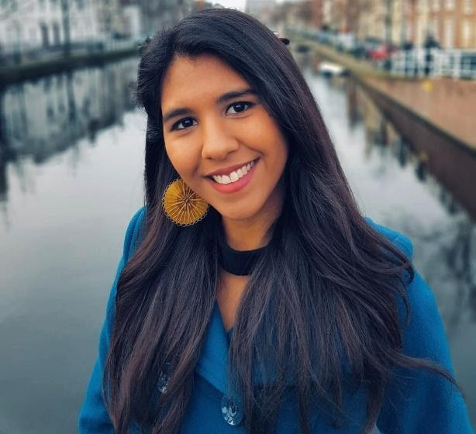
Chandreyi Guharay

Slide 51
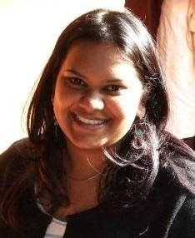
Priyanka Samy

