Slide 1
Gender-Based Violence and
Feminist Movement in South Korea
Present
towards
Gender Based Violence
Gender discrimination
Gender Equality
Generation Equality

Slide 2
01
Gender-based Violence
in Korea

Slide 3
Herstory
Gender-Based Violence
April, 2018
May 17th, 2016
5
off
2019
January 30th, 2018

Slide 4
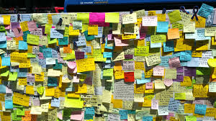
Herstory
Gender-Based Violence
April, 2018
May 17th, 2016
Femicide at Gangnam Station
5
off
2019
January 30th, 2018

Slide 5
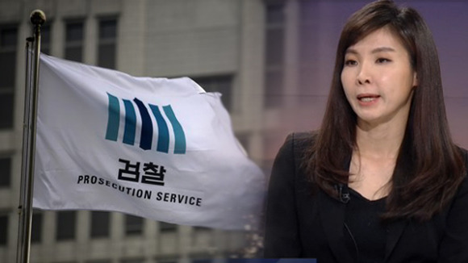
Herstory
Gender-Based Violence
April, 2018
May 17th, 2016
Femicide at Gangnam Station
5
off
2019
January 30th, 2018
High-profile #MeToo

Slide 6
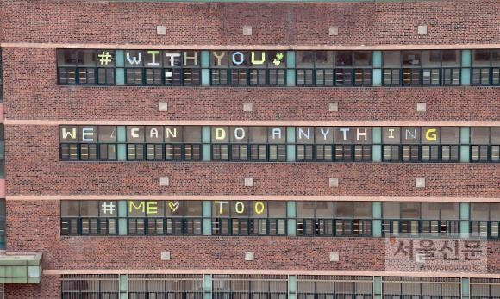
Herstory
Gender-Based Violence
April, 2018
School Metoo movement
May 17th, 2016
Femicide at Gangnam Station
5
off
2019
January 30th, 2018
High-profile #MeToo

Slide 7
Herstory
Gender-Based Violence
April, 2018
School Metoo movement
May 17th, 2016
Femicide at Gangnam Station
5
off
2019
Revenge porn problem
January 30th, 2018
High-profile #MeToo

Slide 8
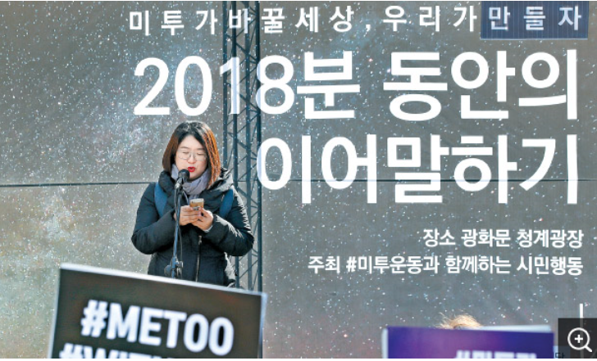
MeToo marathon
Gender-Based Violence
5
off

Slide 9
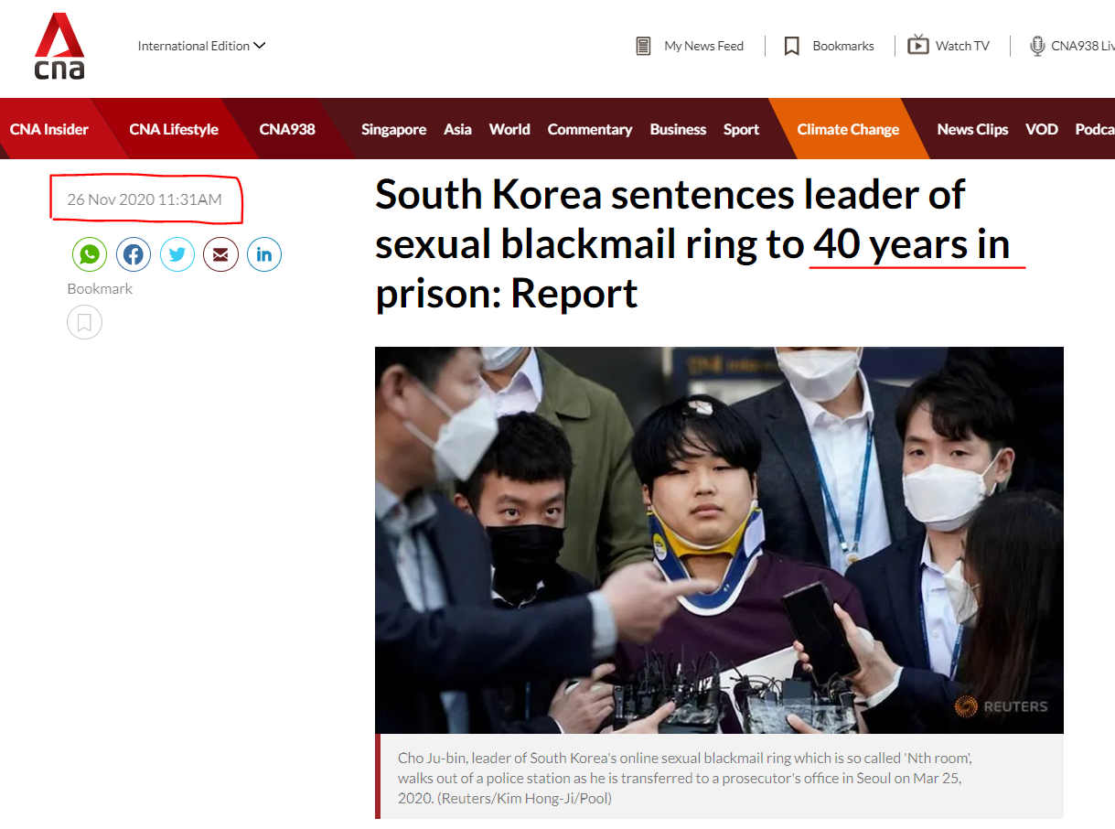
Nth Room Case

Slide 10
Violence rate in Korea
Sexual Violence

Slide 11
02
Feminist Movement against GBV
of YWCA Korea

Slide 12
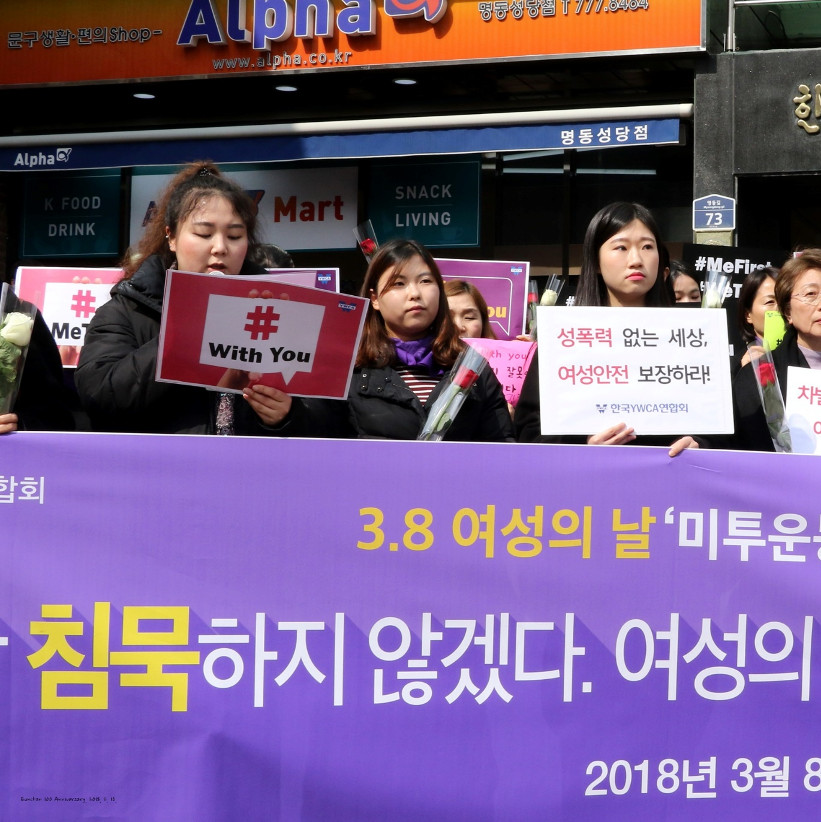
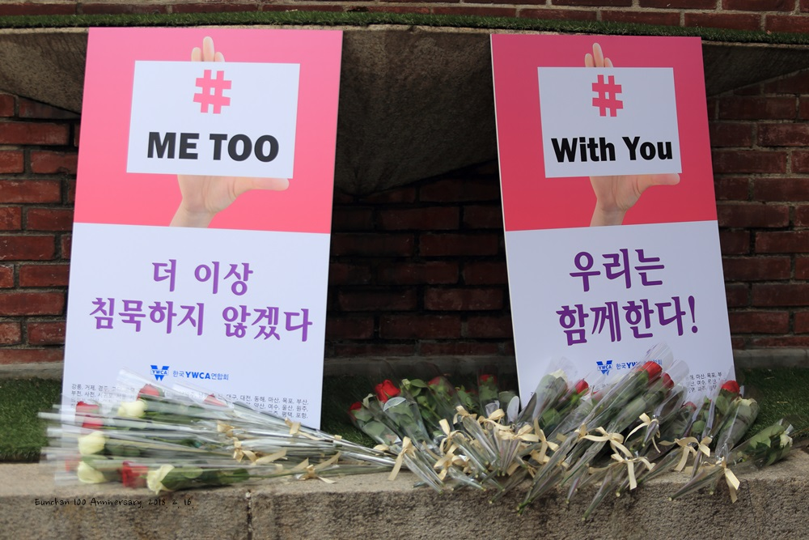
Campaign Movement

Slide 13
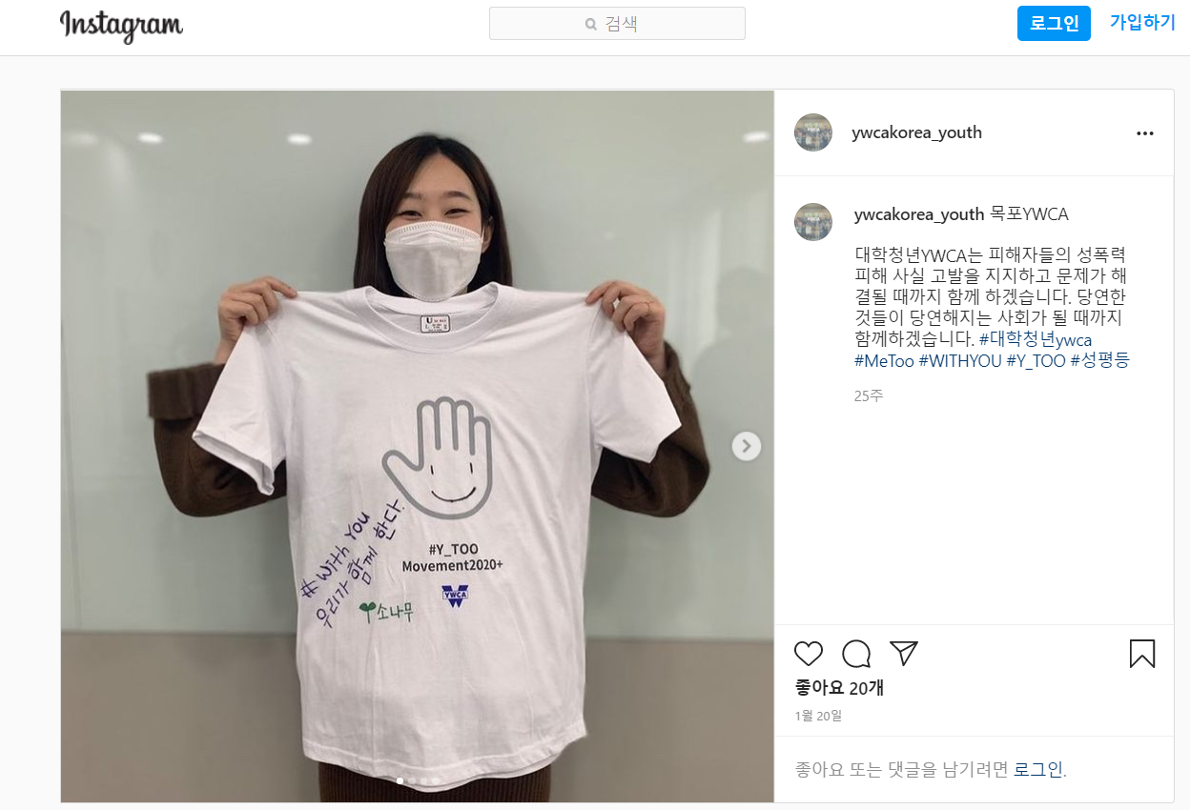
Campaign Movement

Slide 14
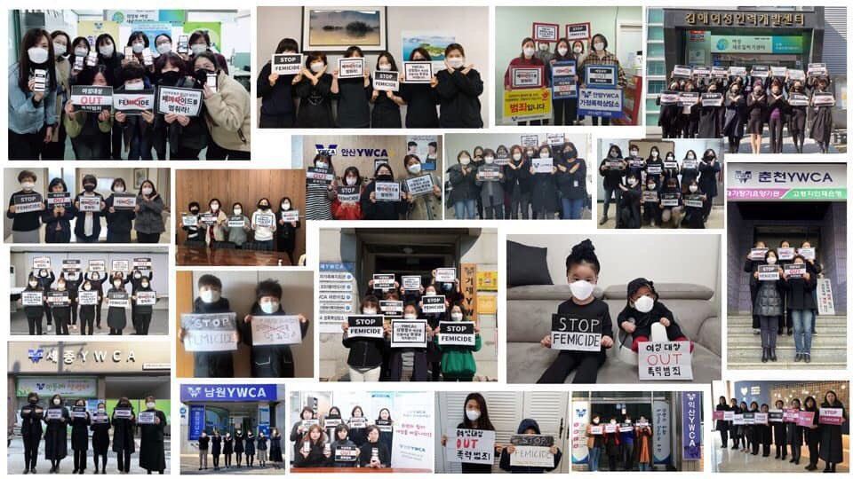
Campaign Movement

Slide 15
Campaign Movement

Slide 16
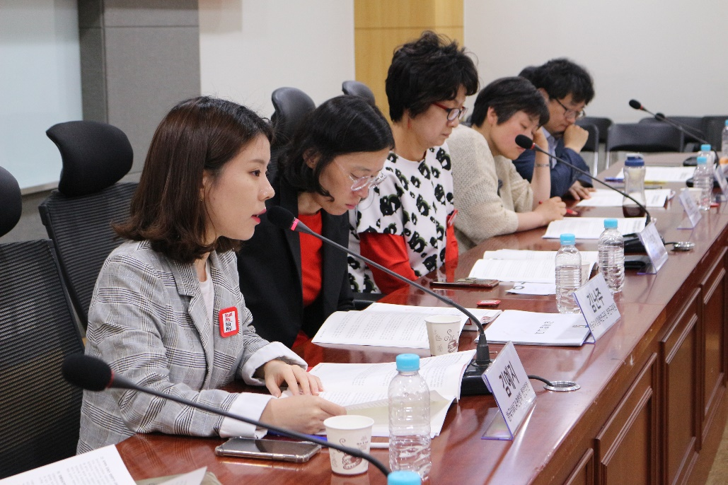
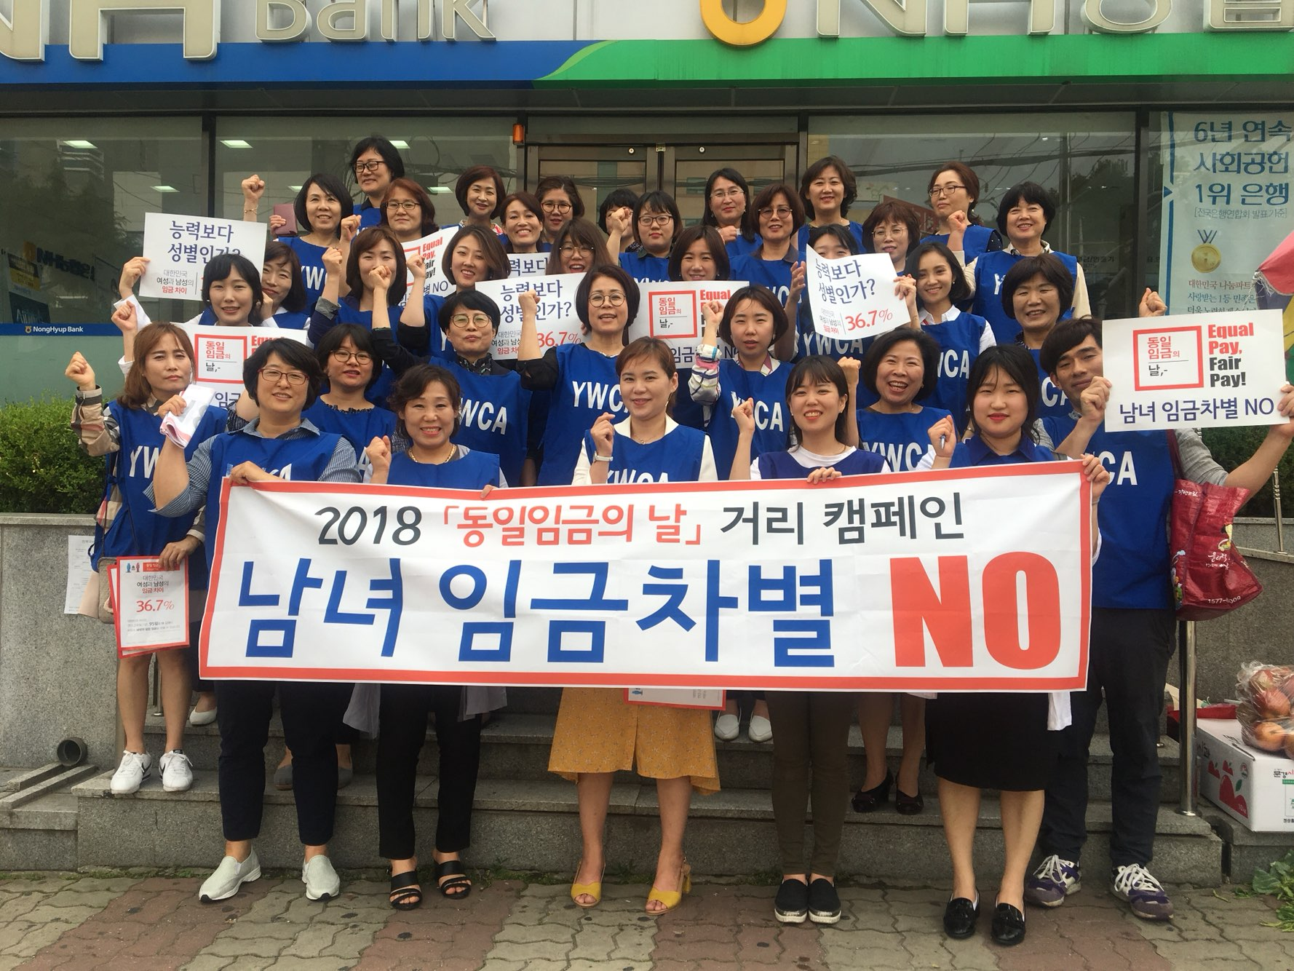
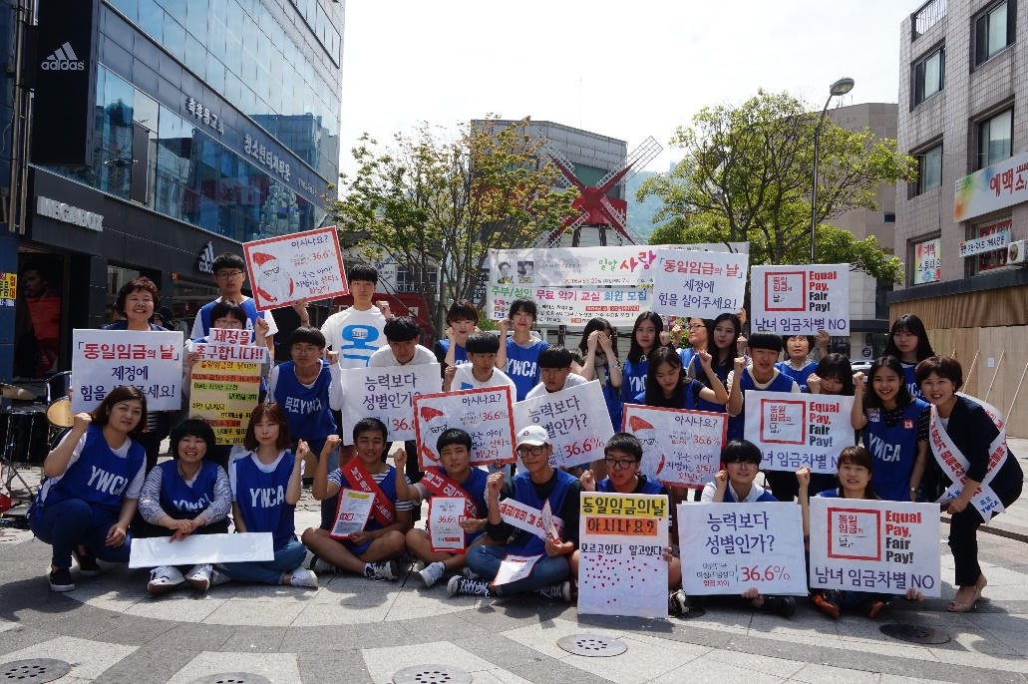
Legislative movement

Slide 17
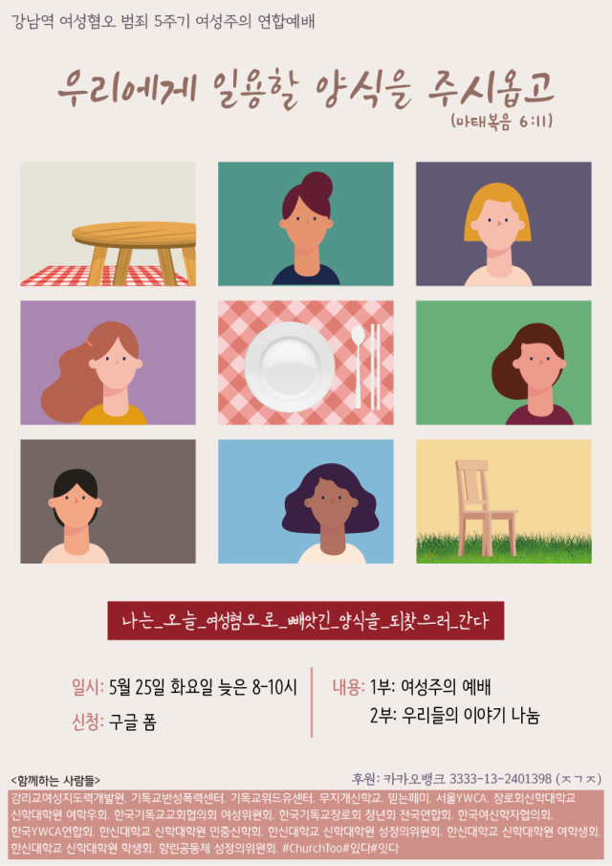
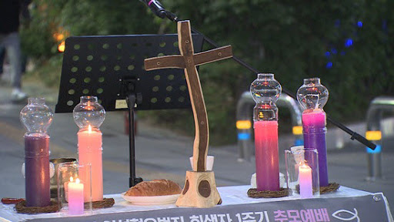
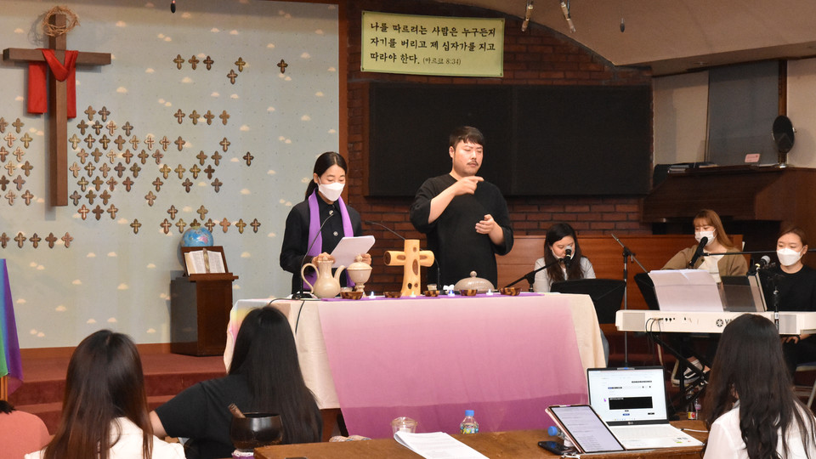
Solidarity activities

Slide 18
03
Feminist Movement for our Generation

Slide 19
