Slide 1
Gender and Gender Roles

Slide 2
Gender Sex
Gender refers to the expectations that people have from some one because they are male or female.
It refers to difference between men and women within the same HH and between cultures that are socially and culturally constructed and change over time.
Sex is the physical and biological difference between men and women.
It is universal and static.
Sex is the biological characteristic of being male and female which is genetically determined.
Notes:
The term ‘gender’ is often confused with ‘sex’. However, ‘sex’ generally refers to male and female biology and anatomy, whereas ‘gender’ refers to a set of qualities and behaviours expected from men and women by society

Slide 3
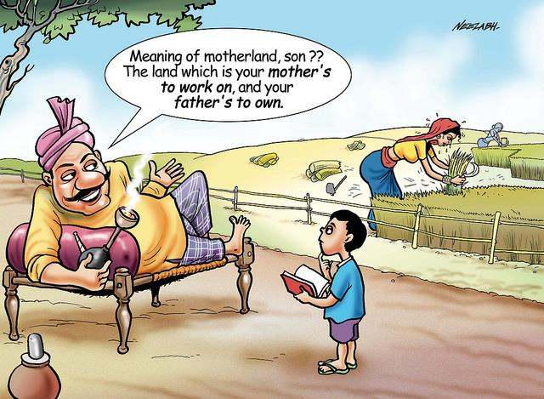
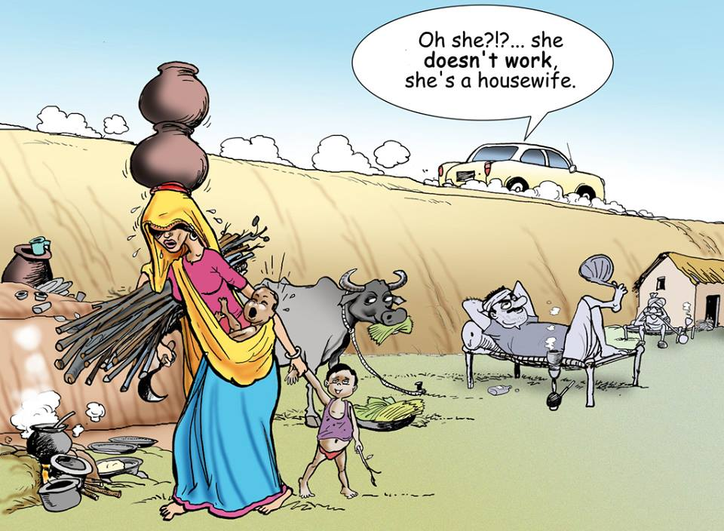
Notes:
Boys are expected to behave and act according to norms expected of men, while girls are expected to act in ways considered appropriate for women.

Slide 4
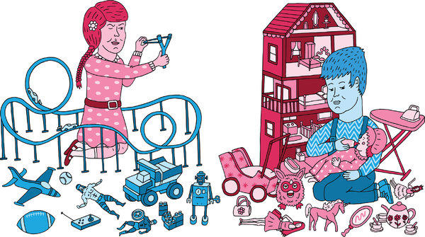
Notes:
Boys are expected to behave and act according to norms expected of men, while girls are expected to act in ways considered appropriate for women.

Slide 5
Gender roles are learned, and vary within and among cultures depending on socio-economic factors, age, education, ethnicity and religion.
“Women prepare and serve food in the home”
“Boys don’t cry”
“Teaching jobs are best suited for women, men have more technical jobs”
Girls are gentle; boys are tough.
Men drive cars/ buses/ fighter jets/ autorickshaws/ trucks.
Men’s voice break at puberty; women’s don’t.
Women are better at caring for children than men.
Women are emotional, men should not display their emotions.
Boys play outdoors; girls tend to enjoy playing inside the house.
Notes:
Boys are expected to behave and act according to norms expected of men, while girls are expected to act in ways considered appropriate for women.

Slide 6
Gender Gaps
Women earn only ten percent of the world’s income, but are responsible for 66 percent of overall working hours.
Two-thirds of children who are denied primary education are girls, and 75 percent of the world’s 876 million illiterate adults are women.
Worldwide, women hold only fourteen percent of parliamentary seats, and only eight percent of the world’s cabinet ministers are women.
Notes:
Gender inequality represents a huge loss of human potential, with costs for men as well as for women.

Slide 7
Concepts of Sexuality
People express their sexuality through both +ve and –ve attitudes and behavior.
Sexuality expressed +vely thru consensual, mutually respectful and protected (non abusive) rns, enhances well being, health and quality of life.
Sexuality expressed –vely thru violence, harassment, abuse diminishes a person’s dignity and self worth causing long term harm.
Notes:
Being sexual is not only about sexual acts and behavior, it also includes thoughts, attitudes and feelings.

Slide 8
Concepts of Sexuality
Which areas of the body can strangers touch/ look?
Which areas of the body can people who are close to you touch/ look?
Which areas of the body can you touch in public?
Which areas of the body can colleagues or seniors touch?
What feeling do we have if a person touches us in a place that is ‘out of bounds’ ?
How much control do we have over where and how people touch/ look you?
Men and women experience their body in relation to private, public and work spaces very differently
Notes:
Being sexual is not only about sexual acts and behavior, it also includes thoughts, attitudes and feelings.

Slide 9
Personal Boundaries and Comfort
A boundary around oneself that protects you from invasion and harm.
Individuals experience their personal boundaries differently.
People have different comfort zones for different individuals with whom they interact
It is only after a sexual behavior, of whatever degree, has crossed someone’s boundaries that the question arises of whether it was welcome or unwelcome
Notes:
Being sexual is not only about sexual acts and behavior, it also includes thoughts, attitudes and feelings.

