Slide 1
UNCT-SWAP Gender Equality Scorecard Toolkit Resource
What? Language Matters (UN Women Mexico). United Nations Gender Inclusive Language website provides resources designed to help UN staff to communicate in a gender-inclusive way in the six official languages of the Organization. (https://www.un.org/en/gender-inclusive-language/index.shtml) |  | Why? This training program was designed by UN Women Mexico to help build the capacities of the UN Communications Group and others across the system to recognize and utilize gender inclusive language in communications and advocacy. This good practice example is tailored to the Spanish language and includes many specific examples that illustrate how language reinforces stereotypes. The training offers ideas and recommendations for substituting non-sexist language alternatives. The interagency approach to building gender capacities is in line with Performance Indicator 5.2 requirements and supportive of Performance Indicator 2.2. The good practice training draws on materials provided via the UN Gender Inclusive Language site, including guidelines to help staff to use gender-inclusive language in any type of communication. A toolbox offers training materials on the practical application of the Guidelines, information on related training courses and other relevant resources.
Performance Indicator 2.2 Communication and Advocacy
Approaches Minimum Requirements | Meets Minimum Requirements |  | Exceeds Minimum Requirements
a) The UNCT has contributed collaboratively to at least one joint communication activity on GEWE during the past year. | b) The UNCT has contributed collaboratively to at least one joint advocacy campaign on GEWE during the past year; and c) Inter-Agency Communication Group Annual Work Plan or equivalent visibly includes GEWE communication and advocacy. |  | Meets minimum requirements and d) The UNCT has contributed collaboratively to communication or advocacy in at least one non-traditional thematic area during the past year.

Slide 2
Language matters

Slide 3
Language:
Languages are systems of communication consisting of words and symbols used consciously by a group in a structured or conventional way.
The distinction between feminine and masculine in a language is not a sign of sexism or discrimination, since it is sometimes needed to mention men and women separately.
Sexism happens when these distinctions become hierarchical and discriminatory, placing one group over the other.

Slide 4
Sexism
Among the different forms of discrimination, sexism is one of the most frequent and spread out in the world. Sexism consists of discrimination or prejudice based on sex or gender, considering that one sex is superior to another sex. It primarily and historically affects women more than men.
Eliminating sexism within language follows two objectives:
raise awareness of women and social diversity, and
balance gender asymmetries.

Slide 5
10 recommendations for a non-sexist language
1. Use the generic
The masculine gender of some nouns in Spanish is used to refer to all the people, assuming wrongly that “everything” is associated with men.
Expresión sexista | Alternativa no sexista
El hombre ha creado sistemas… | La humanidad ha creado sistemas…
Los derechos del hombre… | Los derechos humanos…
Niños de la calle… | La gente en situación de calle…
Los trabajadores | El personal
Las enfermeras | El personal de enfermería
Sexist expression | Non-sexist alternative
The man has created systems… | Humans have created systems…
Man rights… | Human rights…
Street children (masculine)… | Street people…
The workers (masc.) | The staff
The nurses (feminine) | Nursing staff

Slide 6
2. Use abstract nouns
Refer to positions as if everyone in those positions are men, marginalizing women.
If the sex of the person who is referred to is unknown, avoid the use of masculine pronouns and use the word “who”.
Expresión sexista | Alternativa no sexista
Enviar los documentos a los coordinadores… | Enviar los documentos a las coordinaciones…
Es responsabilidad de cada jefe de departamento… | Es responsabilidad de las jefaturas de departamento…
Se van a reunir todos los directores… | Se van a reunir los y las titulares de las direcciones…
Será el juez el que lo determine… | Quien juzgue determinará…
El supervisor emitirá su opinión… | Quien supervise emitirá su opinión…
Tras la planeación, los administradores iniciarán el proceso… | Tras la planeación, quienes administren iniciarán el proceso…
Sexist expression | Non-sexist alternative
Send the documents to the coordinators (masc.)… | Send the documents to the coordinations…
It is responsibility of each head (masc.) of department… | It is responsibility of the leadership of department…
All directors (masc.) are going to meet… | All chiefs of directions (masc. and fem.) are going to meet…
The judge (masc.) will determine… | Whosoever tries will determine…
The supervisor (masc.) will give his opinion… | Whosoever supervises will give his or her opinion…
After planning, administrators (masc.) will start the process… | After planning, whosoever manages will start the process…

Slide 7
3. Use articles and pronouns
Articles can be used to differentiate gender without repeating the noun.
Expresión sexista | Alternativa no sexista
Los trabajadores deben permanecer en su sitio de trabajo… | Los y las trabajadoras deben permanecer en su sitio de trabajo…
Los usuarios morosos deben… | Las y los usuarios morosos deben…
It is also possible to replace the generic masculine
by the pronoun “our”.
Expresión sexista | Alternativa no sexista
Es bueno para el bienestar del hombre… | Es bueno para el bienestar de la humanidad… Es bueno para nuestro bienestar…
Sexist expression | Non-sexist alternative
Workers (masculine) must stay in their workplace… | Workers (feminine and masculine) must stay in their workplace…
Defaulting users (masculine) must… | Defaulting users (feminine and masculine) must…
Sexist expression | Non-sexist alternative
It is good for man’s welfare… | It is good for human welfare… It is good for our welfare…

Slide 8
4. Use slash and the parentheses in vocatives
When it is unknown whether a man or a woman will receive the message, use slash or the parentheses in vocatives.
Expresión sexista | Alternativa no sexista
Estimado: | Estimada/o:
Interesado: | Interesado(a):
Sexist expression | Non-sexist alternative
Dear Sir, | Dear Sir/Madam,
To whom it may concern (masc.), | To whom it may concern (masc. and fem.),
*Vocative
Noun or adjective used in addressing or invoking a person.

Slide 9
5. Use academic and professional titles
A common mistake is to mention academic and professional titles in masculine.
It must also be avoided the exclusive use
of the feminine for occupations traditionally
associated with women.
Expresión sexista | Alternativa no sexista
La médico Teresa Peralta… | La médica Teresa Peralta…
Teresa Peralta, asesor del presidente… | Teresa Peralta, asesora del presidente…
Expresión sexista | Alternativa no sexista
Las secretarias… | El personal secretarial…
Las enfermeras… | El personal de enfermería…
Las terapistas… | El personal de terapia…
Sexist expression | Non-sexist alternative
Doctor (masc.) Teresa Peralta… | Doctor (fem.) Teresa Peralta…
Teresa Peralta, President’s advisor (masc.)… | Teresa Peralta, President’s advisor (fem.)
Sexist expression | Non-sexist alternative
The secretaries (fem.)… | The secretarial sfaff…
The nurses (fem.)… | The nursing staff…
The therapists (fem.)… | The therapy staff…

Slide 10
6. Use courtesy expressions
There is hidden sexism in the courtesy expressions, since “miss/missus” is normally used to refer to the single or married woman, respectively; nevertheless “mister” is used for men independent of his marital status.
Expresión sexista | Alternativa no sexista
Señora de Pérez o Señora Pérez o Señora Erika Gómez de Pérez | Erika Gómez o Señora Gómez
Expresión sexista | Alternativa no sexista
Sr. Pérez y esposa o Sr. y Sra. Pérez | Sra. Gómez y Sr. Pérez o Sra. Erika Gómez y Sr. Pedro Pérez o Erika Gómez y Pedro Pérez
Sexist expression | Non-sexist alternative
Perez’s wife or Mrs. Perez or Mrs. Erika Gomez de Perez | Erika Gomez or Ms. Gomez
Sexist expression | Non-sexist alternative
Mr. Perez and wife or Mr. and Mrs. Perez | Ms. Gomez and Mr. Perez or Ms. Erika Gomez and Mr. Pedro Perez or Erika Gomez and Pedro Perez

Slide 11
7. Do not use “at” sign
Do not use the “at” sign @ to refer to men and/or women; it is not a linguistic sign and, in terms of inclusive terms, our language (the Spanish language) is rich in words to reproduce the equality and equity among people.
Uso incorrecto | Alternativa no sexista
Funcionari@s | Funcionarias y funcionarios…
Director@s... | Directores y directoras…
Maestr@s... | Las y los maestros…
Wrong use | Non-sexist alternative
Civil servants (masc. and fem.) | Civil servants (masc. and fem.)
Directors (masc. and fem.) | Directors (masc. and fem.)
Teachers (masc. and fem.) | Teachers (masc. and fem.)

Slide 12
8. Sexist meanings
Sexism specifically happens when some words describe different physical or moral attributes depending on whether they are women or men, reinforcing gender stereotypes.
Mujeres | Hombres
Aventurera: prostituta | Aventurero: osado, valiente, arriesgado
Mujer pública: prostituta | Hombre público: el que interviene en los negocios, la política
Soltera: anda buscando, quedada | Soltero: codiciado
Women | Men
Adventourous woman: prostitute | Adventourous man: courageous, brave, daring
Public woman: prostitute | Public man: businessman, politician
Single woman: old maid, spinster | Single man: sought-after, bachelor

Slide 13
Sexist language discriminates against those groups that do not have men’s assigned attributes as humanity representative.
Uso incorrecto | Alternativa no sexista
Minorías étnicas Los indígenas | Las y los indígenas Las comunidades indígenas Los pueblos indígenas
Las marimachas Los desviados Las tortilleras | Personas con preferencia sexual distinta a la heterosexual Lesbianas
Las vestidas | Personas travestis Personas transgénero
Los enfermos de sida Los sidosos | Personas que viven con VIH sida Personas con VIH sida
Los viejitos Los ancianos Las personas de la tercera edad | Personas adultas mayores
Los mojados Los braceros | Personas migrantes
Las sectas religiosas | Grupos religiosos
Los discapacitados Personas con capacidades diferentes Los minusválidos | Personas con discapacidad
Wrong use | Non-sexist alternative
Ethnic minorities Aboriginal people (masc.) | Indigenous people (fem. and masc.) Indigenous communities Indigenous peoples
Butch women Mannish women Dykes | People with different sexual orientation from heterosexuality Lesbians
Tranny | Transvestite Transgender
AIDS sufferers AIDS carriers | People living with HIV/AIDS People with HIV/AIDS
Old people The elderly | Grown-up adults
Undocumented people | Refugees Migrants
Religious sects | Religious groups
Disabled people Handicapped people | People with disabilities

Slide 14
9. Use non-sexist images
Images are also part of the language and reproduce sexism in the same way.
Some helpful criteria for a non-discriminatory use of visual material are to:
show women and men taking part in activities equally and free from stereotypes.
present women and men doing housework or using products related to such activities.
dissociate women from domestic roles and from marketing strategies of all kind of products.
display women in public life, politics and economics.
equally include women and men in professional situations well-regarded socially and economically.
exhibit women diversity.

Slide 15
10. Gesture language
There are no rules regarding how to express ourselves gesturally without sexism, since many expressions have specific meaning only in the context of communication.
Some sexist expressions are:
• The use and overuse of effeminate tones in order to ridicule and stigmatize women and homosexual people.
• The men’s practice of avoiding visual contact with women in mixed-gender groups, downplaying their participation.
• The exaltation of phallic genitals as a symbol of power and dominance.
In order to fight against these practices it is necessary to become aware of and think about the use of the gestures at the moment of communicating our ideas and opinions in daily social interaction.

Slide 16
Then, why to use inclusive language?
Because language matters: It is true that “In general, there are no good reasons to suppose that changing the vocabulary can prevent from continuing to show our prejudices in our actions, or to think that it is possible to adopt favorable attitudes towards individuals and groups based only on linguistic decorum,” “The language contributes to maintaining invisible some domination and marginalization relations that happen behind the seemingly unbiased established order of what is conventionally considered “correct” or “normal.”
“Discrimination is a learned behavior; we do not acquire it spontaneously through our experiences. This learning process is circular: attitudes and behaviors go from society to the individual, and then, they go back from the individual to society. Being more conscious of the language we use helps break that circle”.
Source: Conapred

Slide 17
Then, why to use inclusive language?
Because it is a trend in communication that is happening all around the world, up to the point that most style guides of different media are including a section about it.
Because we are the UN, and the UN is a model organism that must be at the head of establishing rules for an exemplary exercise of inclusive communication. That is to say, it must lead by example now, not when it is too late.

Slide 18
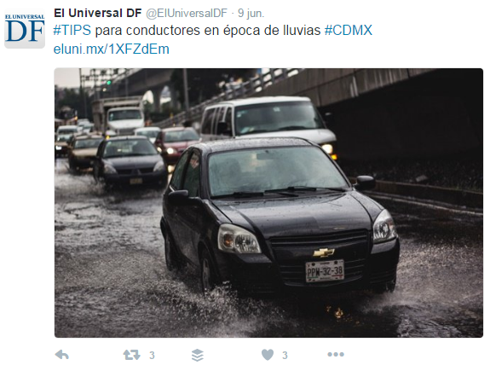
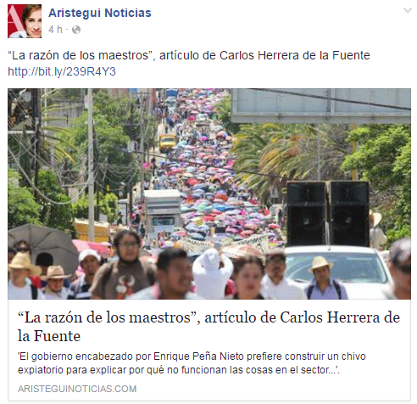
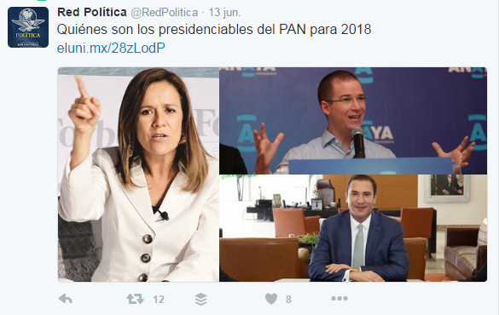
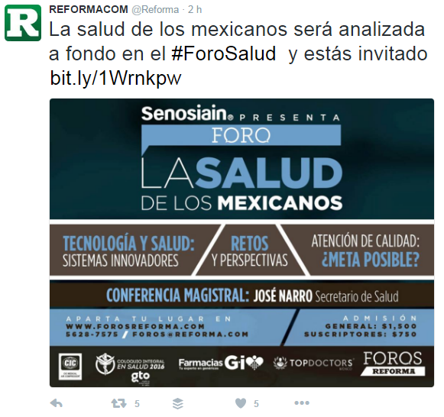
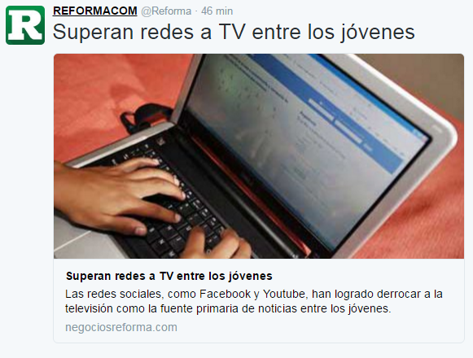
#TIPS for drivers (masc.) in the rainy season #CDMX
“Teachers (masc.) are right”, a Carlos Herrera de la Fuente’s article
Who are PAN’s possible candidates (masc.) for 2018
Social networks beat TV among youths
Mexicans’ (masc.) health will be analyzed in depth in the #ForoSalud and you are invited

Slide 19
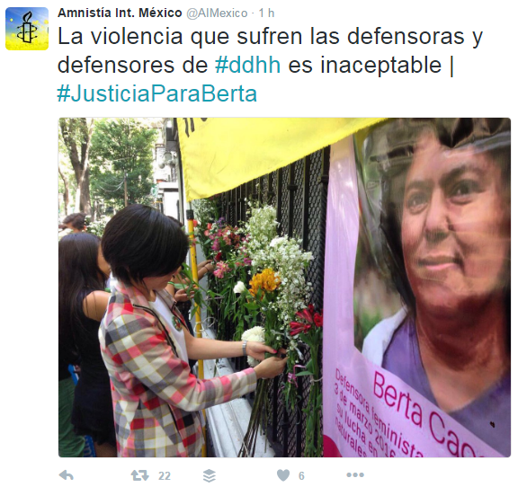
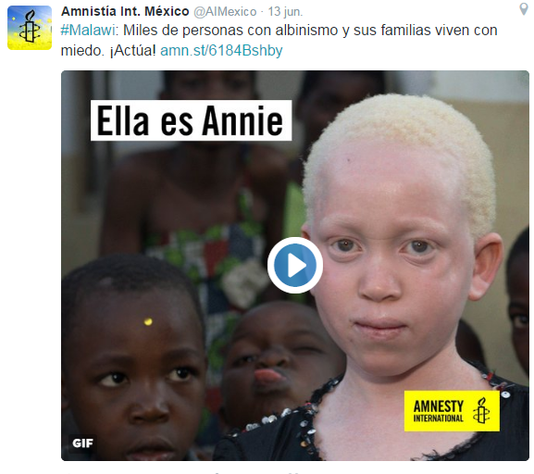
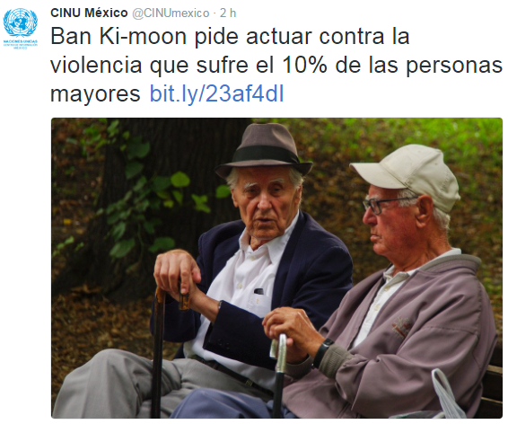
Violence suffered by #ddhh (human rights) defenders (fem. and masc.) is unacceptable
Thank you very much for being the driving force for change for millions of girls and boys
#Malawi Thousands of people with albinism and their families live with fear Act!
Ban Ki-moon requests to act against the violence suffered by 10% of the elderly

Slide 20
Thank you
Sources
Manual para el uso no sexista
del lenguaje. UNIFEM.
Conapred 2009, segunda edición
10 recomendaciones para el uso no sexista del lenguaje,
Textos del caracol, núm. 1.

