Slide 1
HOW-TO GUIDE

Slide 3
Participant Controls located in the lower portion of the Zoom screen:

Slide 4
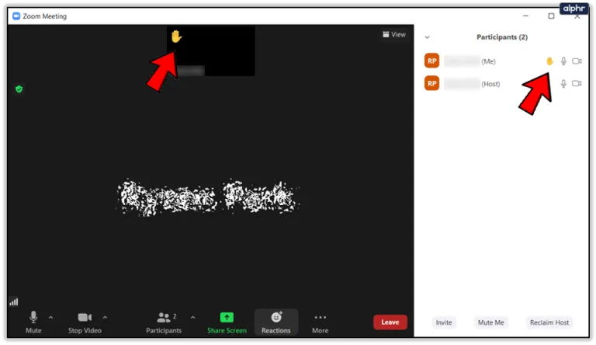
HOW TO RAISE HAND
SHORTCUTS :
If you’re using Windows, press Alt + Y to raise or lower your hand.
if you’re using Mac, press Option/Alt + Y.
Click on the “Reactions” section, at the bottom of your screen.
2. Click on the small icon in the shape of a hand, labeled “Raise Hand”.
3. Your hand is now raised, which means that the hosts and other participants will see that you have something to say.

Slide 5
HOW TO USE INTERPRETATION FEATURE
An “Interpretation” icon and a pop-up message saying that new translation possibility is available will appear
2. By Clicking on the “Interpretation” button,
you can choose the language you would like to hear.
3. (OPTIONAL) By default, you will hear the selected language at 80% volume and the original audio at 20% volume. If you would like to mute/unmute the original audio, click on the corresponding option in the language button.

Slide 6
HOW TO SHARE YOUR SCREEN
To share your screen, click ‘Share Screen’ button at the bottom of your screen.
2. Click on the ‘screen’ option if you would like to share your entire screen to others.
If you would like to share only one window to others, then click the window you would like to share.
Check the ‘share sound’ option on the bottom if you’re presenting a video and want to share the audio. After you’ve clicked on the desired screen, click share.
Share entire screen
Share specific windows
Click share to start the screen-sharing
Share sound

Slide 7
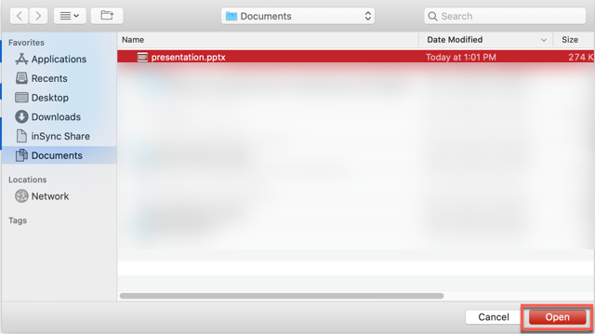
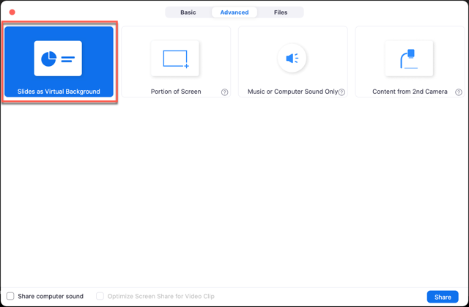
HOW TO MAKE PRESENTATION AS BACKGROUND
Tip : Best used with green screen
Click the button at the bottom of your screen.
Click Advanced, and then click ‘slides as virtual background’. Then click Share.
A pop up will appear, then you pick your file to share.

Slide 8
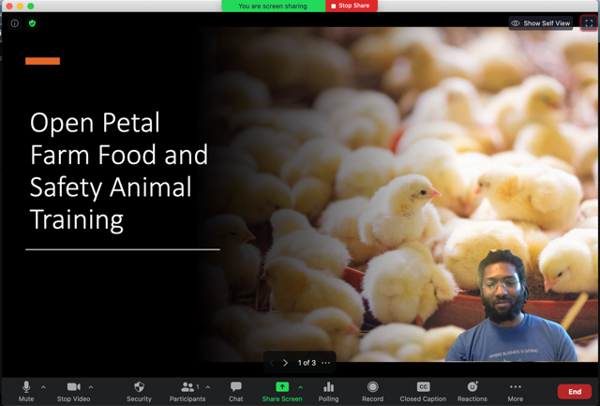
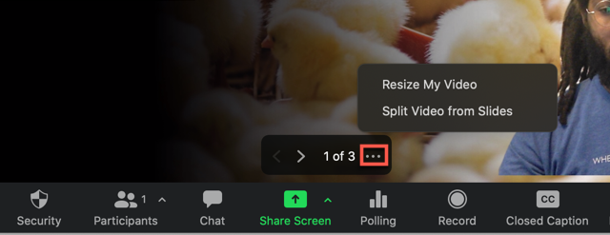
HOW TO MAKE PRESENTATION AS BACKGROUND
4. Then your presentation will be like below. You can change slides by clicking the arrow. You can also resize or move your video, by clicking the three dots and ‘Resize My Video’. To stop this format, click ‘Split Video from Screen’

Slide 9
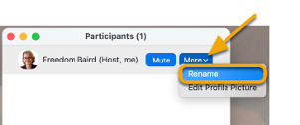
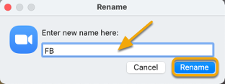
HOW TO RENAME
1. Click the "Participants" icon in the Zoom toolbar
2. In the Participants window, next to your name click "More" and choose "Rename"
3. Enter a new name and click "Rename" to save it for
that meeting
4. You will see the new name showing in the Participants window

Slide 10
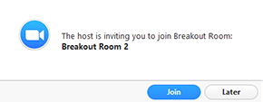
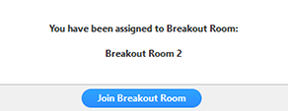
HOW TO JOIN BREAKOUT ROOMS
The host will need to invite you to join the breakout room.
This pop-up will appear in your screen. Click Join.
x. If you choose Later, you can join by clicking the Breakout Rooms option in your meeting controls if you were allowed by the host in its setting panel.
y. Click Join Breakout Room.

Slide 12
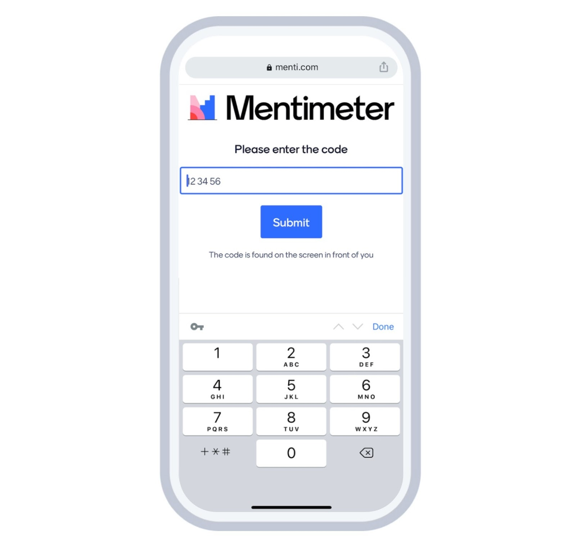
HOW TO PARTICIPATE (audience)
Go to www.menti.com and enter the code provided in the text field, or scan the QR code
Click Submit
4. For this TOT, just click the link provided in the chat box to be redirected to Mentimeter, then you’ll be able to answer the questions immediately
3. The questions will appear on your screen. Simply answer the questions and click submit.

Slide 14
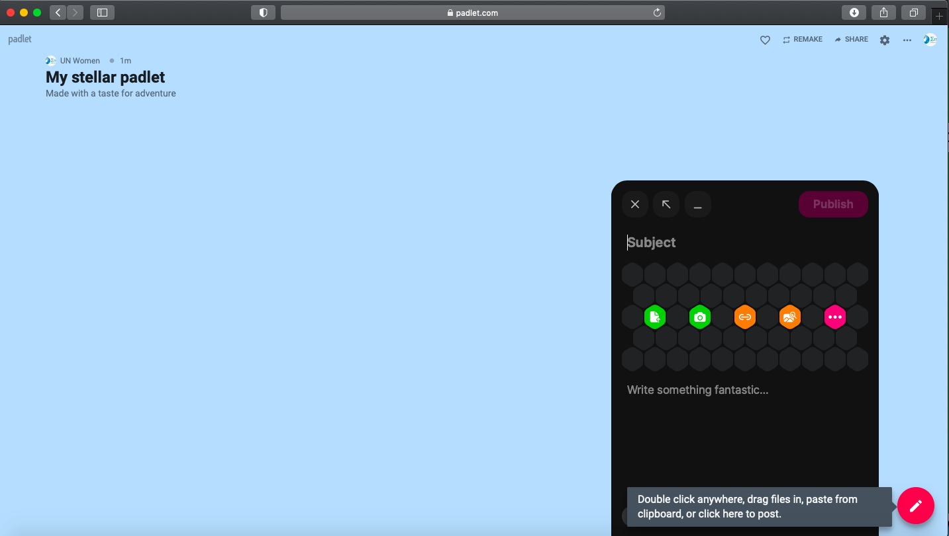
HOW TO PARTICIPATE
Click on the Padlet link shared by hosts. You will be redirected to the Padlet board.
To contribute to the board, double-tap or click the add (+) button on the padlet board.
Add a subject and some text. Tap Publish to post
When you’re done, Click Publish
Add subject/title here
Add some text here
Click here to add post

Slide 15
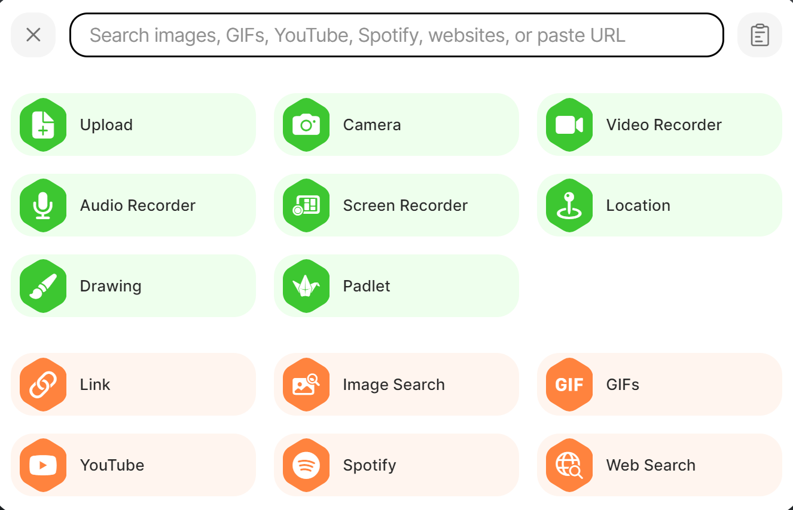
For a more striking entry, you can also add media files to your post.
You can even use your webcam or device microphone to record a video or sound file.
You can also drag and drop files into the Padlet to post multiple items at once!

Slide 16
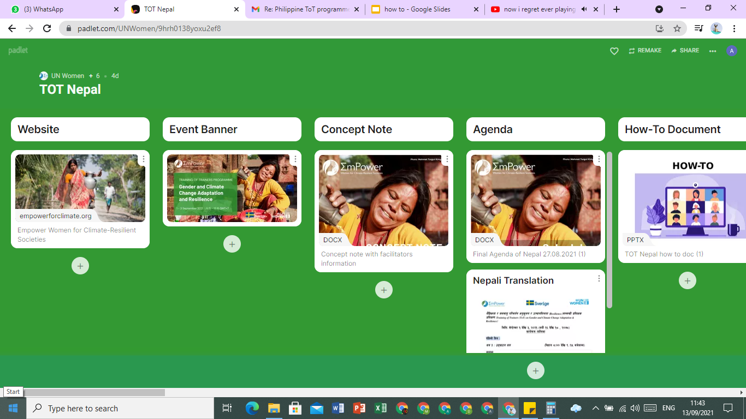
HOW TO ACCESS FILES IN PADLET WALL
1. Click on the link provided to access Padlet.
2. You may scroll to right or left on the Padlet board to see all the sections available, and scroll down on each section to see all files available inside each section/category.

Slide 17
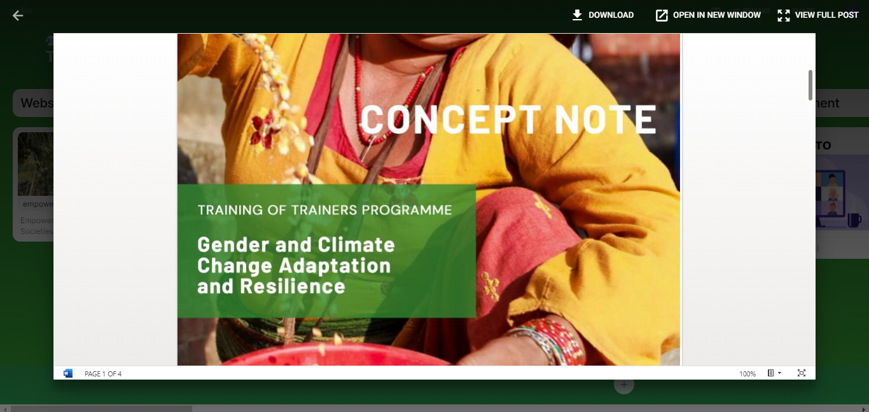
HOW TO ACCESS FILES IN PADLET WALL
3. Click on the files you want to access.
4. You can download the file by clicking ‘download’ button.
For group exercises in Google Docs, you can click ‘open in new window’ to edit/add your answers into the documents.

Slide 19
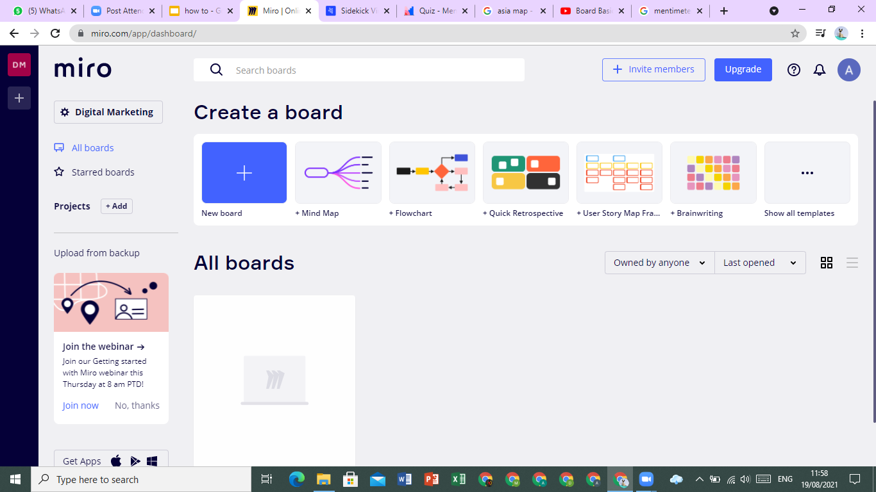
HOW TO CREATE AND USE BOARDS
1. Go to Miro.com and sign up with your email.
2. Click ‘new board” or choose the template that you desire.
3. Don’t forget to invite your members through email or shared link so you can collaborate to make boards real time.

Slide 20
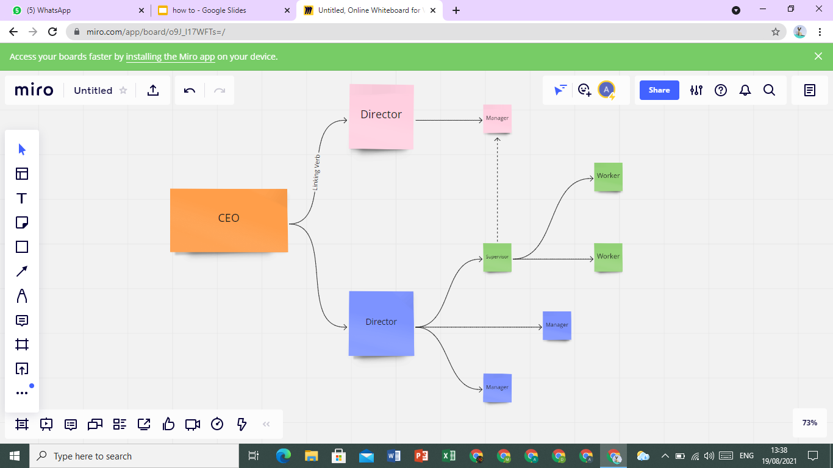
HOW TO CREATE AND USE BOARDS
4. You can use the templates provided, or start from scratch.
5. On the side panel,
you can click on to add shapes, lines, notes, frames, comments, draw with a pen, also upload an image to the board.

Slide 21
HOW TO USE THE PANELS
Easily drag and drop the notes and shape you’d like to use. You can also add frames and add template of your choice. Use the frame tool to make sections of your board.
There’s also a bottom panel where you can switch to presentation mode, you can leave a comment on this board, chat with your team, or view the editing history of the boards made by the whole team.
Presentation
Mode
Chat
Screen
Sharing
Video
Call
History
Frames
Comments
Cards
Voting
Timer

Slide 22
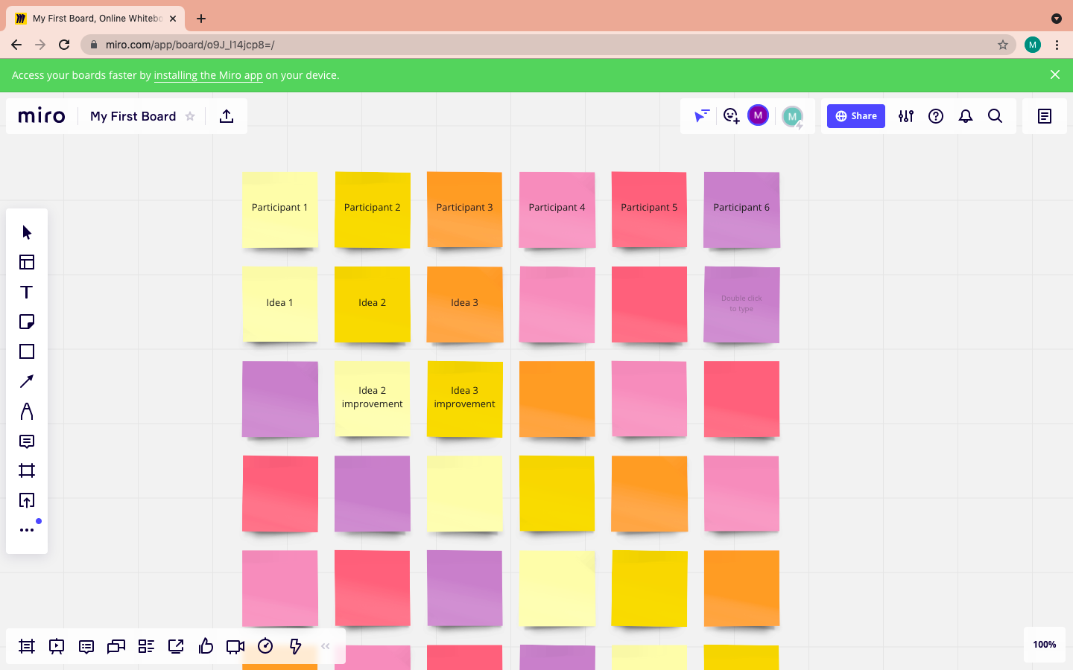
HOW TO PARTICIPATE
Click the unique invite link provided
You will be directed to the
Miro Board
Now, you can collaborate.
Double tap to add text or use
other supporting feature.
https://miro.com/app/board/o9J_l14jcp8=/

Slide 24
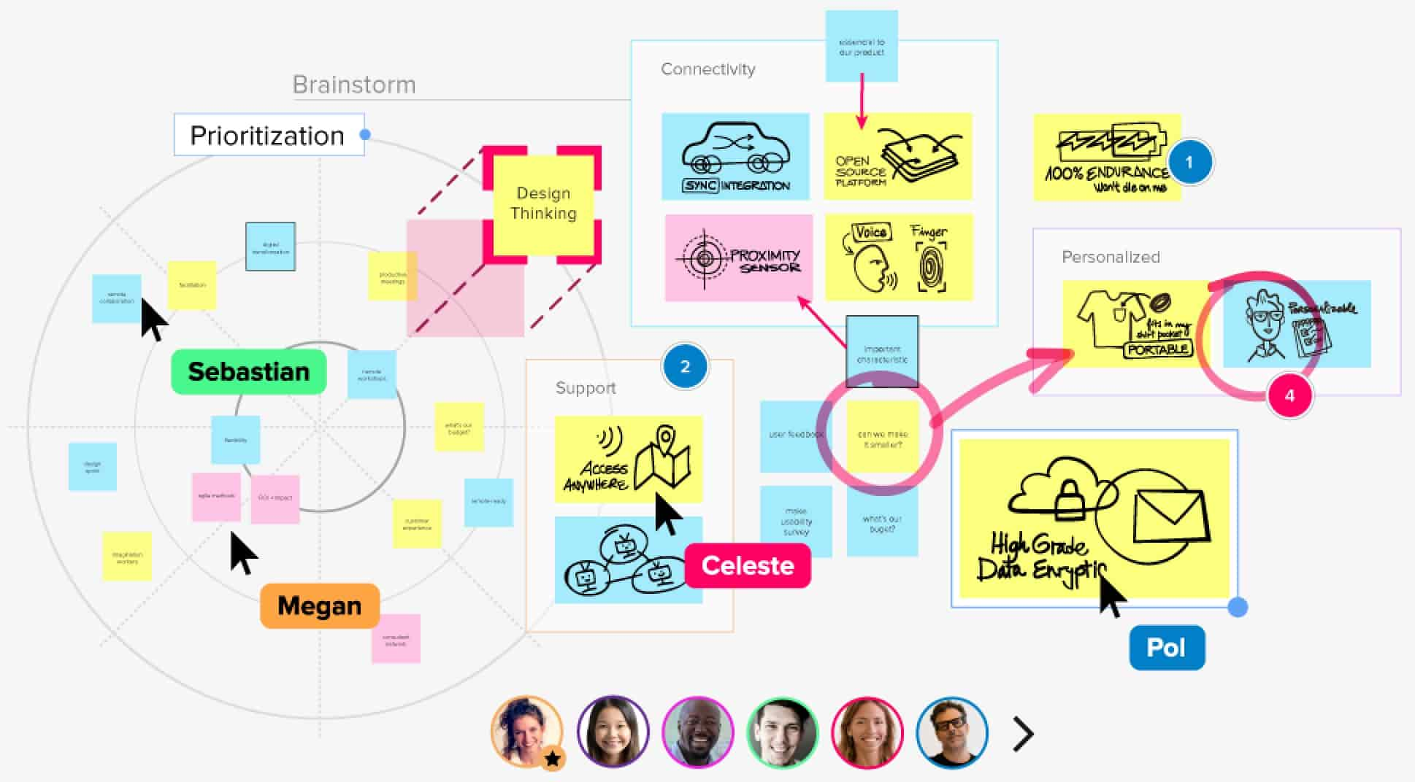
Mural
Mural is a virtual whiteboard for virtual collaboration, brainstorming and mind mapping.

Slide 25
What Do I Need To Do
Validating the setup
Go to https://mural.ly and click Sign in.
Type your work email address and click SIGN IN.
Usage scenario: Creating empathy maps with MURAL
An empathy map can help you better understand a representative user of the application that you're building. If you're part of a geographically distributed team, collaborating with your team to create an empathy map can be difficult.
This scenario shows how a team, whether it is distributed or co-located, can use MURAL to create an empathy map.
Create a mural by clicking Create new mural.
In the CREATE MURAL window, specify a name and purpose for the mural and click CREATE MURAL.
In the SHARE window, share the mural with your team and then click DONE. From the toolbar, you and your team members can add text, shapes, icons, frameworks, images, and files to the mural.

Slide 27
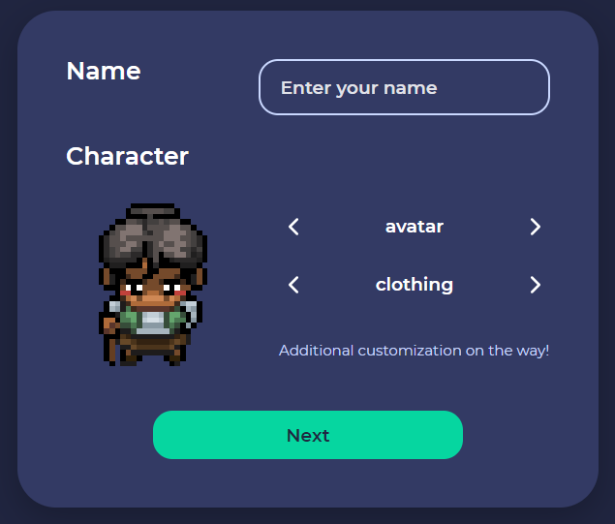
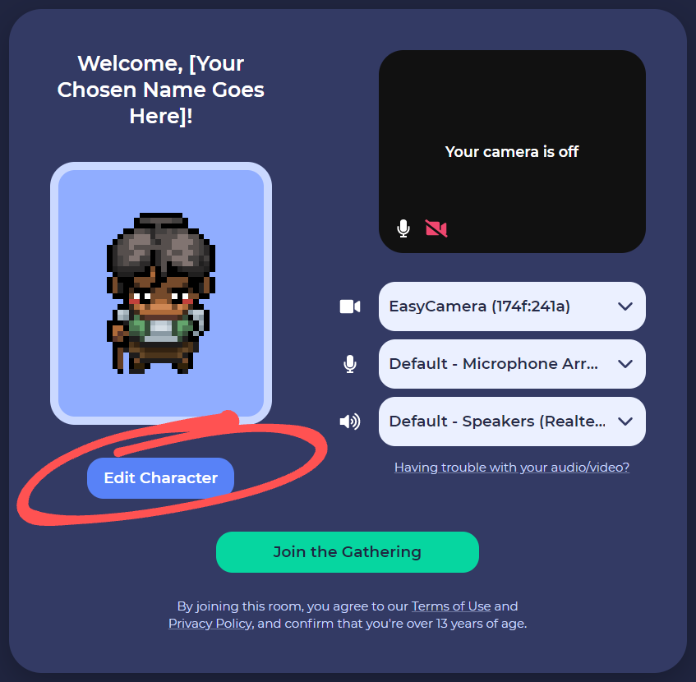
HOW TO JOIN GATHER TOWN (as participant)
1. To join Gather Town, click on the link provided.
2. Enter your name and setup your avatar as you like. You can choose your hair, clothing, skin tone however you please. Just click the arrow on avatar or clothing. After you’re done, click next.
3. Make sure to allow Gather Town to access your microphone & camera. Turn on/off your camera and microphone by clicking the camera & microphone icon. When you’re ready, click join the gathering.

Slide 28
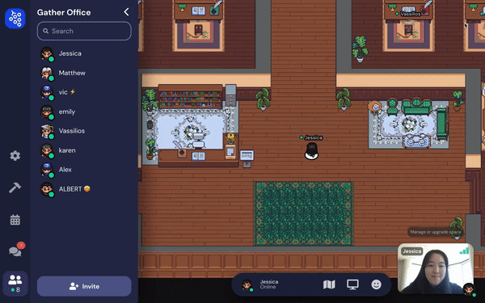
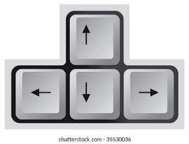
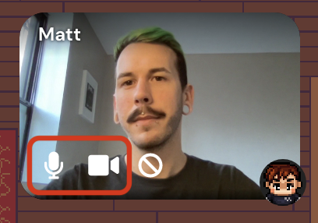
HOW TO USE GATHER TOWN
Use the arrow key on your laptop to move around. To talk to your friend, simply approach them and make sure you turn on your microphone so they can hear you.
When you’re talking to lots of people, click the full screen button on the top right of your screen to see your friends all at the same time.
You can always turn on/off your microphone/camera when you’re in Gather Town. Click the microphone icon to mute/unmute, click the camera icon to turn on/off your camera.

Slide 29
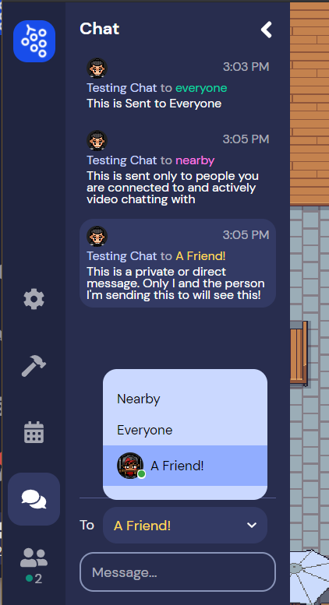
HOW TO USE GATHER TOWN
4. On the side panel, you can chat with your friends.
-To send a message to people nearby, click ‘Nearby’ option and send your message.
-To send a message to everyone, click ‘Everyone’ option then send the message.
-To send a message to a specific person, click on their name and send the message.

Slide 30
Insert photo within the green frame
Thank you!

