Slide 1
Gender Dimensions of Climate Change
SESSION 02
(Insert Name and Organisation of the Presenter)
[insert date, month, year | time, time zone]
Notes:
Suggested time for the presentation: 30 minutes
More information: UN Women Training Manual on Gender and Climate Change Resilience (Pages 35-50 and Pages 76-78)

Slide 2
Let’s discuss
What do you understand by the term ‘Weather’ and how is it different from ‘Climate’?
What is ‘Climate Change’?
Notes:
You can keep an open-mic or chat for the participants to answer or use online tools like mentimeter/slido for the same

Slide 3
Understanding Climate Change
Weather is the average of daily or weekly status on the following six components for a particular area:
temperature, pressure, wind, humidity, precipitation, and cloudiness
Climate is the average weather of a given region or area over a given period of time
The changes in the average weather conditions and variations in the given region or area is Climate Change

Slide 4
Causes of Climate Change
Increased concentration of greenhouse gases (GHGs) in the atmosphere taps heat from the sun and causes global warming leading to climate change
Human activities are responsible for a majority of the increase in GHG in the atmosphere since 1750.
These include deforestation, agriculture (e.g. rice production), livestock (cattle, sheep, pigs, and poultry) rearing, burning of fossil fuels for electricity, heat, and transportation
Of these, transportation in the form of cars, trucks, ships, trains, and planes emits the largest percentage of carbon dioxide
Notes:
GHGs include carbon dioxide, methane, nitrous oxide, water vapour and chlorofluorocarbons

Slide 5
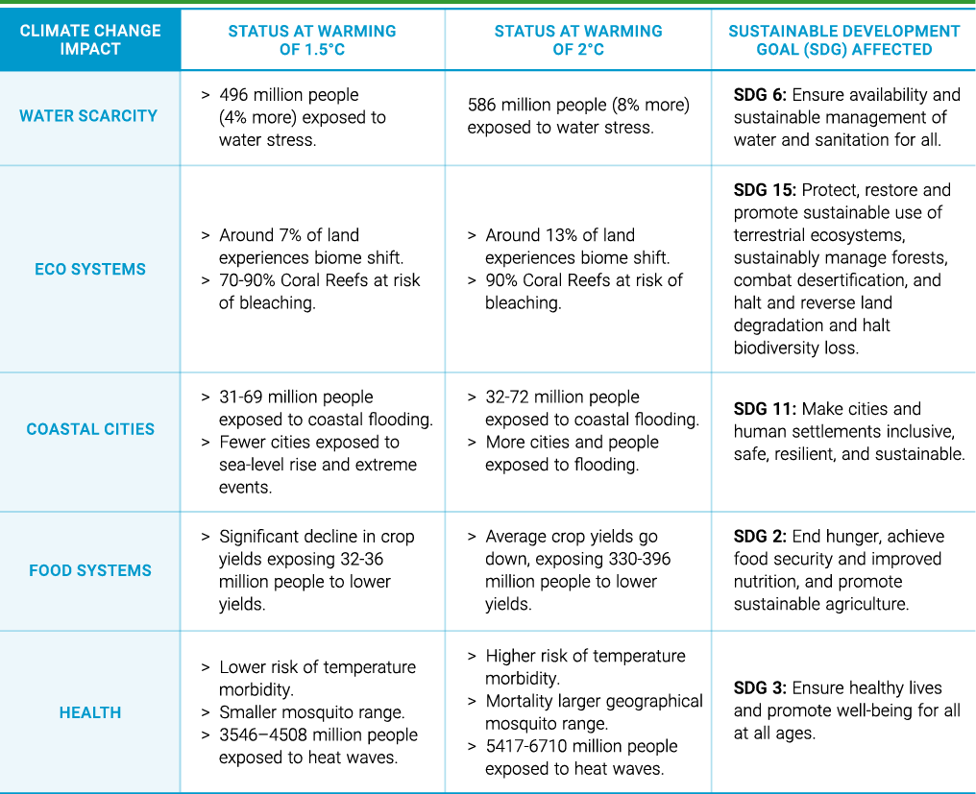
Climate Change, Disaster Risk and Development
Notes:
Source: IPCC-AR5 (2014)

Slide 6
Climate Risks are Global, Vulnerability is Not
Geographical Exposure
Gender Discrimination
Occupational Exposure
Vulnerability depends on existing Inequalities
Social marginalization
Infrastructure Deprivation
Financial Susceptibility

Slide 7
Let’s discuss
Have you observed any of the following in your region due to climate change or after disasters? (pick all that are applicable)
Increase in Domestic work and Time Poverty
Exacerbated Health Burden and Caring Responsibilities
Greater Risk of Death, Injury and Violence
Higher Loss of Livelihoods and Assets
Notes:
You can keep an open-mic or chat for the participants to answer or use online tools like like zoom poll/mentimeter/slido for the same

Slide 8
Women’s traditional gender roles will be impacted
Increase in Domestic Work and Time Poverty
Asian women’s unpaid care and domestic work, already 4 times that of men will increase
With reduced food crop production and increased food prices, poor women will be strained to maintain food security
With more than 2 billion people expected to face water shortage by 2025, women and girls will have to travel longer distances and spend more time fetching water
Damage to water supply infrastructure in floods and cyclones, will also hurt women in urban areas
As pressure on land for food and fuel grow, grazing land will reduce, increasing the workload of women for arranging fodder
Forest protection and clean energy policies will affect fuelwood availability- a source of 90% energy for poor women

Slide 9
Girls and young women will face more
Exacerbated Health Burden and Caring Responsibilities
Skewed intra-household food distribution will result in women and girls being deprived of basic food intake and nutrition
Women being more exposed to standing water due to water fetching responsibilities will be at higher risk of water-borne diseases
Physiological characteristics also make women, especially pregnant women, more susceptible to vector-borne diseases, especially Malaria
Drinking saltier water (a direct result of sea-water ingress) will also have severe impacts, especially on pregnant women, as rates of hypertension and preeclampsia will escalate
Post disasters, women’ sexual and reproductive health needs are further marginalized

Slide 10
Women and LGBTIQ+ people will suffer more
Risk of Death, Injury and Violence
Women and children are 14 times more likely to die or be injured in a disaster than men due to gender inequalities
Forced to sleep in insecure homes and emergency shelters without privacy and hygiene facilities women, and LGBTIQ people are particularly vulnerable to physical and sexual assault
Women and girls also often face elevated levels of violence if they have to travel long distances to fetch water, firewood, or fuelwood after a disaster
Adolescent girls especially report higher levels of sexual violence in the aftermath of disasters. The risk and likelihood of early marriage was increases
Post traumatic Stress Disorder among men often leads to hegemonic masculinity crisis, increasing pre-existing levels of violence
Women and children also face greater risk of trafficking and being pushed into sex trade

Slide 11
Women, especially poor and in rural areas, will also suffer
Higher Loss of Livelihoods and Assets
Women are more dependent on natural resource-based livelihood and hence will face more loss due to droughts, flooding, etc.
Women are often more involved in subsistence farming, and provision of agriculture labour, and their livelihoods will be more impacted by loss of crop yield coupled with water scarcity
Women also own only smaller livestock such as chickens, ducks, goats, which are not only less likely to be rescued but also more prone to be sold for immediate cash post disasters, thereby resulting in loss of limited assets
With more women being employed in the informal sector, with low paid jobs and lack of social security, their loss of livelihoods will hurt more
Already deprived of access to land and resources, their profound vulnerability will be further exacerbated

Slide 12
Other Gender Intersectionality also need consideration
Disaster and the Male Gender
LGBTIQ and Health Concerns
Climate Change and Elderly Persons

Slide 13
Capacity barriers to resilience will further lead to gender inequalities being amplified
Lack of spaces for participation in local and global decision making
Limited inter-departmental coordination
Few boundary organisations to enable cross-sharing of knowledge
Low awareness levels on climate change and adaptation solutions
Limited micro-level data for local decision making
Ineffective communication channels between technical experts and communities
Lack of understanding of behaviour anomalies and communication tools for futuristic action
Institutional Barriers
Information barriers
Technology Barriers
Financial Barriers
Limited technology options which are cost-efficient, locally available, and gender responsive
Available solutions are not standardised for market processes
Technology development does still does not involve community validation and/or build on traditional knowledge
Low ability to make upfront capital investments
Recurrent expenditure due to high maintenance cost of solutions
Lack of access to credit
Lack of risk retention planning and risk transfer mechanisms for poor

Slide 14
Let’s discuss
Which of the following barrier to climate resilience will amplify gender inequalities most in your region? (pick any two)
Restriction of participation in local (decision making) committees
Lack of land ownership with titles often in the name of men
Lack of awareness and information on climate change
Lack of financial support services (access to credit, insurance)
Lack of gender responsive technology solutions
Limited participation in climate negotiations at national and global level
Any other (please add_________)
Notes:
You can keep an open-mic or chat for the participants to answer or use online tools like zoom poll/mentimeter/slido for the same

Slide 15
Need for Integration of Gender in Climate Change and DRR Policies
The right thing to do- legally and morally
Women, girls, and those with other sexual identities are still among the most marginalized groups and particularly vulnerable to climate change and disaster risks- need to be the key target of the LNOB approach
Protect the human rights of all women and those with other gender identities
Address concerns of gender inequality
All policies and measures affect different genders differently, hence undertaking gender analysis and inclusion of gender dimensions into policy planning is important
Gender integration helps find ways to mitigate possible risks that may exacerbate gender inequality and highlight opportunities to enhance positive outcomes
Achievement sustainable development outcomes
Improve national productivity and sustainable economic growth
Enable better policy decisions required for more peaceful and equitable societies
Especially for food, nutrition, education, health, and family welfare

Slide 16
Need for Gender Integration continued
Make climate action more effective
Gender inequalities and gender roles play a key role in determining the choice of adaptation strategies men and women have
The knowledge, skills, and inputs of women are very important for the development of context-appropriate adaptation and DRR policies and strategies
A male bias could lead to inefficient allocations of scarce resources
It is important that they are also as much informed, prepared, and equipped as men, if the adaptation and DRR strategies have to be effectively implemented
Failing to identify women and other genders as a target group for specific measures would lead to limited results
Global mandate
UNFCCC- Lima Work Programme on Gender, Enhanced Gender Action Plan
Sendai Framework for DRR

Slide 17
Gaps /challenges and strategies for gender mainstreaming in climate action
Prioritizing availability of Climate Finance for gender responsive projects at all levels
Gender is still not a priority in national CCDRR policies and plans
Promote policy dialogues on transformative gender using the CEDAW commitment in national climate change planning processes
Advocate for GRB or Gender-Responsive Budgeting to be adopted in the CCDRR sectors
Inadequate Institutional mechanisms
Improve coherence between national strategies, CCDDR planning, and international agreements on gender like CEDAW that they have ratified
Support technical ministries in undertaking sectoral gender analysis for CCDRR to enable evidence-based planning

Slide 18
Gender mainstreaming in climate action continued
Women’s participation and leadership within the climate sector is still limited at all levels of governance
Enable direct participation to capture the ideas and knowledge of men, women, and those with other gender identities
Insufficient gender analysis and knowledge management
Promote in-depth gender analysis within sectors especially where the gender impacts are not directly visible
Undertake research especially in sectors
Publish statistics and knowledge products highlighting gender dimensions within the sector- a handy document for technical ministries
Notes:
Focus sectors like transport, informal employment, migration, among others

Slide 19
Gender mainstreaming in climate action continued
Gradual shifting from gender mainstreaming to gender transformative approaches
Designing and piloting gender transformative projects, implemented with strong evaluation process to generate evidence for advocacy
Addressing Sex, Age, Disability Disaggregated Data (SADDD) gaps
Need to focus on men and other gender identities
Restricted information on gender outreach of current plans and response measures
Promoting Community-led CCDRR projects
Focus on projects led by women, and/or other vulnerable populations
Moving beyond addressing Vulnerability to Exploiting Opportunities for a more gender equal society
Promoting diverse livelihoods options for women in order to increase their resilience to hazards
Notes:
Vulnerable populations include elderly, (dis)abled, LGBTIQ, indigenous communities, ethnic minorities, migrants/refugees, among others

Slide 20
Women as Partners and Agents of Change
Women can play a critical role in disaster preparedness
The case of Barishal, Bangladesh
Evidence shows an increase in community resilience where women are empowered to create institutional platforms
Women-Led Forest Management, Nepal
Pro-active engagement can be a win-win situation, especially for poor women
SWaCH model of Waste Management, India

Slide 21
Insert photo within the green frame
Thank You !

