Slide 1
Local and Sectoral Adaptation Models and Gender
SESSION 02
(Insert Name and Organisation of the Presenter)
[insert date, month, year | time, time zone]
Notes:
Suggested Time: 20 minutes (This ppt has multiple models presented, it is recommended to select 2 to 3 most relevant to the participants for the presentation)
More information: UN Women Training Manual on Gender and Climate Change Resilience (Module 4)

Slide 2
Understanding Adaptation
Adaptation refers to adjustment in ecological, social, and human systems in response to actual and expected climatic stimuli and their effects
Primarily, adaptation means risk management and reduction of vulnerability to climate variability, uncertainties, and climatic extreme events
Adaptation helps to cope better and harness benefits from the changed situation
Adaptation to climate change involves anticipating the adverse effects of climate change and taking appropriate action to prevent or minimize the damage they can cause
The goal is to reduce vulnerability and exposure to the harmful effects of climate change (like sea-level rise, extreme weather events, or food insecurity)
It also encompasses making the most of any potential beneficial opportunities associated with climate change (for example, longer growing seasons or increased yields in some regions)

Slide 3
Adaptation Models
Adaptation models can be short-term (less than 10 years), addressing impacts that are already occurring and are likely to rise in the immediate future.
These are often local measures, infrastructure or service-oriented and often targeted to a specific risk (EWS)
Many adaptation models are medium or long-term responses
These focus on enhancing adaptive capacity or the ability of a system (human, natural or managed) to adjust to climate change

Slide 4
Local Adaptation Models
1

Slide 5
Local Adaptation Plans of Action (LAPA) in Nepal
Initiated in 2013 as part of NAPA
Also included in the NAP process
LAPA is a spatial approach to adaptation planning.
Prepared at the local government level with coverage of a decentralized administrative or geographical unit
May be with or without community participation
Although in most cases, LAPAs have mainstreamed participatory processes
Consist of seven steps for integrating climate change resilience into local-to-national planning processes

Slide 6
Seven Steps of LAPA
Step 1: Climate Change Sensitization
Step 4: LAPA Formulation
Gender analysis and mobility mapping
Setting milestones and targets with focus on ‘how to ensure equitable benefits for women’
Step 2: Vulnerability and Adaptation Assessment
Step 5: LAPA Integration into planning process
Identification of vulnerable men and women across social groups in the hotspots
Systems for gender and social inclusion including Gender Responsive Budgeting
Step 3: Prioritization of Adaptation Options
Steps 6 and 7: Implementation and Progress Assessment
Gender sensitive multi-criteria ranking to prioritize adaptation actions based on gender needs and priorities
Gender inclusion in decision making processes and M&E based on gender, age, class, class and ethnicity disaggregated data

Slide 7
City-Resilience Action Plans
Defines Urban Resilience as
the capacity of individuals, communities, institutions, businesses, and systems within a city
to survive, adapt and grow
no matter what kinds of chronic stresses and acute shocks they experience
Uses multiple strategies to help cities understand their vulnerabilities and prepare for climate impacts and disasters

Slide 8
The City-Resilience Framework
The City Resilience Framework (CRF) describes the essential systems of a city in terms of four dimensions
Health and Wellbeing
Economy and Society
Infrastructure and Environment
Leadership and Strategy
Each dimension contains three “drivers” – a total of 12 goals
These are further broken into 52 indicators which reflect the actions that cities can take to improve their resilience
Notes:
CRF has been developed by Arup International and Rockefeller Foundation

Slide 9
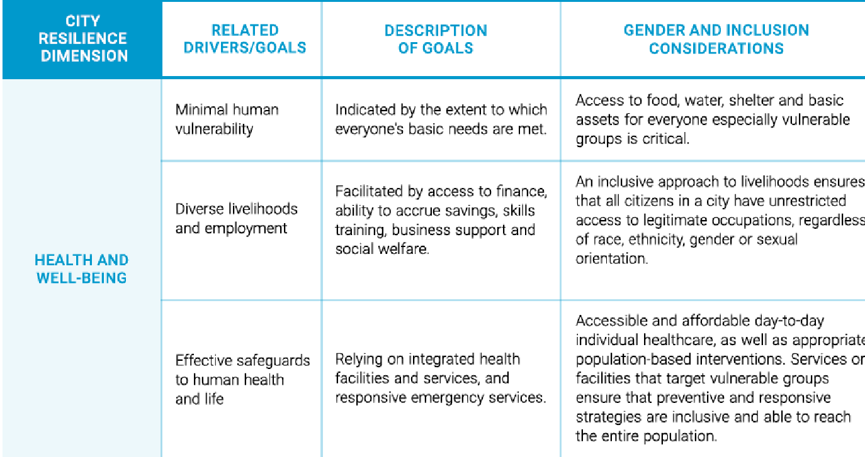
CRF for health and wellbeing

Slide 10
Infrastructure-based Planning
The approach stipulates an integration of climate change considerations in each phase of project implementation by:
Taking into consideration future climate conditions (along with past and current climate conditions); or
Considering uncertainty in the review and use of climate data through sensitivity testing and adjusting the design (for example, through a greater safety margin) or, at a minimum, adjusting the performance or service expectations of the designed structures.
While these projects per se may seem gender-neutral, they may not essentially also benefit women due to the ‘Male norm’ influence in designs

Slide 11
Gender-responsive infrastructure planning
Gender-responsive infrastructure planning requires that
Rights, priorities, and needs of women and those with other gender identities are also considered
Women, along with men, are meaningfully included and represented in the planning, design, and management of the new infrastructure
The gender-differentiated access over infrastructure and related services is kept in mind while designing such services
This involves mainstreaming gender across all steps of infrastructure planning and development

Slide 12
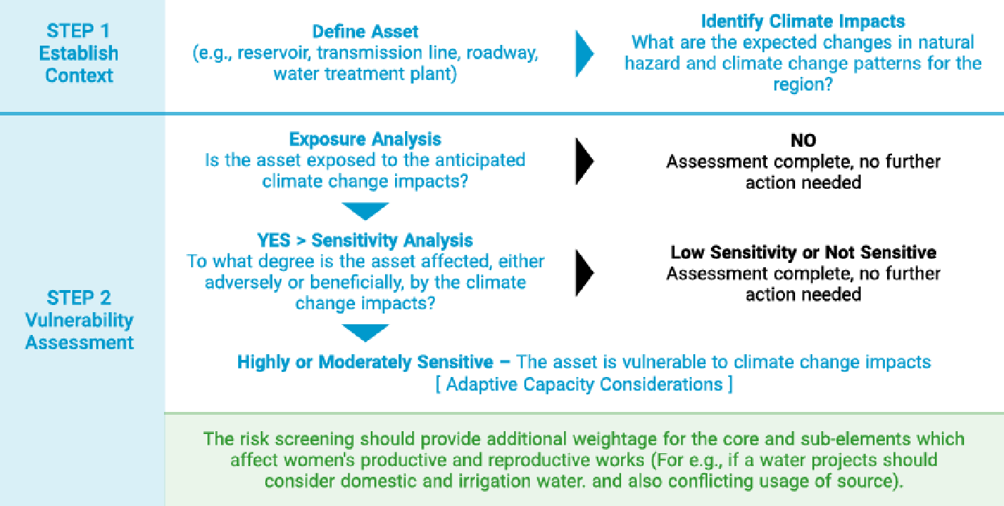
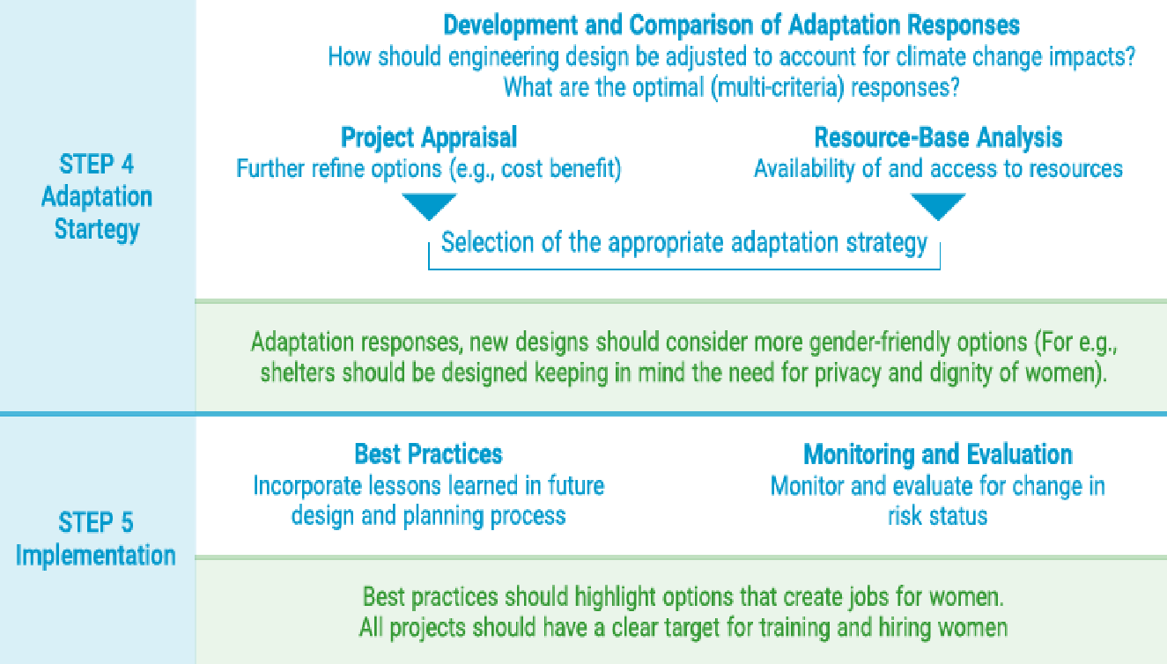
Infrastructure planning process

Slide 13
Ecosystem-Based Adaptation (EbA)
Use of environmental assets and natural protection measures as solutions to address climate change and disasters
For example, “floodplain forests and coastal mangroves provide storm protection, coastal defences, and water recharge, and act as safety barriers against natural hazards such as floods, hurricanes, and tsunamis; while wetlands filter pollutants and serve as water recharge areas and nurseries for local fisheries”
Central to the EbA concept is the importance of adopting a holistic approach to maintaining ecosystem structure and functioning, and ecosystem service provision
However, ecosystems have limits beyond which they cannot function
Thus ecosystem resilience builds on developing and maintaining “capacity of a system to tolerate impacts of drivers without irreversible change in its outputs or structure”

Slide 14
EbA and inclusion
EbA often provides greater opportunity to target vulnerable groups whose livelihoods directly depend on natural resources
EbA also provides a larger space for women’s involvement
The knowledge that women have as managers of natural resources can provide important insights into the design of effective strategies
However, gender integration is not a default process, and it is important to take steps that include local and gender-based experiences in EbA planning processes

Slide 15
Community-Based Adaptation (CBA)
CBA is a community-led process, based on communities’ priorities, needs, knowledge, and capacities, which should empower people to plan for and cope with the impacts of climate change
CBA is generally driven by multiple components
Involves working in partnership with place-based communities to improve their capacity to adapt to climate risks and impacts
Knowledge enhancement of the communities- of both likely future changes in the climate and possible adaptation strategies
CBA is more like a movement since it involves a community with a shared interest in advocating for institutional and financial support for vulnerable communities to adapt to climate change

Slide 16
Key steps of a CBA model
Focus on adaptive capacity-building than adaptation action
Sustained mobilization for trust building among communities and with other stakeholders
Recognise existing local power relations and create spaces for participation of vulnerable groups
Integration of local wisdom and scientific knowledge through capacity building on complexities of climate change
Community-based vulnerability assessments and resilience planning approaches
Addressing underlying causes of vulnerability- building an integrated model
Negotiating institutional barriers and coordination with government

Slide 17
Gender mainstreaming in CBA
Gender mainstreaming is a critical factor to the success of a CBA project
This requires:
Ensuring that women are part of all discussions of local vulnerability assessments
Applications of participatory gender analysis tools to highlight the gender roles and gender-based vulnerabilities in the community
Focus on knowledge and information sharing and capacity-building of women

Slide 18
Sectoral Adaptation
2

Slide 19
Climate Smart Agriculture (CSA) and Food Security
Climate Change will have an effect on the agriculture ecosystem, especially in Asia
Reduced average yields of most crops, especially rice, wheat, and maize
Sea level rise also threatens coastal and deltaic rice production areas
Indo-Gangetic Plains are under threat of a significant reduction in wheat yields
With reduced yields and production of rice and wheat, there is bound to be a “food production shortfall”

Slide 20
Gender and CSA
Women and girls will be more impacted
As they have the responsibility of ensuring food security within their households
Existing social discrimination and cultural practices with women and girls eating last and being the first to forgo nutrition in case of shortage will impact health
Increase water stress, will increase the work burden of women subsistence farmers who need access to water for food production and preparation
Changes in vegetation cover and frequent disasters will also affect women’s livestock-based livelihoods more
Women and girls will be more impacted
Climate Smart Agriculture (CSA) thus needs to be more gender-responsive

Slide 21
Potential Gender Considerations in CSA projects
Notes:
Source: Nelson and Huyer (2016)

Slide 22
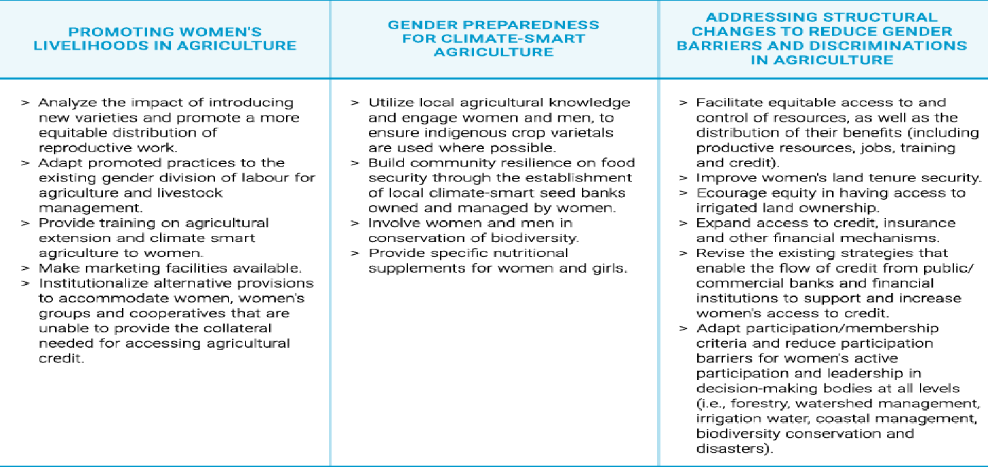
Gender Responsive Strategies for CSA projects

Slide 23
Climate Change Adaptation with focus on Public Health and Epidemics
Climate change is projected to increase threats to human health through direct effects of extreme events such as
heat-waves
floods and storms
Additionally, it will have health impacts through
more complex pathways of altered infectious disease patterns like rising mosquito lines
negative effects on food and nutrition security and water scarcity

Slide 24
Gender and health
Women’s time-poverty due to health care responsibilities will increase
Mortality and health risks for women in Asia is also likely to be higher than men
Cultural practices leading to higher mortality risks during storms and flood events, greater risk of developing post-traumatic stress disorder (PTSD)
Higher impact of heatwaves, water, and vector-borne diseases (especially malaria)
Access to water and sanitation facilities, health care services, especially sexual and reproductive health services, will also be impacted during disasters
There is also evidence of increased gender-based violence, child marriage, and trafficking
It is thus important to adopt gender-responsive climate change adaptation strategies and practices in the health sector

Slide 25
Adaptation strategies continued
GENDER RESPONSIVE ADAPTIVE STRATEGIES | GENDER RESPONSIVE ADAPTATION PRACTICES
Provide safe shelters and homes for both women and men Training on gender-sensitive disaster risk reduction and early warning systems Promote programmes that facilitate men to seek help for psychosocial problems Empowerment of women to strengthen their capacity to question and change harmful behavioural norms that put them at risk in the case of extreme events | Gender-sensitive disaster preparedness Gender-sensitive early warning systems Ensure women’s participation on equal basis in all policy and programme cycles Target women and men differently in communication campaigns and health promotion strategies, taking into account their gender norms and roles Adopt strategies at all levels of programming to change norms and practices that prevent women or men from appropriate responses and coping mechanisms in situations of natural disasters
A gender perspective must be incorporated into infectious disease analysis and research to target policies and programmes Collected data must be disaggregated by sex, age, socioeconomic status, education, ethnicity, and geographical location, where appropriate An understanding of gender and its implications for health and health-seeking behaviour should be incorporated into the training of health professionals and development of health-sector responses | Ensure better availability and access to, and support by, health systems for both women and men, but especially for women, given their caregiving roles Support outreach activities, using gender-sensitive information, education, and communication strategies and materials for advocacy and training Promote childcare facilities and other approaches to support women’s caregiving role, while trying to transform related gendered roles and norms
Notes:
Source: WHO (2014)

Slide 26
Gender Responsive Health Sector Adaptation
GENDER RESPONSIVE ADAPTIVE STRATEGIES | GENDER RESPONSIVE ADAPTATION PRACTICES
Promote water-saving practices that take into account the different uses and roles related to water for women, girls, and men Address salination and arsenic contamination of water, proposing specific actions that consider the different patterns of exposure and impacts on women and men Counter social stigma attached to the effects of arsenic poisoning on women and men | Ensure affordable drinking water, taking into account the different roles and needs of women and men Empower women and facilitate their equal participation in management of water resources at national, regional, and grassroots levels Appropriate technologies for assuring potable water closer to where families live Strengthen forestation and water harvesting mechanisms, considering the different roles, needs, and impacts on women and men Promote women’s rights to own land and ownership of land use certificates Effective implementation of water policies that consider women’s and men’s different needs and roles for water use, provision, and consumption Ensure equitable access to resources also in relation to payments for environmental services
Build strong and supportive networks for both women and men Promote gender-sensitive training to eliminate violence against women, girls, and boys Capacity building within the health system to ensure early detection of domestic or sexual violence Involve women in management of shelters and distribution activities | Policy initiatives in the health, education, finance and labour sectors to be conceived as a part of a cohesive national/ international violence prevention effort that includes women, girls, men, and boys Implement appropriate health services that respond to the specific needs of women and men based on their respective needs, roles and capacities Design effective referral systems for cases of domestic violence Design referral system for cases of sexual harassment

Slide 27
Strategies continued
GENDER RESPONSIVE ADAPTIVE STRATEGIES | GENDER RESPONSIVE ADAPTATION PRACTICES
Promote programmes that facilitate men to seek help for psychosocial problems Empower women to enhance their capacities to look after themselves and their families and specifically to use available social and other networks to cope with increased burdens and tensions | Target women and men differently in post-disaster relief, taking into account gender norms, roles and relations
Involve women and men in conservation of biodiversity | Training on agricultural extension for both women and men Better nutrition supplements for needy families Marketing facilities Land rights for women
Build strong and supportive networks for both women and men Promote gender-sensitive training to eliminate violence against women, girls and boys Capacity building within the health system to ensure early detection of domestic or sexual violence Involve women in management of shelters and distribution activities | Policy initiatives in the health, education, finance and labour sectors to be conceived as a part of a cohesive national/ international violence prevention effort that includes women, girls, men and boys Implement appropriate health services that respond to the specific needs of women and men based on their respective needs, roles and capacities Design effective referral systems for cases of domestic violence Design referral system for cases of sexual harassment

Slide 28
Climate Change Adaptation and Disaster Management in Coastal Zones
Coastal and marine systems are under increasing stress from both climatic and non-climatic drivers in Asia. These would involve
damage to the coastal ecosystems
increase in disasters due to storm surges and tropical cyclones
Causing loss of livelihoods and social impacts, especially the poor and women. For example,
Women involved in processing fish, preparing for market, and small-scale harvesting –activities that are close to the shore
Decline in near-shore resources will impact food security
Salt-water intrusion and disruption of water systems during extreme events will increase women’s workload for fetching water

Slide 29
Climate Change Adaptation and Disaster Management in Coastal Zones
There is an observed gendered disparity in mortality during disasters, especially storms
There is also evidence of increased gender-based violence, child marriage, and trafficking
It is thus important to adopt gender-responsive climate change adaptation strategies and practices in coastal zones

Slide 30
Gender Responsive Coastal Zone Adaptation
Encourage leadership and women’s effective participation in organizations and all decision-making processes
Involving of women in designing and construction of spaces (physical barriers like sea-walls, gabions, etc) around them
Shelters should be safe and have sufficient space to ensure privacy
Providing opportunities for women in coastal adaptation infrastructure construction
Early warning systems should be accessible to women
Involve women in mangrove regeneration and ecosystem restoration projects
Reproductive health needs to be incorporated in disaster relief and management programmes
Fisheries and tourism sectors should focus on gender-sensitive research, engagement of women in planning and management, and capacity building of women for job opportunities
Include gender criteria in Environment Impact Assessments (EIAs)

Slide 31
Insert photo within the green frame
Thank You!

