Slide 1
Tools for Gender Analysis and Assessment for Climate Change and Disaster Risk Reduction Projects
SESSION 03
(Insert Name and Organisation of the Presenter)
[insert date, month, year | time, time zone]
Notes:
Suggested time for the presentation: 45 minutes
More information: UN Women Training Manual on Gender and Climate Change Resilience (Pages 134-156)

Slide 2
Understanding Gender Mainstreaming
Is the process of
assessing the implications for women and men of any planned action, including legislation, policies or programmes, in all areas and at all levels
It is a strategy for
making women’s as well as men’s concerns and experiences an integral dimension of the design, implementation, monitoring, and evaluation of policies and programmes
in all political, economic, and societal spheres
so that women and men benefit equally and inequality is not perpetuated
The ultimate goal is to achieve gender equality

Slide 3
Let’s discuss
In which of the following stages of the project cycle do you think Gender Mainstreaming has to be applied (pick all that are applicable)
Project Identification: Situational Analysis and Need Assessment
Project Planning: Objective and Activity finalisation
Resource Mobilization: Budgeting
Project Implementation
Monitoring and Evaluation
Notes:
You can keep an open-mic or chat for the participants to answer or use online tools like zoom poll/mentimeter/slido for the same

Slide 4
Gender mainstreaming is required
Across all stages–
project identification, situation analysis, assessment and planning, implementation, and monitoring and evaluation
At all levels–
institutional, policy, programmes/project
It is also important to include other gender identities (LGBTIQ)
Women are also not a homogeneous group, so an intersectionality lens should be applied
With a focus on specific groups of women based on age, (dis)ability, class, race, ethnicity, social status, and others

Slide 5
Gender mainstreaming tools across the project cycle
Gender-Informed Project Identification
National Climate Action Plans & Strategies
Project Identification
Gender Analysis
Information Collection using Frameworks
Gender Analysis Matrix
Gender Assessment
Risk, Vulnerability & Resilience Mapping
Sectoral Narratives
Planning for Gendered Solutions
Problems & Solutions Tree
Gender Action Plan
Gender Assessment Scale
Project Implementation
Meaningful Participation of all Stakeholders
People’s Institution Building & Knowledge Sharing
Monitoring & Evaluation
Gender-Aware Indicators
Results Framework
Report on Gender Outcome

Slide 6
Step 1: Gender Analysis
1

Slide 7
Gender Analysis is the first step of gender mainstreaming
Gender Analysis is defined as
Analysis focused on
the relative distribution across genders of
resources, opportunities, constraints, and power
in a given context
It must address the following questions
WHAT
Are the socio-economic context and cultural norms related to gender equality?
WHO
Is responsible for caregiving, resource management and cash income?
WHO
Has access, control and ownership of resources, goods and services?
WHO
Makes all decisions at household and community level?
WHO
Is more vulnerable to climate change and disaster risks?
HOW
Will the project address the existing inequalities?

Slide 8
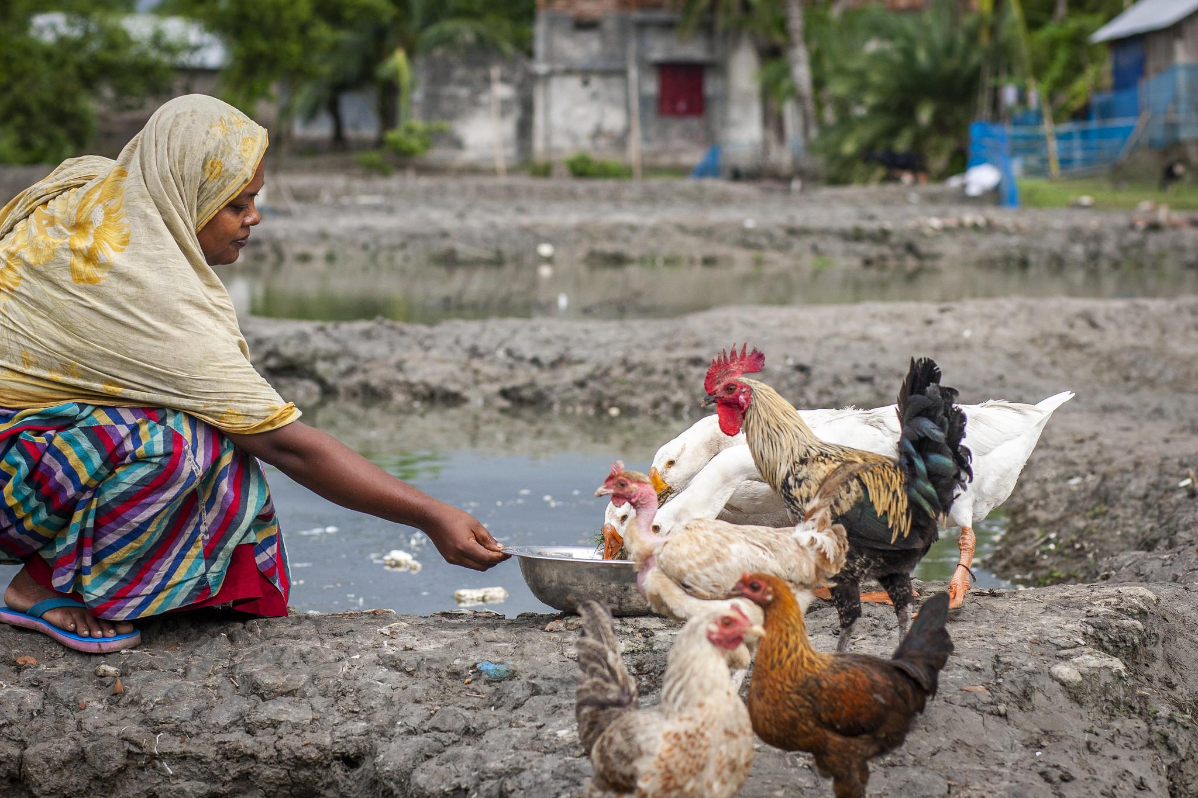
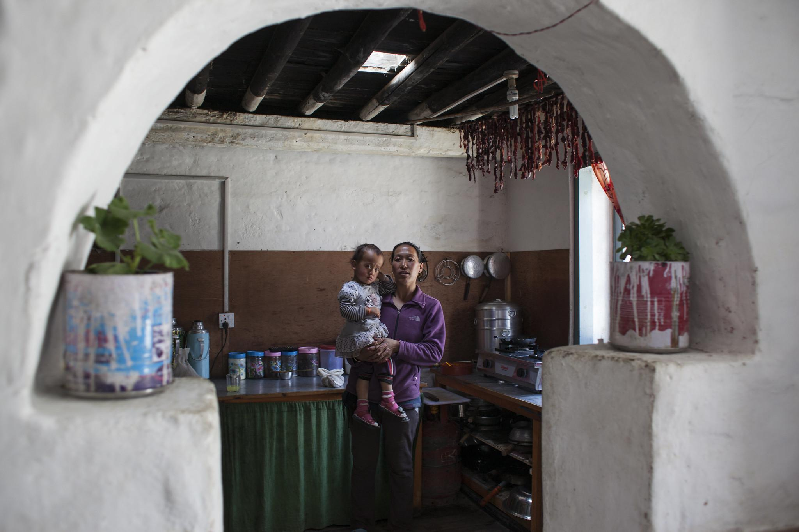
Moser Framework
Photo: UN Women/Fahad Kaizer
Developed by Caroline Moser in the early 1980’s it focuses on gender planning as an independent exercise
The framework consists of six tools based on three fundamental concepts
Identification of gender roles and women’s triple burden (productive, reproductive, and community works)
Practical needs and Strategic gender interests
Categories of Women in Development (WID) and Gender and Development (GAD) policy approaches
Photo: UN Women/Vidura Jang Bahadur

Slide 9
Moser Framework…continued
Tool 1: Gender Role Identification
Tool 2: Gender Needs Assessment
Reproductive Work
Productive Work
Community Work
Practical Needs
Food Security
Water Provision
Primary health care
Fuel and fodder provision
Food preparation
Water collection
Fuel collection
Care
Agriculture
Livestock
Fodder collection
Labour
Village health & Sanitation
Forest protection
Tool 3: Disaggregated control of resources and decision-making
Strategic Needs
Joint land and house title
More cash income
Involvement in policy making
Access to legal mechanisms in case of abuse
Resources
Control
Decision-making
Land
House
Cash Income
Food Stock
Male
Male
Male
Female
Male
Male and Female
Male
Female

Slide 10
Moser Framework…continued
Tool 4: Planning for balancing triple roles
Tool 5: Women in Development (WID) / Gender & Development (GAD) Policy Matrix
Balancing Roles
Agriculture productivity enhancement techniques include small farm tools which help reduce women’s drudgery
Increase in big livestock population is accompanied by sufficient fodder availability mechanisms
Increase honorarium for primary health care volunteers
Project Objectives
Empower women and girls to take charge of their lives, assets, and resources required for their well being.
Undertake activities that increase women’s income while reducing their drudgery / time poverty
Ensure women’s participation in all CCDRRR activities
Tool 2: Gender Needs Assessment
Tool 6: Involving women and gender orgs in planning
Engagement
Women are a part of all project planning, execution, and decision making committees
Project team is gender balanced at all levels, including senior management

Slide 11
Harvard Analytical Framework
Developed in 1985, it aims to demonstrate an economic case for allocating resources for women as well as men at a time with an efficiency approach in mind
The framework has four main components
three tools for gender analysis and
a checklist to examine a project proposal or intervention from a gender perspective using
Gender-disaggregated data and capturing the different effects of social change on men and women

Slide 12
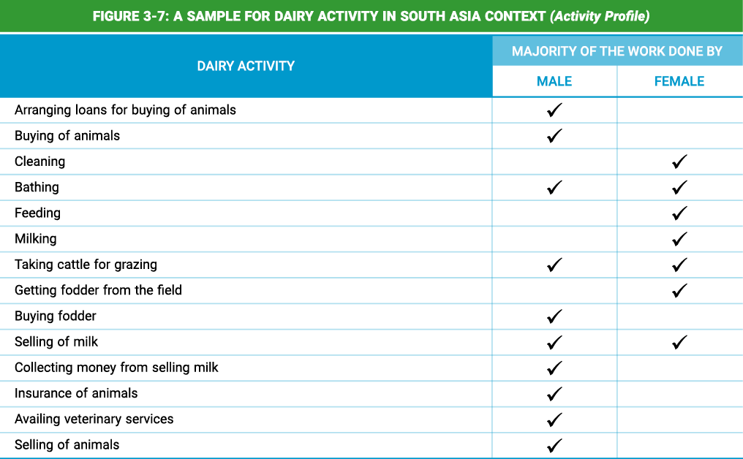
Harvard Framework Tool 1: Activity Profile
Activity | Women/Girls | Men/Boys
Production Activities Agriculture Activity 1 Activity 2 Livestock Activity 1 Activity 2 Home-Based Work Activity 1 Activity 2
Reproductive Activities Water-Related Activity 1 Activity 2 Health-Related Activity 1 Activity 2
Community Activities Social Developmental Political
Notes:
A sample for diary activity will emerge on mouse click when in Power point show mode

Slide 13
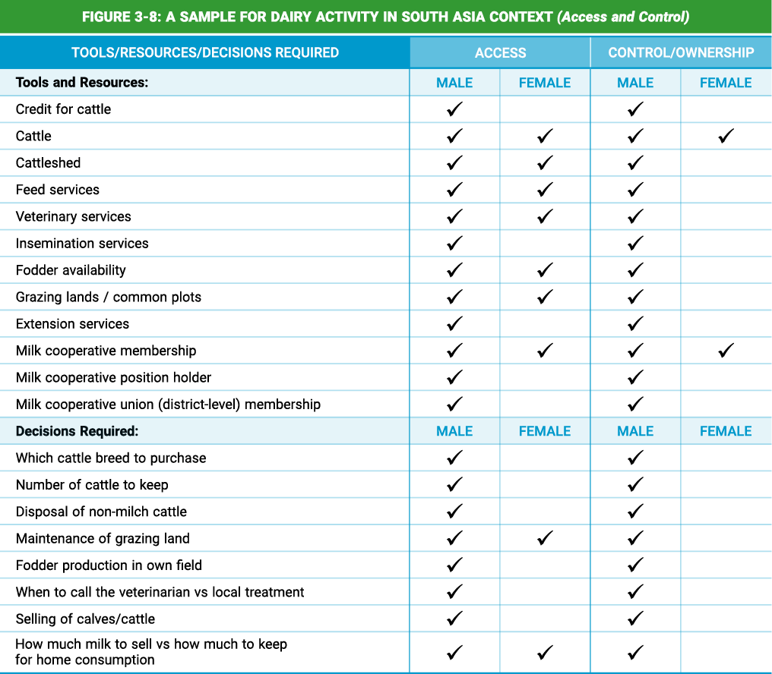
Harvard Framework Tool 2: Access and Control Profile
Resources/Benefits | Access |  | Control/Ownership
 | Women/Girls | Men/Boys | Women/Girls | Men/Boys
Resources Land Labour Equipment Cash Credit Education/Training Healthcare
Benefits Basic Necessities (food, clothing, shelter) Outside/Cash Income Asset Ownership Power and Prestige

Slide 14
Harvard Framework Tool 3: Influencing Factors
Influencing Factors | Constraints | Opportunities
Community norms and social hierarchy Cultural practices and religious beliefs Demographic factors Institutional structures Economic factors Political factors Legal parameters Training Attitude of community to development workers

Slide 15
Gender Analysis Matrix (GAM)
Developed by Rani Parker in 1993
Helps find out the different impacts of development interventions on women and men
By providing a community-based technique for the identification and analysis of gender differences
Examines impacts on four areas: labour, time, resources, and socio-cultural factors
Proposed Intervention | Labour | Time | Resources | Culture
Men
Women
Household
Community
Tool 1: Analysis at 4 Levels of Society
Tool 2: Impact Analysis
Notes:
Source: Parker (1993)

Slide 16
Step 2: Gender Assessment
2

Slide 17
Gender Assessments are key in CCDRR projects
Vulnerability Assessments are a critical step in all climate change and disaster risk reduction planning
It is very important to undertake gender-aware vulnerability assessments
Vulnerability Assessment tools built upon the information collected during the gender analysis phase
They provide an approach to link these with climate change and disaster related vulnerabilities
But first let’s find out
What do you understand by the term “Vulnerability”?
Notes:
You can keep an open-mic or chat for the participants to answer or use online tools like mentimeter/mural/slido for the same
Vulnerabilities- long-term factors which weaken people’s ability to cope with the sudden on-set of disaster, or with drawn-out emergencies. They also make people more susceptible to disasters. Vulnerabilities exist before disasters, contribute to their severity, make effective disaster response more difficult, and continue after the disaster

Slide 18
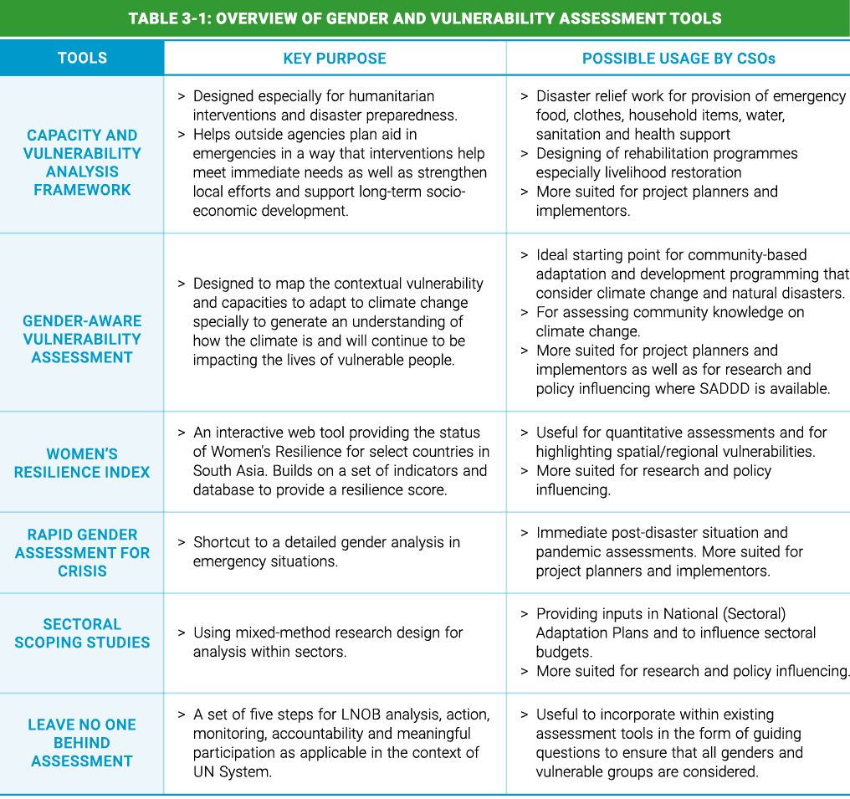
Gender Assessments Tools

Slide 19
Capacity and Vulnerability Analysis (CVA) Framework
Designed by UNDP in 2017, especially for humanitarian interventions and disaster preparedness
Helps outside agencies plan aid in emergencies such that interventions
Builds on identification of Vulnerabilities and Capacities
Sector | Vulnerabilities | Capacities
Social | Poor education levels Poverty Lack of disaster planning / preparedness | Local NGOs Active community leaders
Physical | Unsafe infrastructure Rapid urbanisation | Safe critical facilities
Economic | Mono-crop agriculture Indebtedness | Financial reserves / Remittance Ec. Diversified agriculture & economy
Environmental | Deforestation Pollution of ground, water and air | Mangroves
So what do you understand by the term “Capacities”?
Notes:
You can keep an open-mic or chat for the participants to answer or use online tools like mentimeter/mural/slido for the same
Capacities-existing strengths of individuals and social groups. They are related to people’s material and physical resources, their social resources, and their belief and attitudes. Capacities are built over time and determine people’s ability to cope with crisis and recover from it.

Slide 20
CVA framework continued
Three Categories of Vulnerabilities & Capacities | Vulnerabilities |  | Capacities
 | Men | Women | Men | Women
Physical or Material What were / are / could be the ways in which men and women in the community were / are / could be physically or materially? What productive resources, skills, and hazards existed / exist / could exist? | Fishing on high seas | More deaths | Knowledge of flood-resistant varieties | Food and water management
Social or Organizational What was the social structure of the community before the disaster, and how did it serve them in the face of this disaster? What was the impact of the disaster on social organization? | Out migration for work | Limited information | Political affiliation | Local Forest Committees
Motivational and Attitudinal : How do men and women in the community view themselves and their ability to deal with their social/political environment? What were people’s beliefs and motivations before the disaster, and how did the disaster affect them? | Risk-taking behaviour | Domestic Violence | Credit access | Opportunity to interact and learn

Slide 21
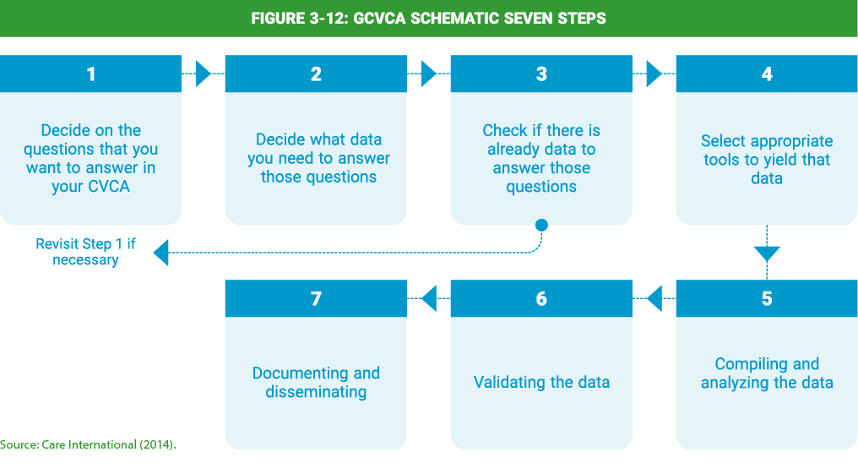
Gender-Aware Climate Vulnerability and Capacity Assessment (GCVCA)
Developed by Care International in 2014 to map contextual vulnerability and capacities to adapt to climate change with focus on how it will continue to impact vulnerable communities
Notes:
Source: Care International (2014)

Slide 22
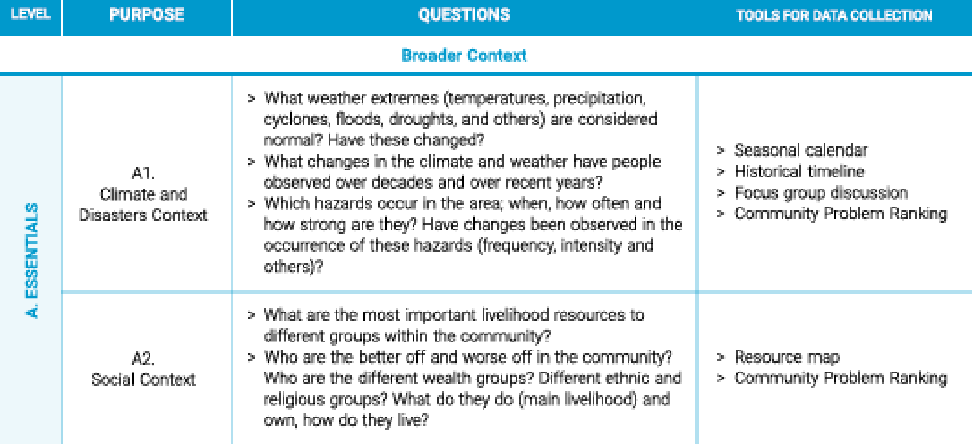
GCVCA continued
Essentials:
Broader Context
A1. Climate and disasters context
A2. Social context
Recommended for Focus:
Underlying Causes of Vulnerability
B1. Access to and control over assets and services
B2. Decision-making and participation
B3. Division of labour, use of time
B4. Control over one’s body
Possible areas of focus for GCVCA:
Climate resilient livelihoods
C1. Livelihoods
C2. Coping and adaptive strategies
Disaster Risk Reduction
C3. Hazards and changes
C4. Disaster risk information
C5. Response and risk management strategies
Local and community capacity
C6. Aspirations for oneself and strategic interest
C7. Knowledge, information and innovation
C8. Flexible and forward-looking decision-making

Slide 23
Rapid Gender Assessment during crisis
Shortcut to a detailed gender analysis in emergency situations
Immediate post-disaster situation and pandemic assessments
Should include information on gender roles and responsibilities, capacities, and vulnerabilities, together with programming recommendations
Builds up progressively, using a range of primary and secondary information
The focus is to understand gender roles and relations and how these may change during a crisis
Stage 1
Find available data that are disaggregated by sex and age, and existing analysis on gender relations.
Stage 2
Collect additional data by sex and age through gender assessments.
Stage 3
Analyze SADDD by comparing existing information with the results of the gender assessments
Stage 4
Write practical recommendation for humanitarian action based on the analysis
Stage 5
Share Rapid Gender Analysis with other actors

Slide 24
Sectoral Scoping Studies
Entry point for understanding the gender roles, responsibilities, and relations within the sector, and how these will be impacted by climate change
Involves using mixed-method research design, which involves both quantitative and qualitative methods using primary and secondary data
More suited for research and policy influencing, especially providing inputs in National (Sectoral) Adaptation Plans, and to influence sectoral budgets
Topic
Issues/ sectors
Method
Qualitative, Quantitative, Participatory
Representation
Aggregated / Disaggregated

Slide 25
Insert photo within the green frame
Thank You!

