Slide 1
Gender Responsive Planning, Implementation, Monitoring and Evaluation
SESSION 04
(Insert Name and Organisation of the Presenter)
[insert date, month, year | time, time zone]
Notes:
Suggested time for the presentation: 30 minutes
More information: UN Women Training Manual on Gender and Climate Change Resilience (Pages 156-171)

Slide 2
Step 3: Gender-Responsive Planning, Project Preparation and Design
1

Slide 3
Gender-Responsive Planning, Project Preparation and Design
Checklist Gender-Responsive Project Preparation
What is the current situation of men and women in the sector of your planned intervention?
Will the proposed project contribute to existing inequalities among men and women?
Does the proposed project break down or challenge existing inequalities among men and women?
Will the proposed project change the perceptions or stereotypes about men and women and their roles in any way?
What options should be considered to strengthen a gender perspective?
Will the proposed project contribute to women’s empowerment?
If not, is there a place for an allied intervention that will contribute to empowerment, so as not to reinforce the disparity between men and women?
It is important to ensure that gender analysis and assessment findings are visible in project plans
The project formulation process should logically follow a way of addressing the identified problem by
Defining the project goals and objectives
Outcome-linked activities
Budgets

Slide 4
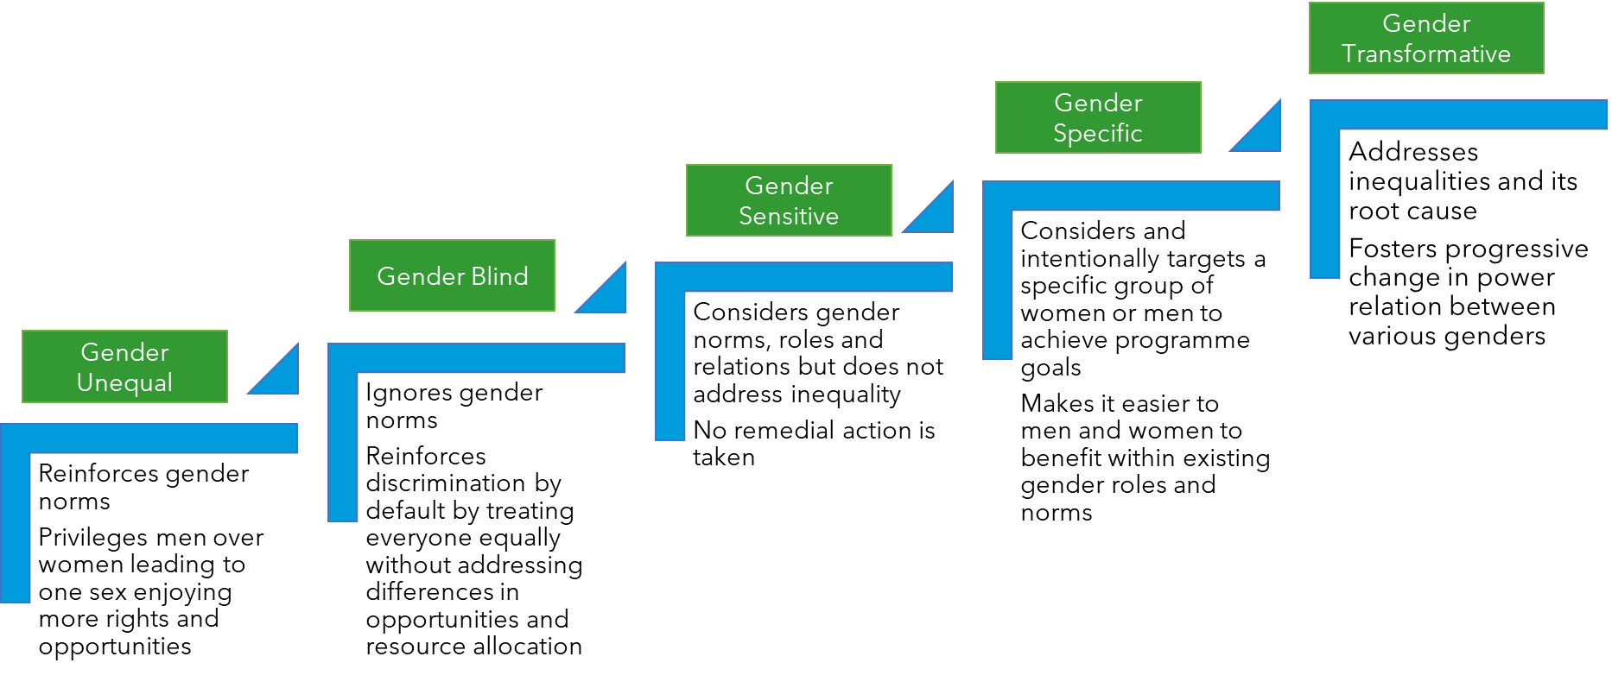
Gender-Responsive Assessment Scale (GRAS)
Provides criteria for assessing levels of gender-responsiveness
Used as a complementary tool to the gender analysis tool
The scale helps design gender-responsive projects

Slide 5
Causes, Consequences and Solutions (CCS) Framework
Adapted version of the problem-solution tree development
Can be a very useful tool in development sector-specific gender-responsive adaptation and disaster risk reduction projects
Follows a seven step process for project designing
Step 1: Identification of the core gender (or gender inequality) problem (s) that the project needs to address
Step 2: Draw a problem tree to trace the possible causes
Step 3: The problem tree should visualize the information
Step 4: Convert the problem tree into positive action
Step 5: Define the expected outcomes and impacts; and
Step 6: Identify strategies and activities
Step 7: Identify who will be the person or institution responsible for action

Slide 6
Step 4: Gender-Aware Implementation Process
2

Slide 7
Gender-Aware Implementation
The implementation or execution phase of a project is usually
the longest and most important in terms of gender integration
The most well-designed gender-responsive projects could not deliver the desired results if
implementation processes are not gender-aware
Three key steps for gender-aware implementation
Maintain partnerships will all stakeholders to ensure ownership
Involve men, women, LGBTIQ+ persons across the board
Proper communication and knowledge transfer
Stakeholder Analysis
Meaningful Participation
People’s Institution Development
Community-based Planning
Innovative Communication
Trainings and Capacity building

Slide 8
Stakeholder Analysis
A stakeholder is
any individual, group, or institution
that has a vested interest in the project area
and/or who potentially will be affected by project activities
and has something to gain or lose
if conditions change or stay the same
Identify stakeholders by asking “Who is most dependent on the resources at stake (women or men)?”
Learn about each stakeholder group in as much depth by asking additional questions
Analyse the stakeholders and finalise strategies to engage them
Keep Satisfied Unit 1 Unit 2 Unit 3 | Manage Closely Unit 1 Unit 2 Unit 3
Monitor Unit 1 Unit 2 Unit 3 | Keep Informed Unit 1 Unit 2 Unit 3
Low INFLUENCE High
Low INTEREST High

Slide 9
Meaningful Participation and People Institutional Development
Participation is community involvement at all levels of the project
But it should not be limited to ‘consensus building’- its more of a two-way process of ‘co-learning and co-management’
Supporting existing women's groups and encouraging the formation of new ones also help women gain access to decision making
Strategies for Women’s Meaningful Participation
Mapping women and other groups participation in existing decision making processes
Identify barriers to participation of women and vulnerable groups
Support women's participation at local level- within existing systems
Promote and strengthen women-only groups and organisations
Ensure inclusion of all vulnerable sections in the women only groups

Slide 10
However, mere group formation is not enough
It is important to also consult with these groups on all project-related matters
Utilise the women’s groups as a building block for increasing women’s knowledge and leadership skills
Create a cadre of community trainers and extension volunteers
Create a cadre of women leaders
Building capacities of women leaders to enable inclusion of all marginalized women irrespective of their race, caste, class, age, (dis) ability, marital status needs to be ensured
Involving adolescent girls and young women are especially important for futuristic thinking and technology adaptiveness

Slide 11
Engendering Community-based Planning
Women should be part of the assessment and plan facilitation team
This should be at the organizational as well as community level
Train community women on the tools and processes as also on facilitation skills
Ensure that the entire facilitation team is trained on gender
To guide the process to bring gender concerns and women’s issues into the forefront
Women should be part of the consultation and planning processes
Ensure that most exercises are conducted separately with women’s groups
Use Moser or Harvard frameworks for gender analysis with both men and women
Notes:
Undertaking gender analysis with both men and women helps the communities understand the gender concerns in CCDRR and plan for the same

Slide 12
Participatory Vulnerability Assessment and Adaptation Planning tools
Resource and Hazard Mapping
Seasonal Calendar
Impact Matrix
Risk Quadrant
Adaptive Capacity Scoring
Solutions Prioritization
Notes:
Pre-select the tools to be shown based on participant profile and time availability

Slide 13
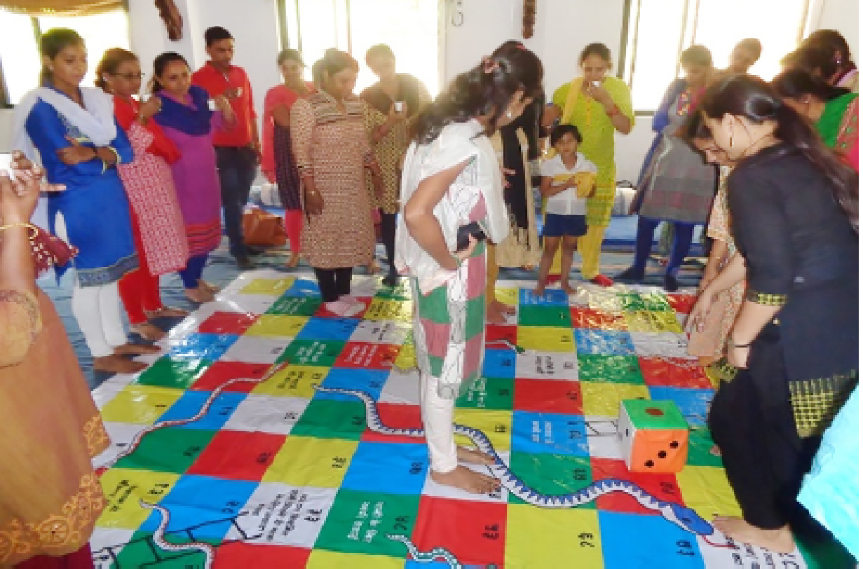
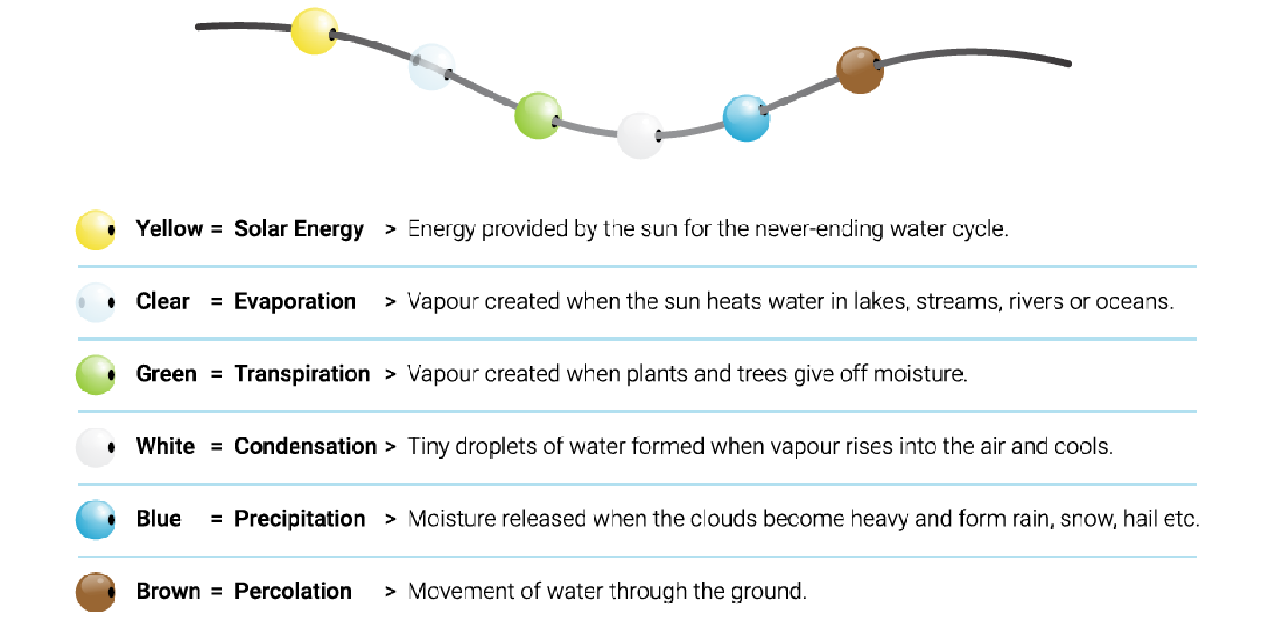
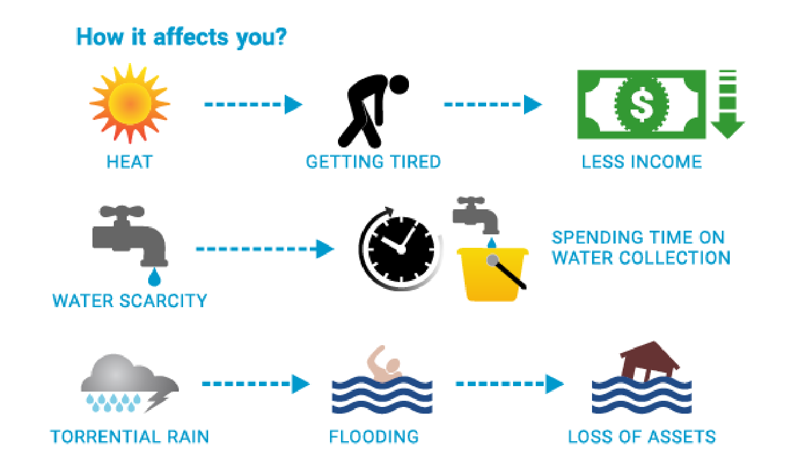
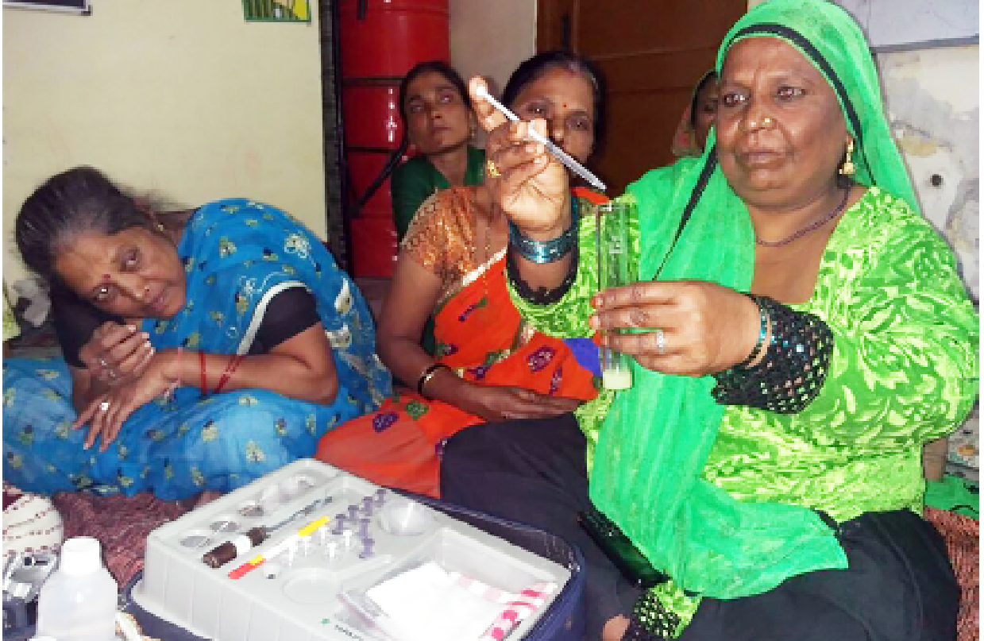
Communication and Knowledge Sharing Tools
Photo: Mahila Housing SEWA Trust
Photo: Mahila Housing SEWA Trust
Notes:
Source: Mahila Housing Sewa Trust (n.d.)
The pictures are for a visual effect only, do not read the content

Slide 14
Step 5: Gender-Sensitive Monitoring and Evaluation
3

Slide 15
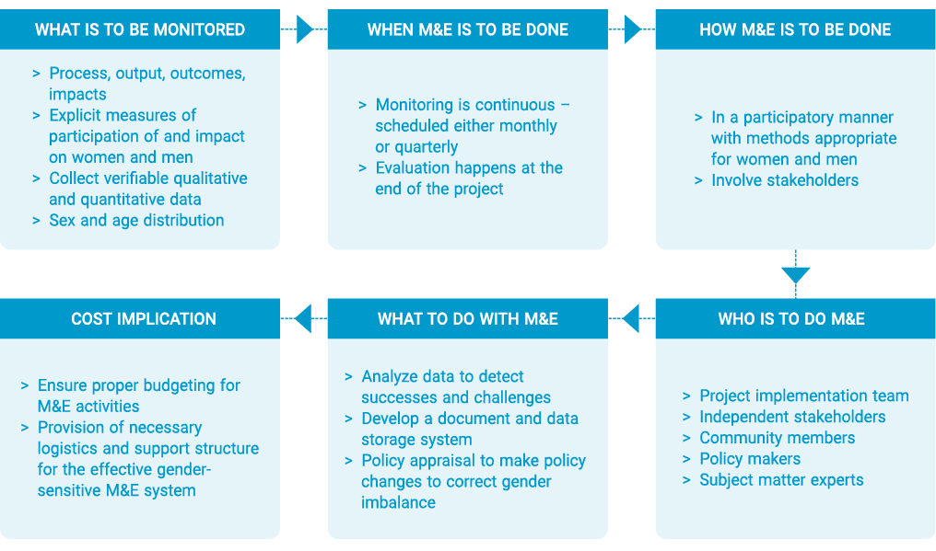
Gender-Sensitive Monitoring and Evaluation (M&E)
Refers to the review of processes and impacts of climate change programs and projects
using a gender lens
that will recognize differentiated outcomes for women and men,
whether planned or not
M & E Framework
Notes:
Source: NEST (2011)

Slide 16
Gender-aware Indicators
Examples of Sex-Disaggregated Indicators for GEF Projects
Tracking sex-disaggregated and gender-aware indicators at all levels of outcomes, outputs, and results are important
Indicators of a gender-integrated approach would also need to reflect the extent to which central or local policies integrate gender perspectives
Projects should also develop and track unintended negative consequences of gender equality policies and programmes
Knowledge filters | Number and percentage of men and women participating actively in consultations, workshops, and committee meetings Number and percentage of men and women serving leadership positions relating to the areas of intervention or in the project context
Benefit Sharing | Number of women and men benefitting from tools and resources Number of women and men benefitting from financial investments due to project interventions
Access to resources and sharing | Number of men and women who have ownership of land in their name Number of women and men in leadership positions related to land, water, forest, etc

Slide 17
Gender Monitoring Matrix
Activity: Community-Based Planning
What to look for | Means of Checking | Warning Signs | How to Check | When | Actions | Who
Number of women participating | CBA meeting records | Less than 20% of participants are women | The person who finalizes the plan document should report the warning sign | Every Quarter | Project Funds based on such CBAs should not be released | Finance person
Number of exercises conducted with women’s groups | CBA document | No exercise conducted separately with women’s group Results not separately documented and analyzed
Notes:
CBA is Community-based adaptation project
Source: NEST (2011)

Slide 18
Insert photo within the green frame
Thank You!

Slide 19
High income poverty and health expenditure
Problem Tree
High burden of Vector-borne diseases on health services
High burden of caring for diseased on women
Consequences
High incidence of vector borne diseases
Problem
Immediate Causes
Homes store water wherein disease causing mosquitoes grow
Individuals who contract malaria or malaria like ailments do not go to govt healthcare facility
Home store water for more than seven days
Schools, workplaces store water for longer periods
Homes, schools and workplaces use one or more techniques of mosquito repellant
Unreliable supply of piped water obviates the need for water storage (thriving vectors)
People now aware of government healthcare facilities for diagnosis and treatment
Community not involved in the process
No awareness on life cycle of disease carrying mosquitoes
Mosquito repellent devices /techniques are not available/ not well publicized
Underlying Causes
Physical system exists
Govt healthcare facility don’t provide comprehensive treatment
No check on water storage practices
Root Causes
Potable water sources exist
Healthcare facilities do not exist and are not functional
Lack of awareness on what causes exposure to disease carrying mosquitoes

Slide 20
Reduced income poverty and improved quality of life
Impact Goal
Solutions Tree
Outcomes
Reduced Burden of Health Services for Vector-borne diseases
Reduced burden of caring for diseased on women
Objective(s)
Reduced incidence of vector borne diseases
Outputs
Homes do not store water and so disease causing mosquitoes do not grow
Individuals who contract malaria or malaria like ailments go to govt healthcare facility
Incidentally stored/ collected water in the neighbourhood is emptied once a week
Homes, schools, workplaces change stored water at least once in 7 days
Homes, schools and workplaces use one or more techniques of mosquito repellant
Activities
Piped water supply scheme is functional
Assured/ reliable supply of piped water so as to obviate the need for water storage (in which disease carrying mosquitoes might thrive)
Awareness raising activities to popularize govt. healthcare facilities for diagnosis and treatment, so as to ensure comprehensive treatment
Community based monitoring systems exist
Awareness raising activities for disruption of life cycle of disease carrying mosquitoes
Mosquito repellent devices /techniques are effective (mosquitoes are not immune)
Physical system exists
Govt healthcare facility provides comprehensive treatment
Neighbourhood cleanliness drives are thorough
Structural Changes
Potable water sources exist
Healthcare facilities exist and are functional
Awareness raising activities for prevention of exposure to disease carrying mosquitoes

Slide 21
CCS Output format
Problem Description | Solutions Description | Indicators* | Responsible Agency
Development Consequences | Impact Goal
Immediate Consequences | Outcomes
Core Problem | Objectives
Immediate Causes | Outputs
Underlying Causes | Activities
Root Cause | Strategies (or Risks)
* You can also define the outputs and outcomes in the form of quantitative and qualitative targets and gender-responsive indicators to get an elaborate M&E framework

Slide 22
Resource and Hazard Mapping
Notes:
Source: FAO (2013)

Slide 23
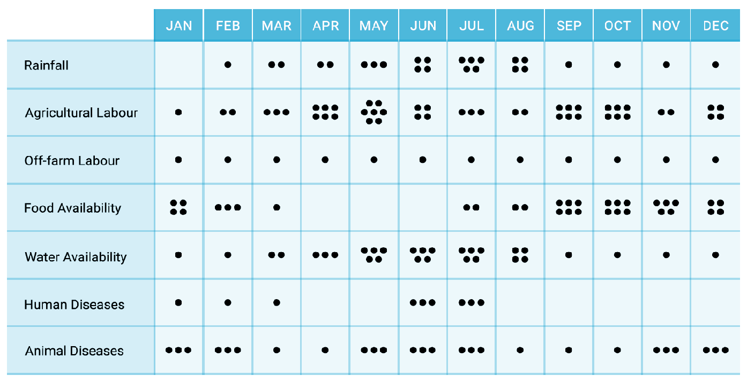
Seasonal Calendar
Notes:
Source: Care International Vietnam (2015)

Slide 24
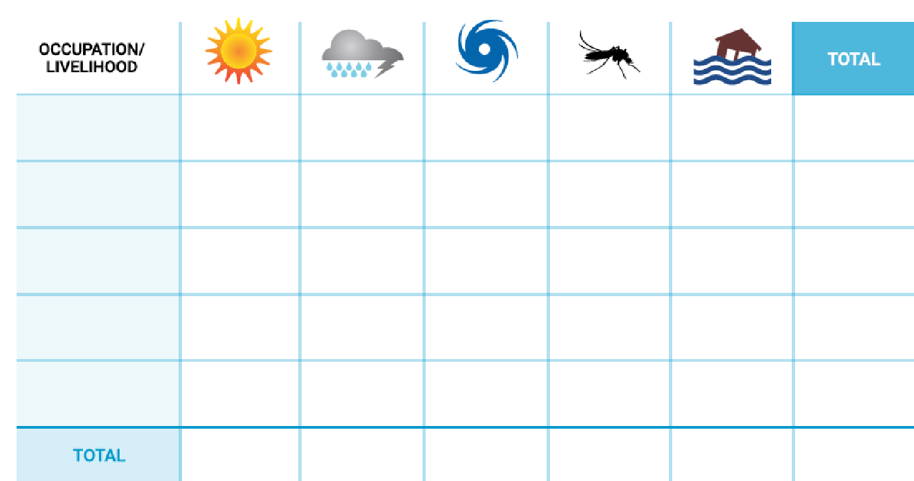
Impact Matrix
Notes:
Source: Mahila Housing Sewa Trust (n.d.)

Slide 25
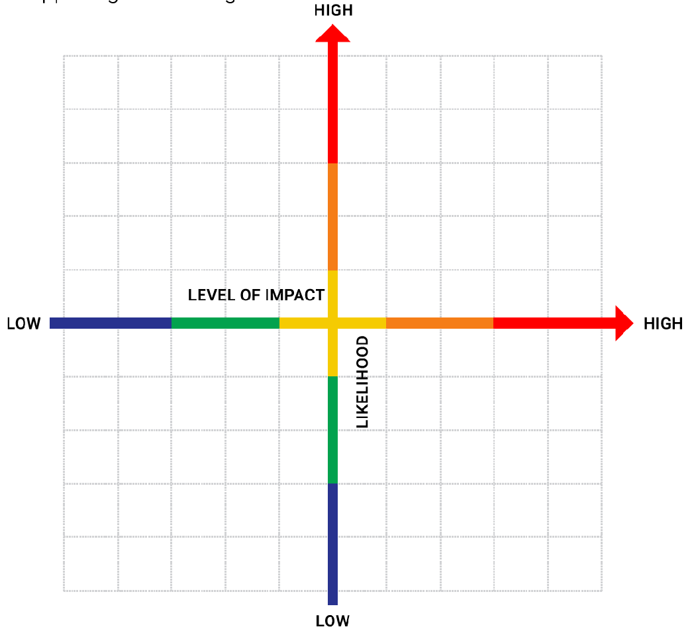
Risk Quadrant
Notes:
Source: Mahila Housing Sewa Trust (n.d.)

Slide 26
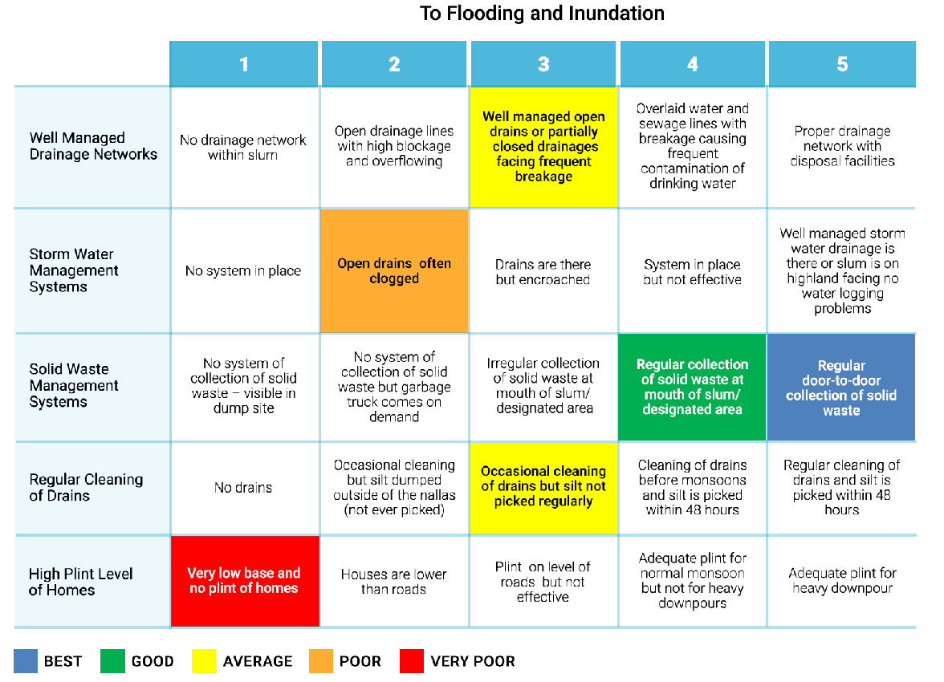
Adaptive Capacity Scoring
Notes:
Source: Mahila Housing Sewa Trust (n.d.)
Visual not to be read

Slide 27
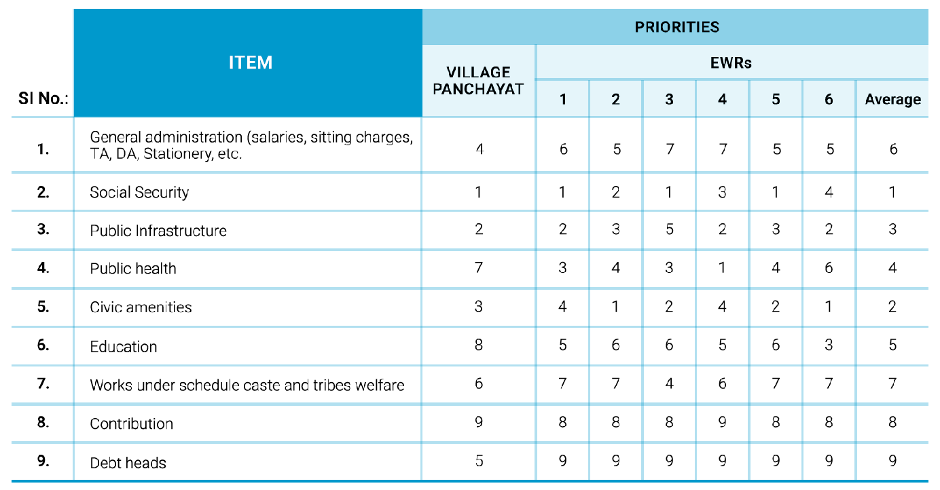
Solutions Prioritization
Notes:
Source: Building budgets from below, Bhat et al (2003)
Visual not to be read

