Slide 1
National Climate Change Adaptation (CCA) and Disaster Risk Reduction (DRR) Policy Frameworks
SESSION 07
(Insert Name and Organisation of the Presenter)
[insert date, month, year | time, time zone]
Notes:
Tentative time for the presentation: 20 minutes
More information: UN Women Training Manual on Gender and Climate Change Resilience (Pages 85-90 and 92-104)

Slide 2
National Adaptation Programmes of Action (NAPA)
Adopted in Marrakesh COP 2001
NAPAs provide process for the LDCs
to identify priority activities that respond to their urgent and immediate needs
wherein delays in meeting those needs could significantly increase the vulnerability
or lead to higher costs at a later stage
on adapting to climate change
Once a NAPA is submitted to the UNFCCC Secretariat,
the LDC Party is eligible to access funding
under the Least Developed Countries Fund (LDCF)
managed by the Global Environment Facility (GEF),
for the implementation of the NAPA
As of December 2017, 51 countries had completed and submitted their NAPAs to the UNFCCC Secretariat

Slide 3
Key features of NAPA
Identification of specific climate-related vulnerabilities, and immediate and urgent adaptation needs of the LDCs
A multidisciplinary approach that builds on existing plans and programmes with the aim to mainstreaming NAPAs into development planning
Not research-based, with stress on participatory processes. NAPAs build on existing information with community input as an important source
Contain a list of ranked priority adaptation activities and projects, with short profiles of each to assist in the development of proposals for implementation
Action-oriented, country-driven, flexible, and based on national circumstances
Presented in a simple format, easily understood both by policy-level decision-makers and the public

Slide 4
Gender mainstreaming in NAPA
Key questions for review at national level
What are the key vulnerabilities identified?
Have women’s priorities and concerns at the country level been identified and included?
What are the activities prioritized in the country’s NAPA?
Who stands to benefit from these activities?
How would the livelihoods of men and women be affected by these options?
Are women’s time poverty concerns included?
How were community inputs gathered in the preparation phase?
Who participated in the process?
Were women and men at the grassroots level both involved in the consultation processes
Notes:
Examples:
In countries like Bangladesh and Malawi gender equality was a criteria for selecting projects
Interventions focusing on empowering women through access to microfinance, ensuring easier access to water and energy sources, and developing a rural electrification programmes, etc
In Eritrea one type of projects particularly targeted female-headed household
In Malawi, women’s NGOs were consulted during the preparation of the NAPA. In Bangladesh Indigenous women participated in the NAPA process. In Eritrea too, women’s groups participated in the development of the NAPA.

Slide 5
National Adaptation Plan (NAP)
NAP process was adopted in 2011 in Durban
In 2012, UNFCCC experts group developed a detailed set of NAP technical guidelines to assist developing countries, especially LDCs, with adaptation planning
NAP approach focuses on
Integration with national development planning and inclusion of country-specific plans and solutions
Iterative, ongoing process, not a one-time activity

Slide 6
Key elements of the NAP process
Laying groundwork
Stocktaking of needs, opportunities, entry points, and key resources for adaptation
Establishing a national institutional framework for CCDRR within the country along with a legal or administrative mandate
Preparatory Elements
Risk and Vulnerability Assessments
Review and selection of appropriate adaptation options
Implementation strategies
Sequencing of activities, assigning roles and responsibilities
Financing and capacity building plan
Reporting, Monitoring and Review mechanisms

Slide 7
Gender Responsive NAP Process
Strengthen the mandate for gender using international commitments and national laws
Establish a gender-balanced team
Stocktaking should build on existing information and knowledge on gender
Facilitate gender analysis and gender aware-vulnerability assessments
Ensure gender-inclusive stakeholder engagement
Prioritize adaptation actions across different genders and social groups
Use “contribution to gender equality” as a criterion
Ensure sex-disaggregated data and gender-sensitive language across all communications and reports
Notes:
Source: Daze and Dekens (2017)

Slide 8
Nationally Determined Contributions (NDCs)
Prior to the Paris Agreement in 2015, each signatory country was invited to outline the domestic climate actions they intend to take under the new agreement
These outlines are known as Intended Nationally Determined Contributions (INDCs)
INDCs reflect a country’s ambition by indicating the steps that the government will take to address climate change and foster transparency, accountability, environmental integrity, and capability
INDCs turned into Nationally Determined Contributions (NDCs) once the country formally joined the Paris Agreement
There is also a provision for a five-year review and update of the NDCs
As of January 2021, 190 Parties had submitted their first NDC and eight Parties their second NDCs
With the five-year review cycle of the NDCs being in process, it is an opportune time for integrating gender equality into national climate change planning and action

Slide 9
Gender Responsive NDCs
Building Blocks for Gender Responsive NDCs
National Analysis and Consultations
Institutional Frameworks and Coordination Mechanisms in place
Alignment of National Policy and Planning Instruments
Monitoring and Evaluation
=> Analyse national context for gender trends, SADDD
=> Identify key sectoral action points
=> Assess Institutional Gender Equality Frameworks
=> Review integration of women's participation and leadership
=> Review Gender integration in NAP
=> Consultations with women and women's organisations
=> Support capacity building on gender
=> Use SADDD for M &E
=> Advocate for gender responsive finance mechanisms and budgeting (GRB)

Slide 10
Gender and Climate Change National Focal Point
Point-of-contact for questions on thematic issues e.g. climate finance and gender
Coordination of the country delegation’s positions on gender within the gender and climate change agenda item and other thematic areas at UNFCCC
Awareness-raising and capacity-building at a national level on gender and climate change issues (on request and subject to resources and availability
this could be done in collaboration with e.g. secretariat, Women and Gender Constituency or other entities)
Coordination at the national level for climate planning e.g. between ministries on climate change and those dealing with gender, and to better connect the UNFCCC process to national processes
Participation in networking and capacity-building events organized by other entities in support of the UNFCCC process
Notes:
Source: https://unfccc.int/sites/default/files/resource/NGCCFP_Workshop_PolicyOverviewandTools.pdf

Slide 11
National Focal Point continued
Point-of-contact for the secretariat (and others) to communicate about relevant events, information, training etc.
Raising awareness and tracking progress on gender-responsive climate plans and communication (NDCs, NAPs, national communications etc.)
Tracking progress on your delegation’s goals on gender balance at UNFCCC and other meetings
Advocating for gender balance in the country’s delegation’s or Group’s nominations to constituted bodies and Bureaux
Notes:
Source: https://unfccc.int/sites/default/files/resource/NGCCFP_Workshop_PolicyOverviewandTools.pdf

Slide 12
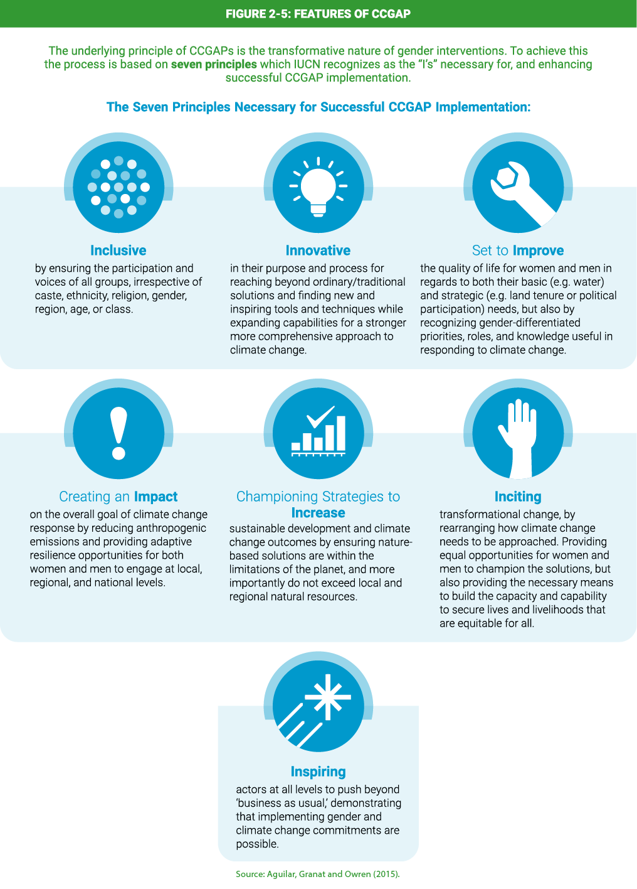
Climate Change and Gender Action Plans (ccGAPs)
Is initiated on the demand of the focal Ministry for Climate Change in the country
Understanding of the political, governance, socioeconomic, and environmental circumstances
Capacity building on targeted themes is key to ensure strong engagement and ownership
Facilitating a meaningful participatory and multistakeholder process
Notes:
Source: Aguilar, Granat and Owen (2015)

Slide 13
Gaps and Challenges to Gender Mainstreaming in National Climate Change Policies
1
2
3
4
Ambiguous institutional mechanisms and imbalance in participation
Knowledge and capacity gaps
Ineffective implementation
Limited review and reporting mechanisms

Slide 14
Insert photo within the green frame
Thank You!

