Slide 1
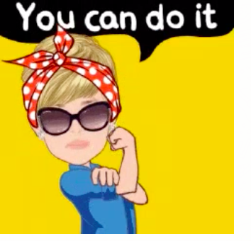
Action Coalition on Economic Justice and Rights
Youth Activism Accelerator

Slide 2
What is economic justice?
Economic justice and rights refer to how economic and political systems are designed, how their benefits or costs are distributed, and how institutions are held accountable for the economic outcomes they generate.
This theme encompasses the full spectrum of paid and unpaid labor and women’s access to and control over productive resources and economic opportunities, and addresses macro and microeconomic factors that reinforce gender inequalities, and how women and girls often lack the rights and access to economic opportunities.

Slide 3
Key Action Points of EJR Coalition
Action 1 - By 2026, increase the number of countries with a comprehensive set of measures including through investments in gender-responsive public and private quality care services, law and policy reforms and the creation of up to 80 million decent care jobs to recognize, reduce and redistribute unpaid care work and reward and represent care workers, while guaranteeing their labour rights.
Action 2 - Create an enabling legal and policy environment and engage women to expand decent work in the formal and informal economy to reduce the number of working women living in poverty by 2026.
Action 3 - Expand women’s access to and control over productive resources through increasing access to and control over land, gender-responsive financial products and services, and the number of firms owned by women by 2026. In doing so,
Secure access to ownership and control over land and housing is increased for 7 million women;
The gender gap in women’s financial inclusion is reduced to 6% by increasing both formal and informal financial inclusion;
The number of women's economic empowerment national programs integrating digital financial services and participation through gender-responsive platforms is increased by at least 50%;
The number of firms owned by women is increased by 25%.
Action 4 - Design and implement gender-responsive macro-economic plans, budget reforms and stimulus packages so that the number of women and girls living in poverty is reduced by 85 million including through quality public social protection floors and systems by 2026.

Slide 4
Poll: Which Action you would like to begin working upon in your region?
Open Menti.com
Input access code: 3995 1523

Slide 5
IDEATE for ACTION II:
"Create an enabling legal and policy environment and engage women to expand decent work in the formal and informal economy to reduce the number of working women living in poverty by 2026."

Slide 6
What is our idea of Decent Work and Employment, which resonates with the younger women today?

Slide 7
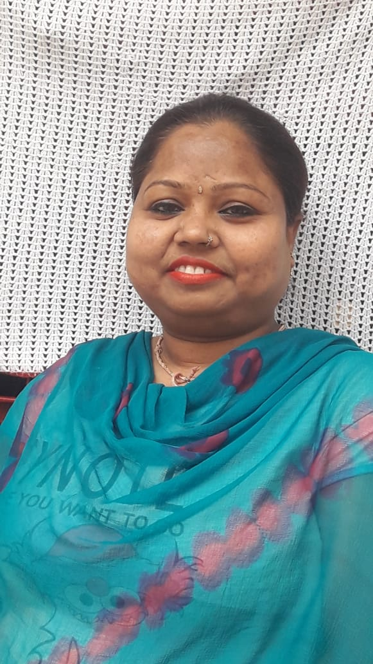
Neha Jalwania
Grassroot Researcher, SEWA Bharat
Neha Ben is from Delhi, she has studied till 12th grade, currently working grassroot researcher, SEWA Bharat. She had stints working with aari embroidery and mehendi applications. Her association with SEWA continued and she became an aagewan. This greatly enhanced her natural leadership abilities and gave her the confidence to manage people. In the COVID pandemic and subsequent lockdowns, she has been a pillar of strength for the women in her area and helped not just coordinate relief efforts. She is a caregiver to her parents, as well as a mother and wife, but most importantly she is a leader who constantly hustles because the problems faced by the women around her drives her to do more.

Slide 8
What is missing in the legal and policy environment of your country and what strategies can be used to create an enabling environment?

Slide 9
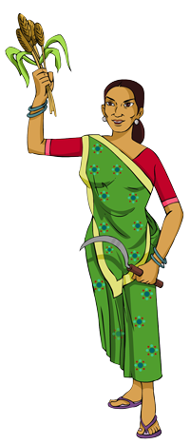
MAKAAM
MAKAAM, or Mahila Kisan Adhikaar Manch (Forum For Women Farmers' Rights) is a nationwide informal forum of more than 120 individuals and organizations of farming women, of women farmers' collectives, civil society organizations, researchers and activists, drawn from 24 states of India, to secure due recognition and rights of women farmers in India.
Patriarchy affects women farmers in several ways – Resource ownership, mobility, load of work, access to information and services, gendered farm activities, decision making process among other aspects
Thematic areas we have actively engaged with - Identity and Recognition, Land rights, Access to natural resources such as Water, Forest rights, Farm suicide affected households, Agro-ecology, FPOs, Impact of COVID 19

Slide 10
STATUS OF WOMEN IN FARM SUICIDE AFFECTED HOUSEHOLDS
Gendered nature of the agrarian crisis but women farmers invisibilised!
Increase in men suicides increase women headed households with an additional burden of running the home and the farm, single handedly with little or no access to resources and decision-making process

Slide 11
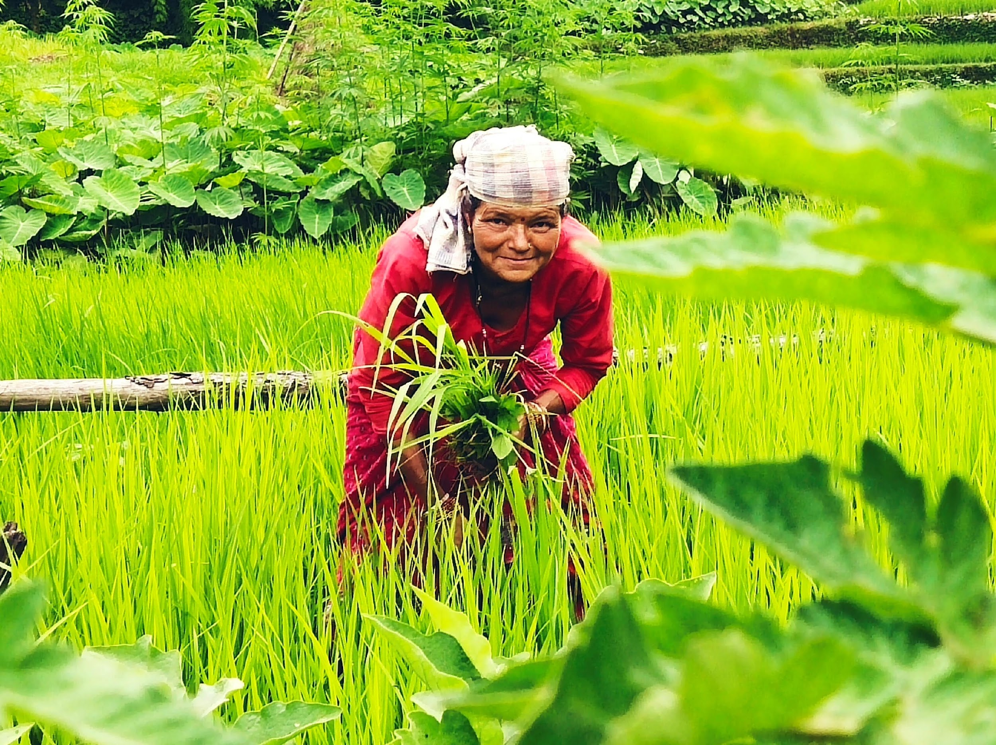
What does ‘DECENT WORK’ mean for women farmers from farm suicide affected families?
RIGHTS
Land rights
Widow pensions
Violence and harassment faced by families, revenue officials
Assistance in marketing produce as markets are patriarchal spaces
Subsidized ration supplies
REPRESENTATION
Lack of the affected women and their experiences in the decision-making process to inform policy
No follow up on entitlements received
RECOGNITION
One time ex gratia compensation difficult to obtain – left with onus to ‘prove’ the suicide, prove ‘farming family’
No eligibility, no compensation
Agricultural laborer, shared croppers etc. left out
RESOURCES
Current loans not waived, especially by nationalized banks or registered institutions

Slide 12
Major demands put forth by MAKAAM
The major demands put forward by Makaam based on the recommendations that came from state level studies were broadly categorized into four categories
a) comprehensive policy for ‘recognizing’ the suicide as a suicide in a farming family and coming up with a detailed data base of women farmers from farmer suicide affected farmers;
b) bringing out a relief and rehabilitation package to include compensation, pension and other social security schemes and support for economic rehabilitation; waiving of all the outstanding debts of these families within a time limit; government orders needs to be issued to secure land and property rights for women from these families;
c) addressing the old and other pending cases where that have not been supported by government especially for compensation and
d) prevention of suicides where measures such as setting up helplines like Kisan Mitra and setting up Mahila Kisan Resource Centres and promoting ecological agriculture are put in place.

Slide 13
Tools and strategies
Evidence gathering by way of state studies in 6 states highly affected by farm suicides
Engagement with different government officials, departments and mobilizing state and national machinery at various levels.
Press conferences, online campaigns, rallies - visibility on the issue
National Consultation hosted by MAKAAM and UN Women in January 2020 where women farmers from farm suicide affected households themselves shared their issues and placed their demands

Slide 14
OUTCOMES
Maharashtra passed a Government Resolution in 2019 based on MAKAAM’s work since 2016 on easing the process of getting the land deed (7/12 document) on the woman’s name, priority in social security schemes, education for her children directed at different departments.
Maharashtra government in terms of issuing identity cards for women from farmer suicide affected families to access the entitlements; Karnataka giving 'farm widow' pensions and Andhra Pradesh, which has re-opened old pending cases since 2014, of every suicide affected family that was deemed non-eligible for compensation were raised in the consultation which can be followed by other state governments.
Mr Belagurki, Chairperson, Karnataka Agriculture Price Commission to specifically deal with the challenge of marketing that women farmers face, especially single women, proposed a mobile procurement mechanism, Fixed deposit suggestions were made for the compensation and the amount of collateral-free institutional loans should be beyond the current ceiling of one lakh rupees and should be increased to 5 lakhs by RBI, so that livestock and other such livelihood sources can also be covered.
The issue of a lack of identity cards for women is of utmost importance, according to Dr. Gorhe, Deputy Chairperson, Legislative Council of Maharashtra and Chairperson Stree Adhar Kendra. It was this understanding that prompted the Maharashtra government to issue a common Government Resolution, addressing 9 departments (incl. forest and agriculture) to prioritize the needs of the women farmers in farm suicide families.

Slide 15
Timeline of the campaign
Government Resolution passed by Maharashtra to make access to land rights for women easier, social security benefits
Tamil Nadu came out with the first report on the status of women from
farmer suicide affected households.
National Consultation at New Delhi with UN Women
1995
2017-2018
2018
2019
2019-2020
2020
State studies carried out in 6 states to articulate issues of women from farm suicide affected families and place their demands
National Crime Records Bureau started recording farmer suicide numbers and this was recognized as a phenomena
Consultations held in Nagpur and Aurangabad supported by the MSCW

Slide 16
Tools and Resources
Action Coalitions: Global Acceleration Plan Executive Summary
Economic Justice and Rights: Action Coalition
Grind of Work: Ela Bhatt
http://makaam.in/ for policy notes

Slide 17
Thank you!

Slide 18
Key Action Points of EJR Coalition
Action 1 - Increase women’s economic empowerment by transforming the care economy
Action 2 - Create an enabling legal and policy framework to expand decent work and employment in formal and informal economies
Action 3 - Increase women’s access to and control over productive resources
Action 4 - Promote gender transformative economies and economic stimulus, through quality social protection systems

Slide 19
Today, 740 million women globally work in the informal sector, where job insecurity, low earnings and harsh working conditions and hours are prevalent

Slide 20
The gender gap in labor force participation BEFORE COVID-19 has not shifted in 30 years. For three decades it has stagnated at 31 percentage point gap.

