Slide 1
Zonta Club of Kathmandu’s Work on Youth Activities

Slide 2
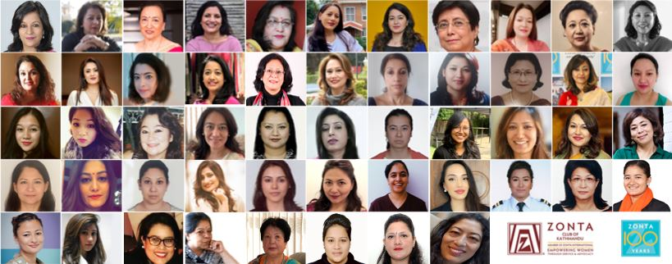
Zonta Club of Kathmandu
Established in 2012
Represented by women leaders from diverse backgrounds
To provide service for local community
Following the mission of Zonta International, “Empowering women through service and advocacy”

Slide 3
Zonta Club of Kathmandu Projects

Slide 4
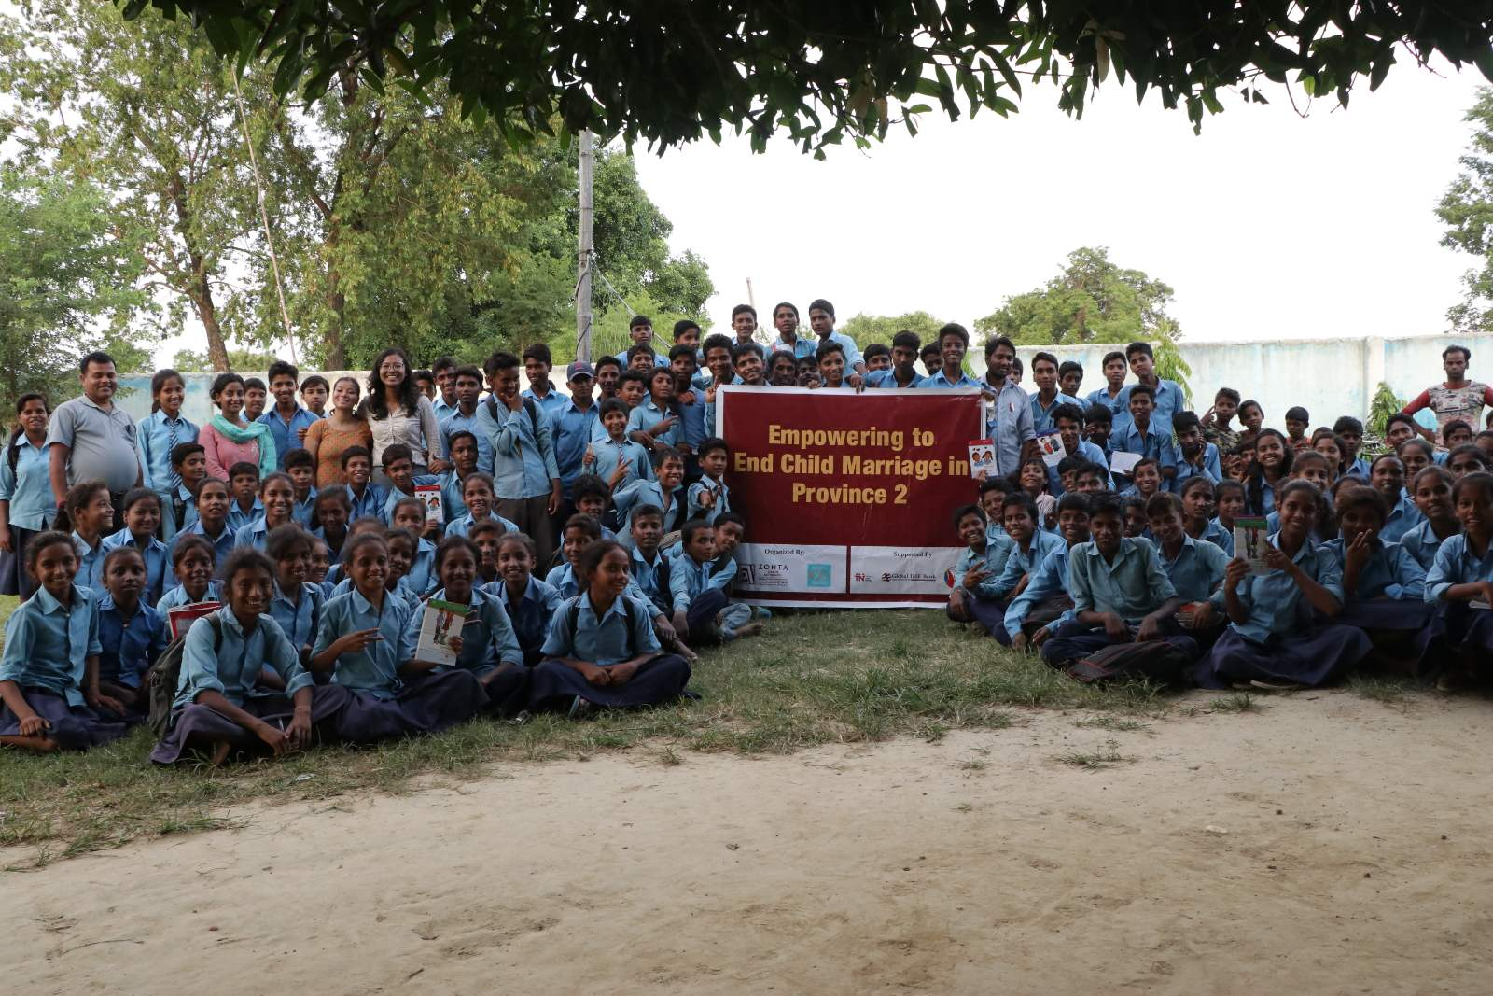
Awareness Program to End Child Marriage

Slide 5
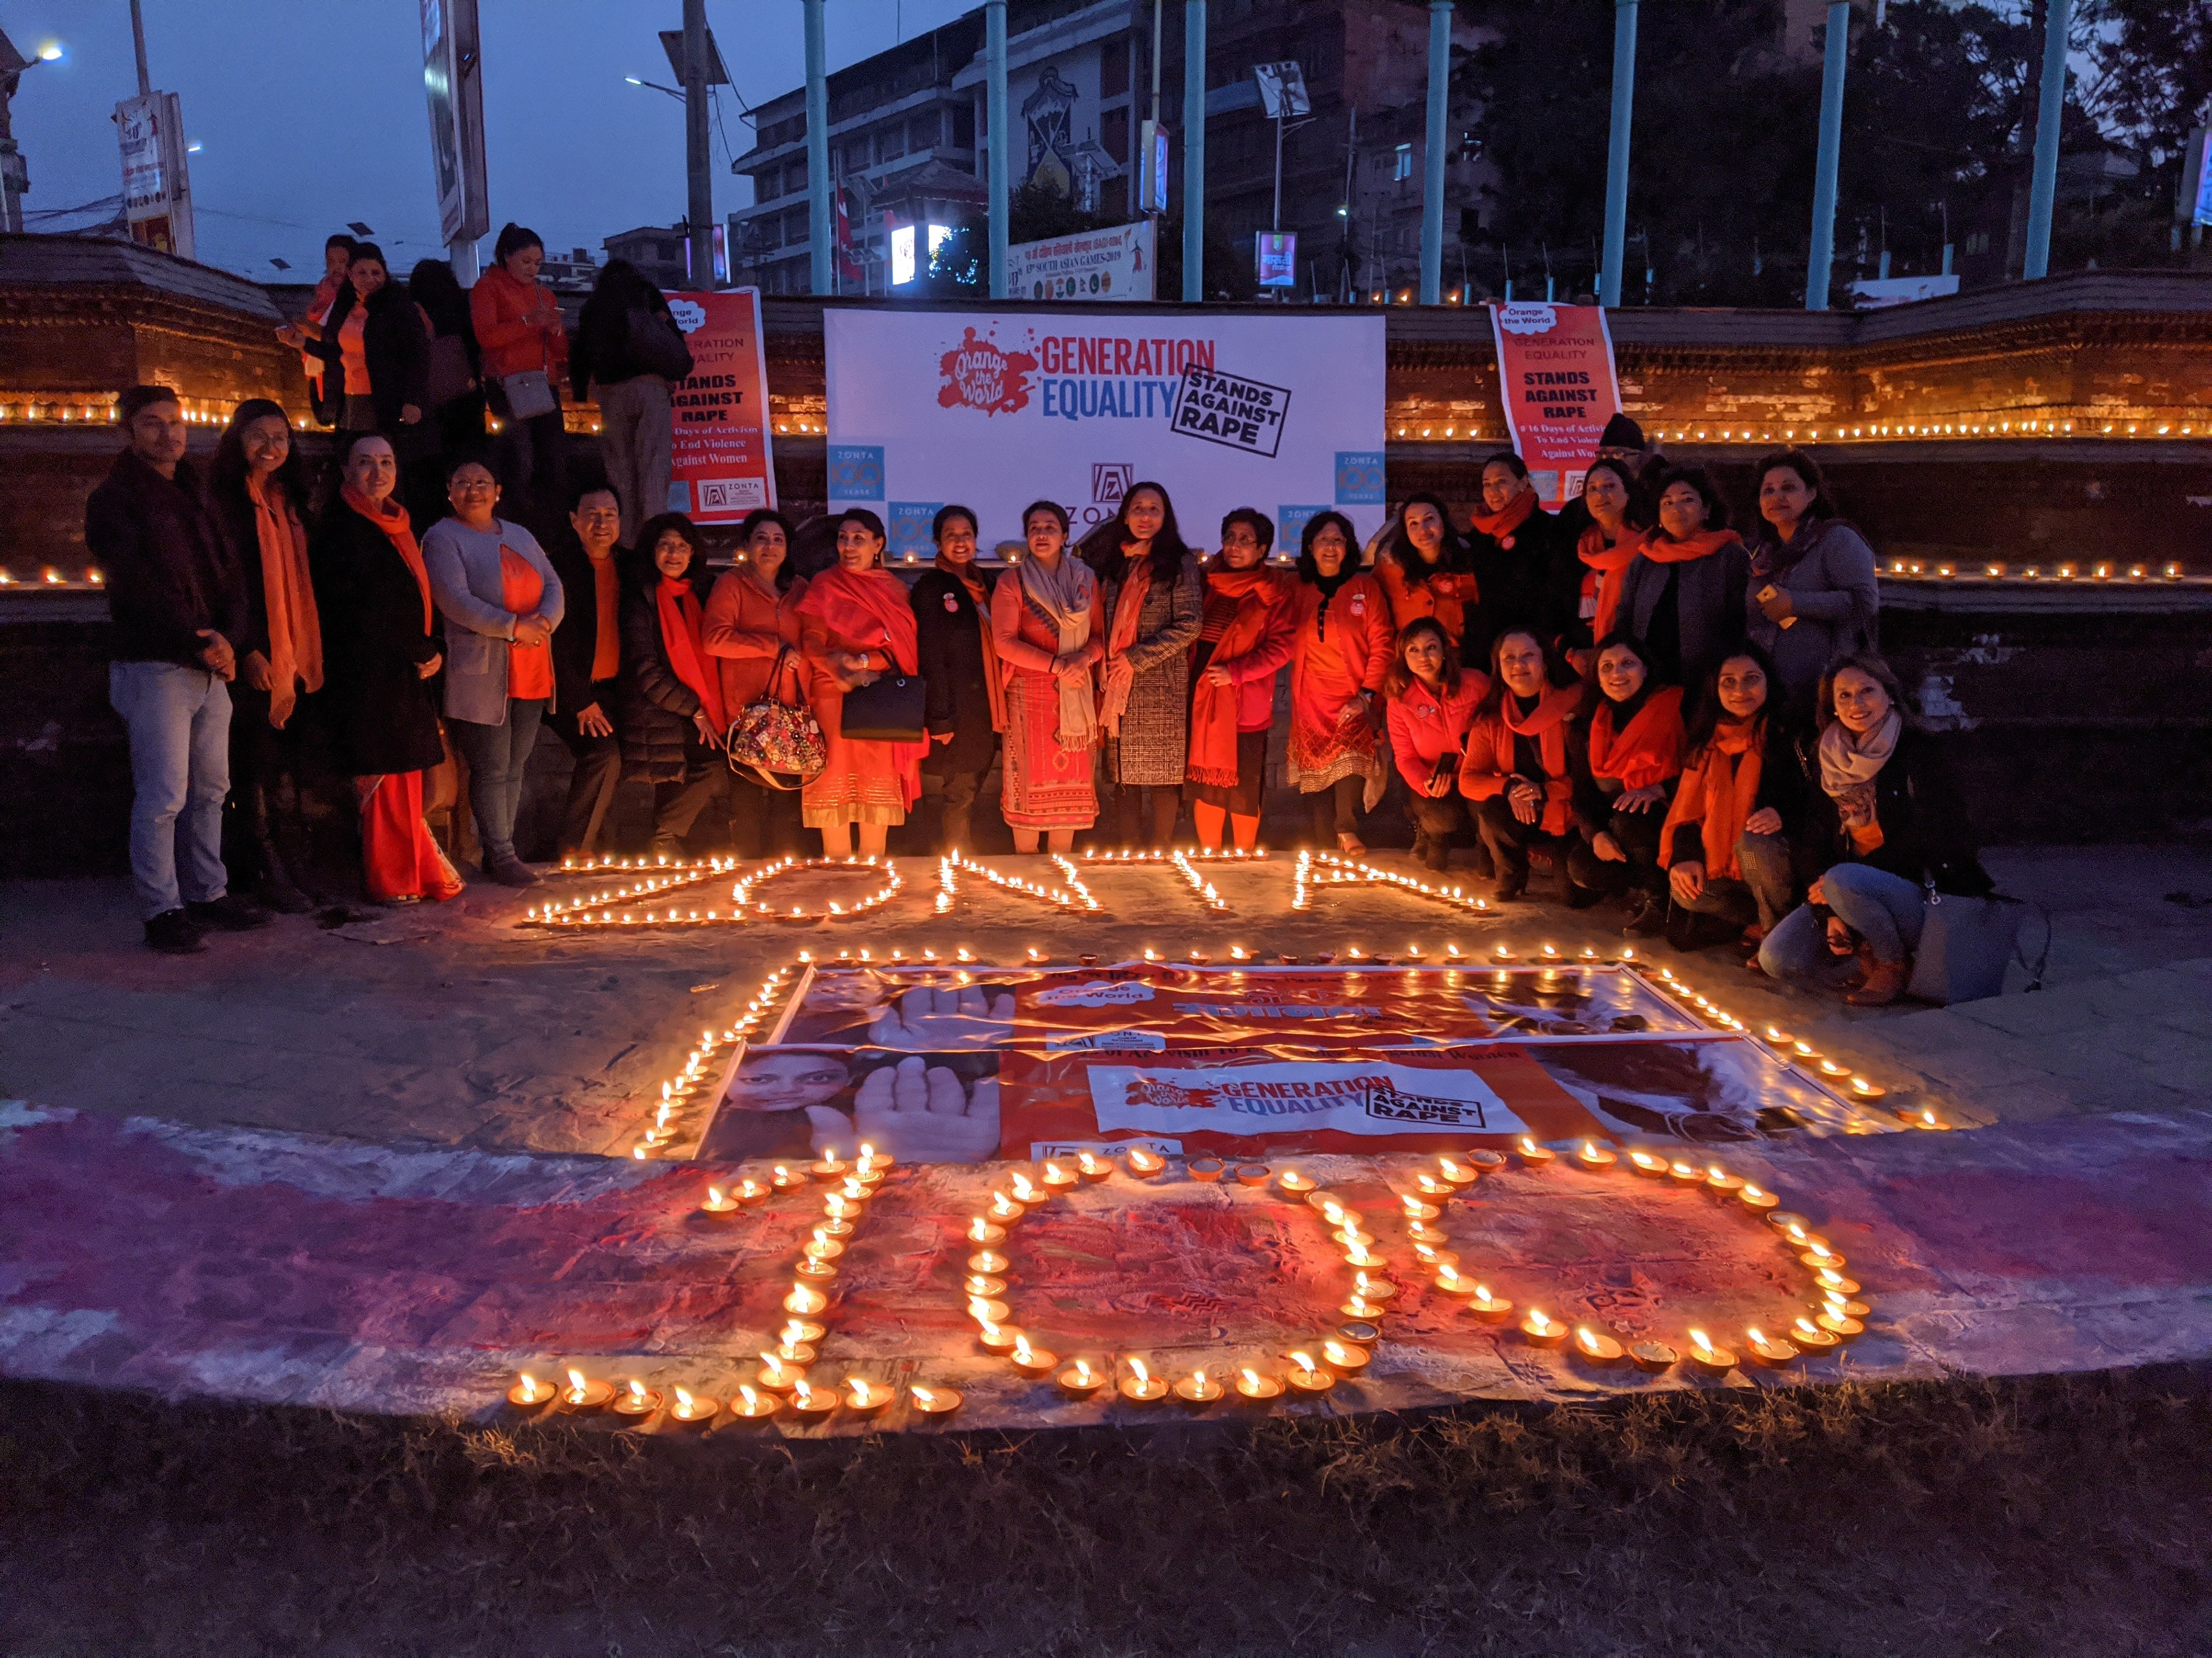
16 Days Activism on Violence Against Women - Candle Walk & Candle Lighting

Slide 6
16 Days Activism on Violence Against Women Campaign & Webinar for Youth

Slide 7
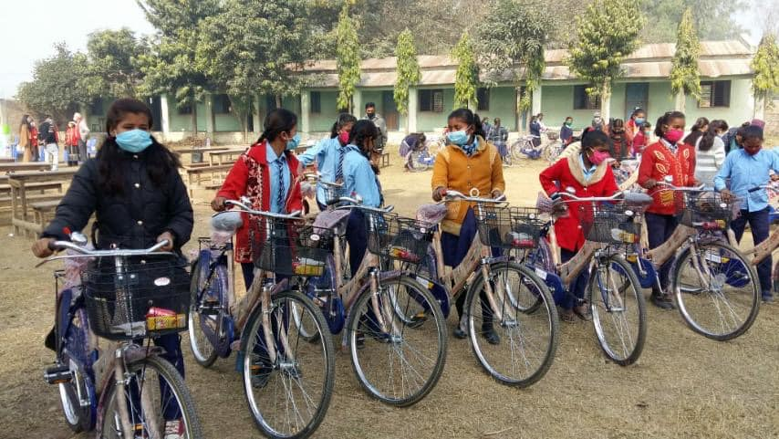
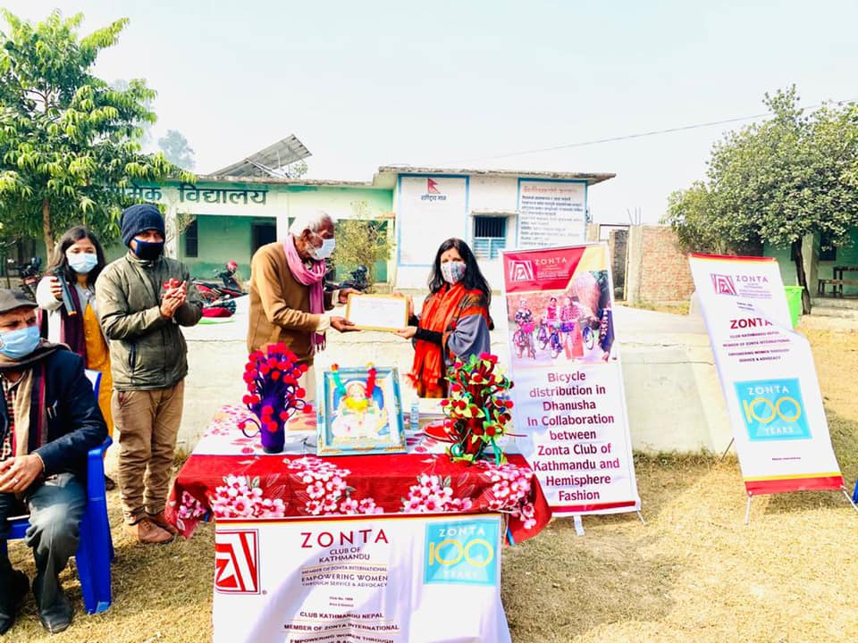
Cycle Distribution to Schools in Dhanusha

Slide 8
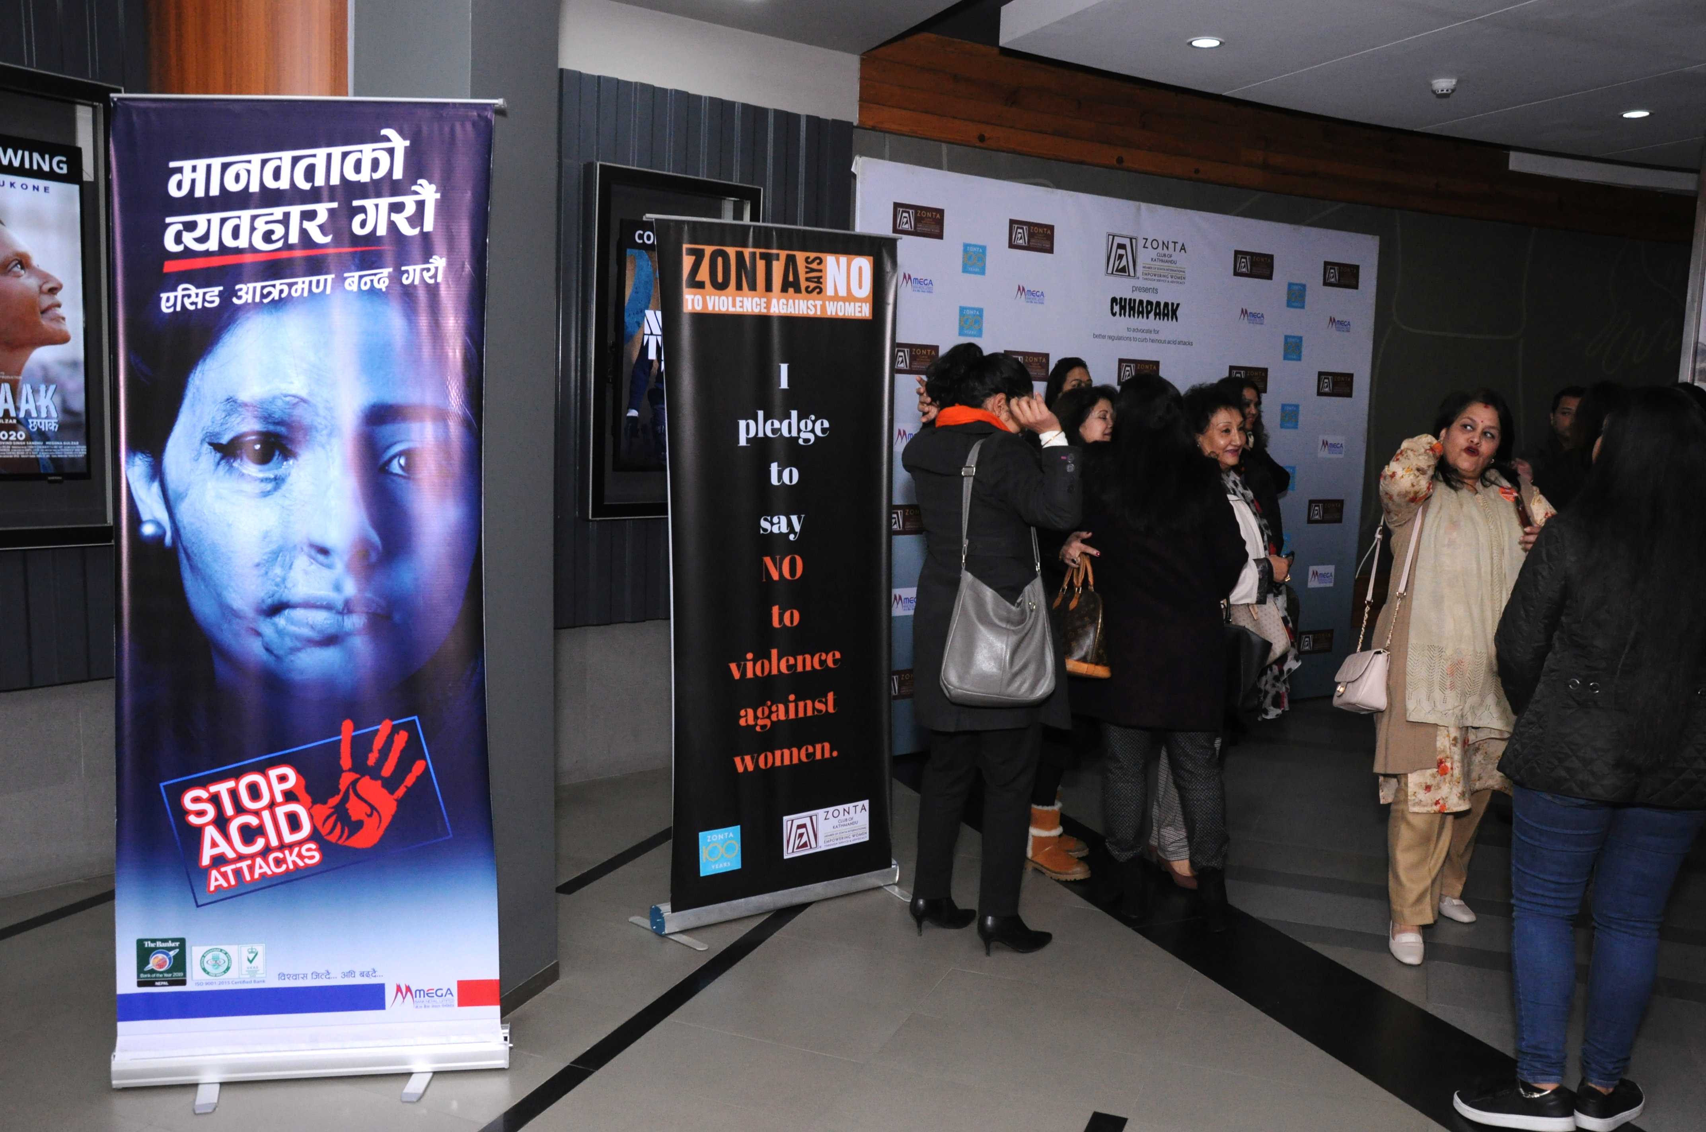
Fund Raiser & Awareness Program in Support of Acid Attack Victims

Slide 9
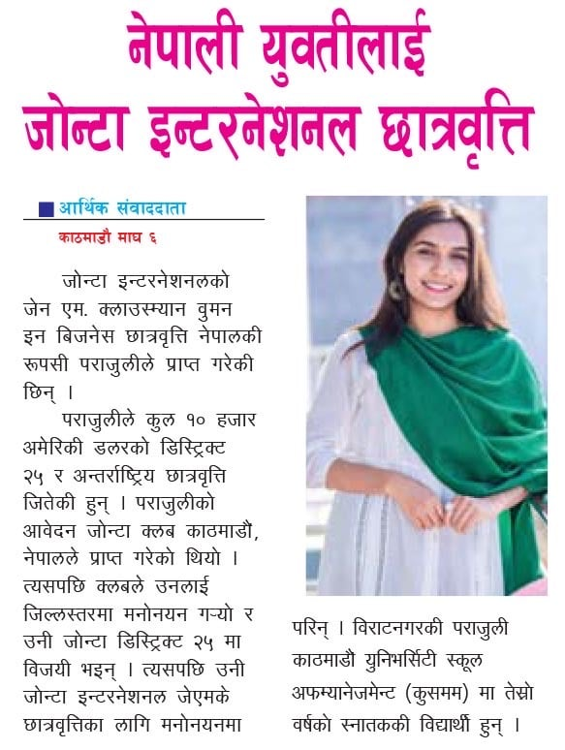
Rupsi Parajuli – Jane M. Klausman Women in Business Scholarship Recipient (Top 6 – Winner in District and International)

Slide 10
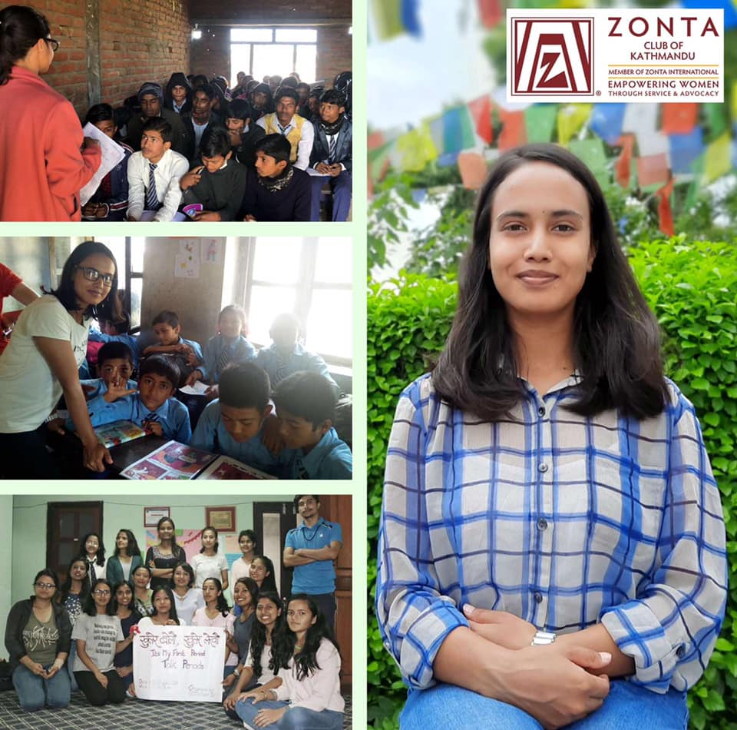
Dipisha Bhujel– Young Women in Public Affairs Award Recipient (Top 10 Zonta International)

Slide 11
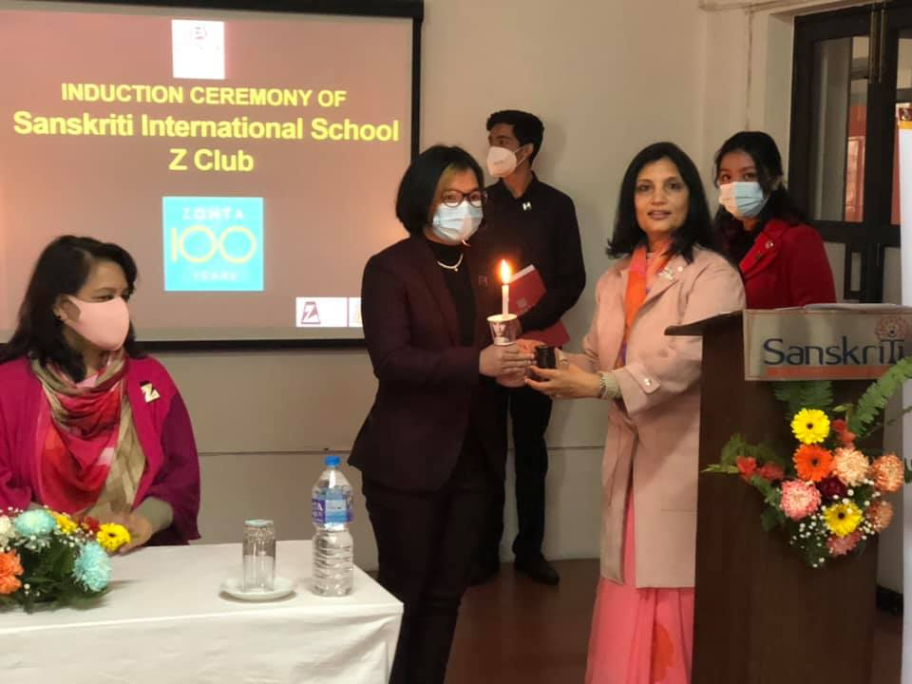
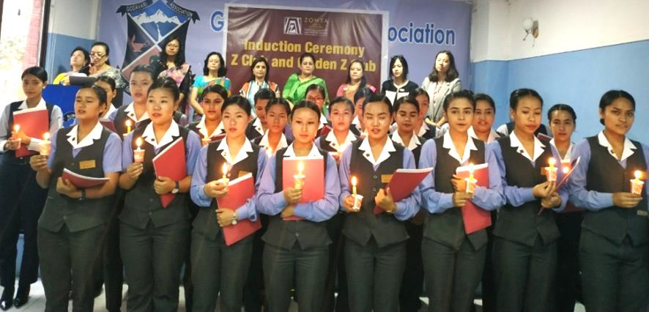
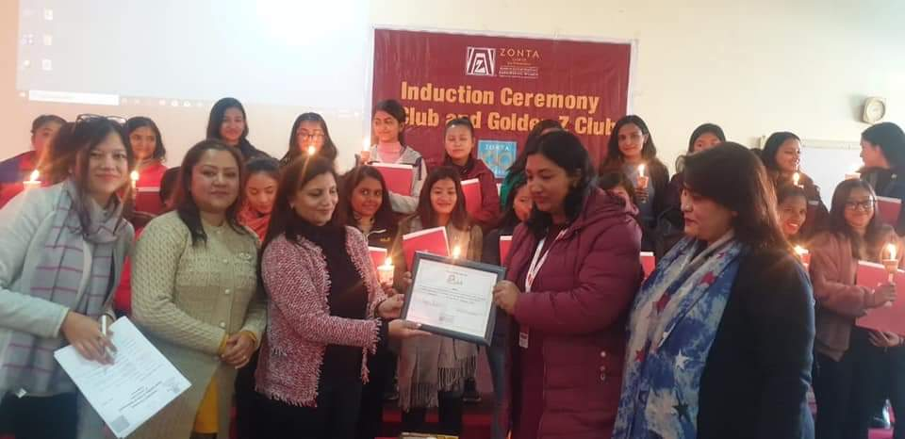
Z Club and Golden Z Club Clubs
Induction Ceremony of The British School
Z Club -
The British School
Sanskriti International School
Golden Z club -
Silver Mountain College
NAMI College
Total: 108 Members
Zonta Club of Kathmandu is proud to have active participation from both female and male students in leadership roles
Induction Ceremony of Sanskriti International School
Induction Ceremony of Silver Mountain College
Induction Ceremony of NAMI College

Slide 12
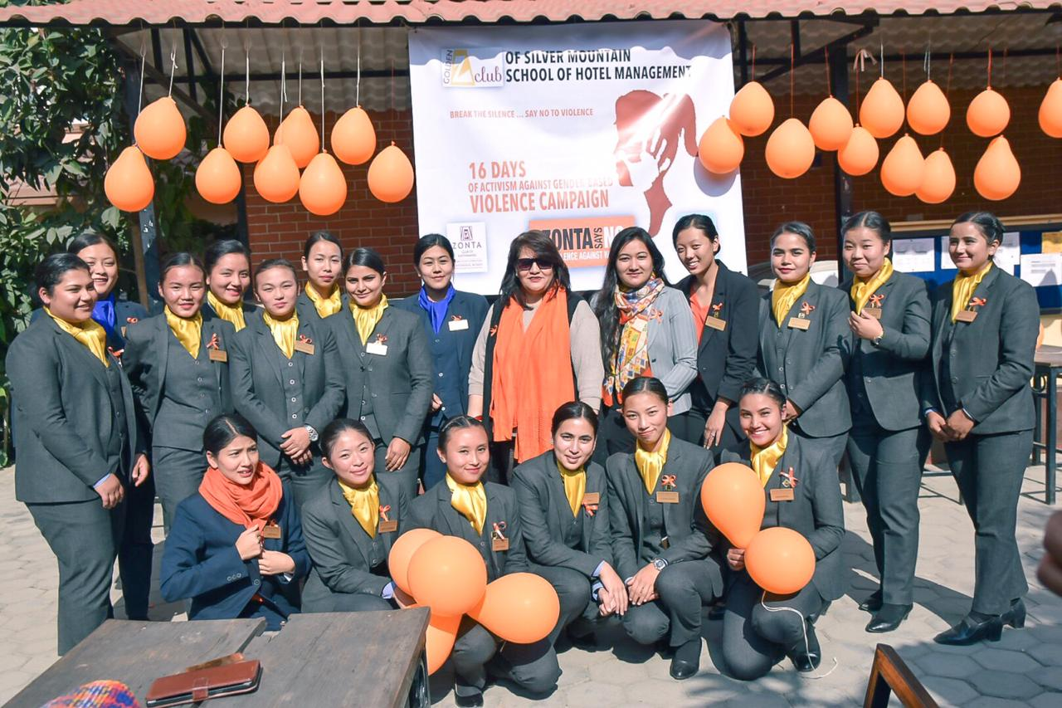
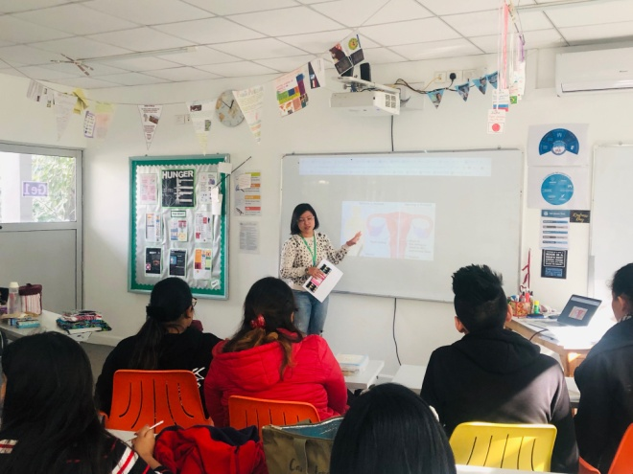
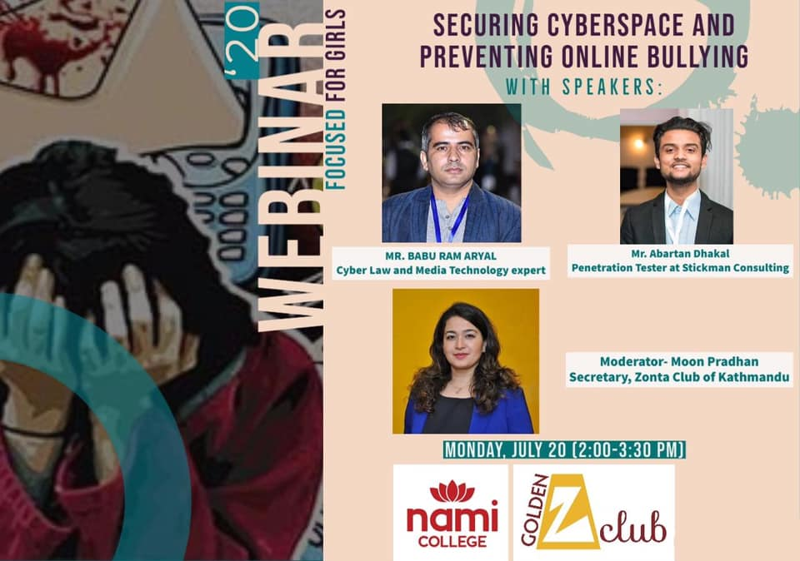
Some of the Z & Golden Z Club Youth Activities
Health Fair to raise funds for awareness campaigns at British School
Violence against women awareness program at Silver Mountain
Training session in coordination with charity, 'We All Rotate' on how to deliver reusable sanitary pad training
Webinar on securing cyberspace and preventing online bullying by Nami

Slide 13
Z & Golden Z Helps Shape Youths - The Future Leaders of Tomorrow
Leadership skills & Personality Development
Exposure
Networking
Career Choices exploration
Doing something that matters

Slide 14
Proposed Plans of Z & Golden Z Clubs for Youth Awareness
Climate change awareness campaigns and talk sessions
Social media campaign to raise awareness about mental health and cyber crimes
Donations of books and clothes to government schools
Collaboration with NGO for awareness on acid attacks and violence against women
Fundraiser to raise money for sanitizers and pads for government schools, orphanage or prison

Slide 15
For More Activities, Please Visit:
www.facebook.com/ZontaKathmandu

