Slide 1
UNCT-SWAP Gender Equality Scorecard Toolkit Resource
What? Case study on coding key activities in the Joint Work Plan using UNCT-GEM (UN Women, 2020). |  | Why? This case study in the form of a PowerPoint presentation showcases how the Kyrgyzstan UN Country Team (UNCT) approached the Gender Equality Marker (GEM) based on the UNCT GEM Guidance (2019) coding at the Key Activity/ Sub-Output level. Further, it lays out what budget thresholds were proposed for the four-point GEM codes, to track financing to advance results related to gender equality and the empowerment of women (GEWE). Lastly, the PowerPoint outlines the key learnings from the UNCT’s experience carrying out this exercise in Kyrgyzstan.
Performance Indicator 6.1 Financial Resources
Approaches Minimum Requirements | Meets Minimum Requirements |  | Exceeds Minimum Requirements
a) The UNCT has carried out at least one capacity building event on the UNCT Gender Equality Marker over the current Cooperation Framework cycle. | Approaches minimum requirements and b) The UNCT has established and met a financial target for program allocation for gender equality and empowerment of women. |  | Meets minimum requirements and c) The UNCT has established and exceeded a financial target for program allocation for gender equality and empowerment of women.

Slide 2
Coding Key Activities in the Joint Work Plan using the UNCT GEM
Case study: Kyrgyzstan
Notes:
By Diana Mamatova, GEM Consultant, mamatova.diana@ unwomen.org

Slide 3
Content
How UNCT members in Kyrgyzstan approached GEM coding at the Key Activity level
What budget thresholds were established per GEM code in order to track financing for GEWE
How UNCT members in Kyrgyzstan applied GEM code to a Key Activity and calculated financial allocations for GEWE (through a joint UN project)
What are the learnings from the Kyrgyzstan experience

Slide 4
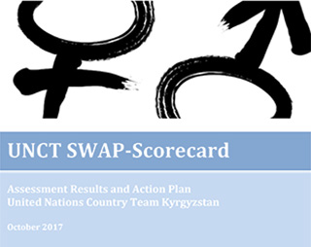
2017
2018
2019
present
The score on financial resources - ‘missing minimum standards’ (2017)
Target of gender-responsive peacebuilding investment 30% (2013-2018)
ONE UN reform (present)
UNCT Kyrgyzstan joined UN INFO platform (2019)

Slide 5
Key challenge was: Agree on definition what legitimately can be counted towards GEWE expenditure and How to calculate?
UNCT GEM Codes and Definitions
Code | Code Definition
GEM-0 | The Key Activity is not expected to contribute to GEWE
GEM-1 | The Key Activity contributes to GEWE in a limited way
GEM-2 | GEWE is a significant objective of the Key Activity’s overall intent
GEM-3 | GEWE is the principal objective of the Key Activity
Methodology on Tracking Financing for GEWE in UN Programming

Slide 6
4 elements
Key Activity/Project level
Results-based: GEM codes + GEWE results
Budget thresholds per GEM code: tracking financing for GEWE
Project cycle: planning, progress, actual (not just planed) GEM code/GEWE results + $$$
4 elements of HOW Kyrgyzstan piloted methodology:
GEM coding
+
$$$

Slide 7
UNCT GEM/INFO:
JWP Outcome level (Outcome indicators)
UNCT GEM/INFO:
JWP Output level (Output indicators)
UNCT GEM/INFO:
JWP Sub-Output/Key Activity level (i.e. project)
Methodology:
Key Activity/Project by agency/agencies
(project outcomes/outputs/
indicators)
Element 1.
Key Activity
Or
Project level
Results chain in JWP
Notes:
Different levels of results chain are inter-linked, so should be GEM codes. If the JWP Outcome/Output level formulations and its indicators are set to be GEM3 as a commitment to GEWE, then the formulation of the JWP Key Activity level should also match and represent GEM3.

Slide 8
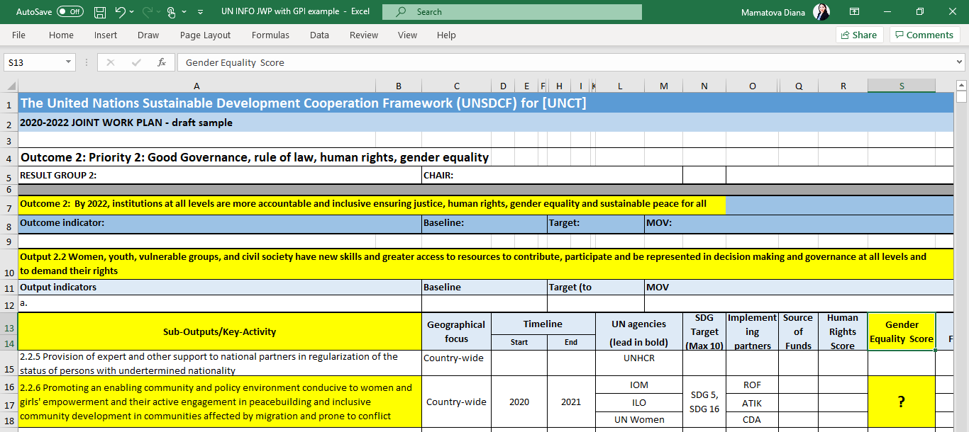
Key Activity / Project level

Slide 9
Key Activity/Project
Project IMPACT/JWP formulation
Key Activity/Project
Project OUTCOMEs/indicators
Key Activity/Project OUTPUTs/indicators
Results chain
in Key Activity/Project
Impact
Outcome
Output
Notes:
Different levels of results chain are inter-linked, so should be GEM codes for Key Activity/Project level. If the Key Activity/Project level formulations are set to be GEM3 as a commitment to GEWE, then the formulation of the Key Activity/Project Outcome and Project Outputs and project indicators should also match and represent GEM3.

Slide 10
Gender Blind/Gender Exploitative (Negative)
Result has no attention to gender, failed to acknowledge the different needs of men, women, girls and boys, or marginalized population. Result has a negative outcome that aggravates or reinforces existing gender inequalities and norms
Gender Sensitive
Gender Responsive
Gender Transformative
Result addresses differential needs of men or women and address equitable distribution of benefits, resources, status, rights but does not address root causes of inequalities in their lives
Result contributes to changes in norms, cultural values, power structures and the roots of gender inequalities and discriminations
Result focuses on the number of equity (50/50) of women, men or marginalized populations that were targeted; recognizes gender differences and attempt to redress existing gender inequalities
Element 2. Results-based: GEM codes + link to GEWE results
The scale is adapted from UNDP’s
Gender Results Effectiveness Scale (GRES)
Notes:
Gender Result Effectiveness Scale (GRES) (by UNDP) was adopted for this methodology to categorize the quality of GEWE results

Slide 11
Element 2. Results-based: GEM codes + link to GEWE results
Element 3. Establishing budget thresholds per GEM code:
tracking financing for GEWE
Notes:
UN INFO does not have budgetary thresholds at the JWP Key Activity level and relies on estimations by UNCT; in our methodology on the Key Activity/Project level we relied on budgetary thresholds per each GEM code/GEWE result

Slide 12
Monitoring GEM codes + tracking $$$: planned progress & actual
Element 4. Looking at the GEM code &
financial tracking across the Project cycle
Stage III:
Closure
Stage I:
Planning
Stage II:
Implementation
How to assign GEM code/ calculate budget in support of GEWE at the planning stage of project design
How to monitor GEM code/ budget spending in support of GEWE during implementation stage of the project
How to confirm GEM code/ calculate actual budget in support of actual contributions to GEWE after the project completion

Slide 13
Piloting the methodology on tracking financing for GEWE in GPI project (gender promotion initiative)
Example of a joint project in Kyrgyzstan:
IOM, ILO, UN Women

Slide 14
Quick poll!
How does your UNCT and/or your UN organization assign a GEM code at the Key Activity level for the UNCT Joint Work Plan (JWP)?
Answer options:
Relevant UN entities look at the title of the programme document which the Key Activity relates to and assign a GEM code based on this
It’s a dialogue process between relevant UN entities (i.e. programme staff, gender focal points, M&E) to assign GEM code based on detailed discussion of the project goal, outcomes, outputs, indicators
UN INFO administrator assigns GEM codes in the UNCT JWP
Don’t know/not sure

Slide 15
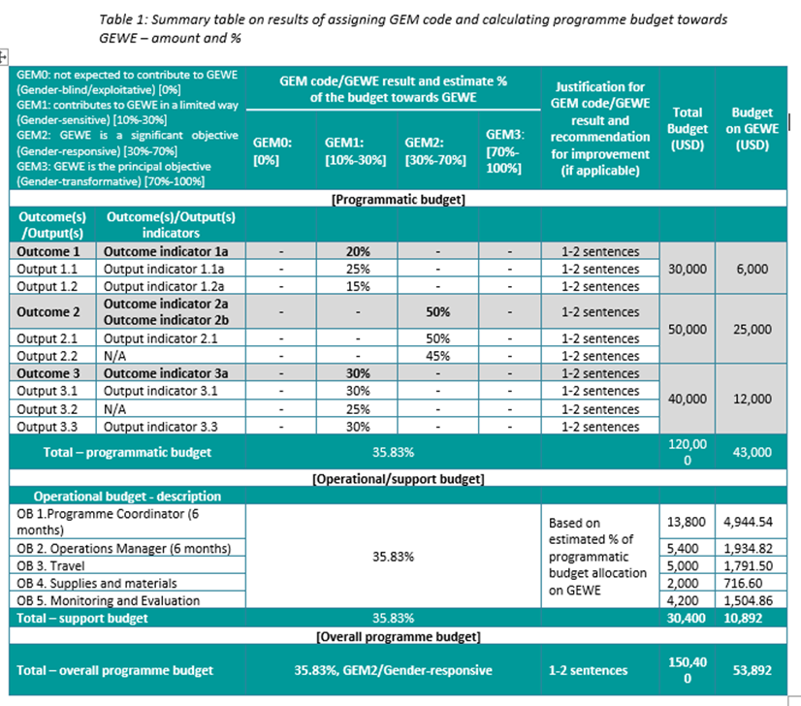
Notes:
Note: Open WORD document and share the screen to present the actual table for GPI project – with the sample of one Outcome

Slide 16
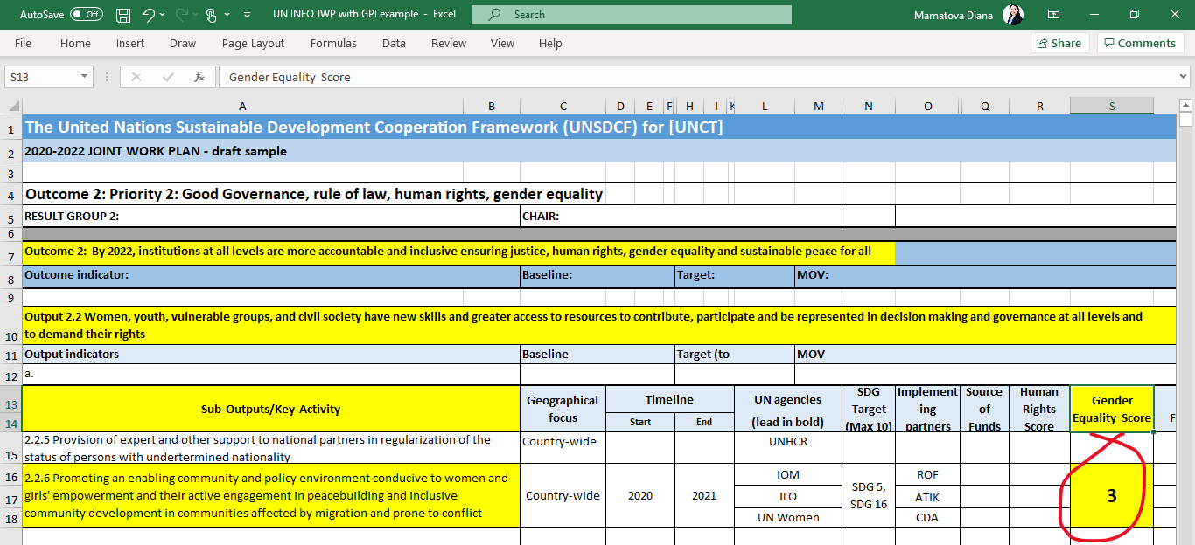
Reflecting a GEM code at the Key Activity / Project level in the UNCT JWP
Notes:
The results of the dialogue, discussion and reflection at the Key Activity/Project level is documented and then reflected in the JWP in a form of identified/assessed GEM code for Key Activity. This GEM code needs to be linked to and reflected in the formulation of relevant JWP Output and JWP Outcome and related indicators.

Slide 17
Learnings from the Kyrgyzstan experience
Uphold commitment and leadership in support of GEWE (UNCT/UN entity)
Apply GEM codes and understand definitions; subjectivity vs objectivity
Decide at which level to apply GEM codes: Key Activity/project level, project outcomes, project outputs, project activities
Notes:
1. Genuine recognition of the importance of GEM and/or a compulsory element
2. Identify quality assurance measures - engage gender focal points, programme team, M&E, finance, GTG
Strengthen capacities on GEM coding and GEWE at the UNCT level
3. Apply GEM codes at the results level of the Key Activity/project – project outcomes and project outputs

Slide 18
Learnings
Discuss formulations at the project planning stage to ensure GEWE considerations; recommend adaptations to meet desired GEWE outcomes
Document joint reflection by writing up justification in a separate document
Adaptive approach: dialogue, collective effort and reflection
Notes:
4. Reflect GEWE considerations in the formulations of project outcomes, project outputs, indicators, project activities
5. Document discussions by providing justification for GEM codes vs. only assigning GEM code in JWP
6. Technical approach: ticking the box exercise

Slide 19
Question prompts – we want to hear from you!
For those who’ve worked on a UNCT Joint Work Plans (JWP), what’s been your experience applying UNCT GEM codes to Key Activities?
For those who’ve not yet been involved in developing their UNCT’s JWP, what opportunities/challenges do you foresee when applying the UNCT GEM?
Has your UNCT taken any steps toward capturing trends and % budget allocations to GEWE – or setting a target?
Discussion and
Q&A
Notes:
E.g., in Viet Nam - The Gender UNCT is considering a target of 15 percent of total expenditure of the OSP to be allocated for gender equality and women’s empowerment in programmatic activities.
UNCT SWAP Gender Equality Scorecard – indicator 6.1 = The UNCT has established and met a financial target for program allocation for Gender Equality and the Empowerment of Women.

