Slide 1
TRAINING: GENDER AND PREVENTING VIOLENT EXTREMISM IN ASIA

Slide 2
Time | Day One | Mode
09:00 – 09:30 | Introductory Session: welcome, scene setting, getting to know you
09:30 – 10:15 | Session 1: Introduction to Gender and Preventing Violent Extremism | Slides
10:15 – 10:30 | Morning Tea
10:30 – 11:30 | Session 1: Group Exercises | Group Discussion/Activities
11:30– 11:45 | Session 1: Wrap Up | Discussion
11:45 – 12:30 | Session 2: Participation (Gendered Dynamics of Violent Extremism) | Slides
12:30 – 13:30 | Lunch
13:30 – 14:30 | Session 2: Group Exercises | Group Discussion/Activities
14:30 – 14:45 | Session 2: Wrap Up | Discussion
14:45 – 15:00 | Afternoon tea
15:00 – 15:45 | Session 3: Protection (Rights and Responsibilities) | Slides
15:45 – 16:45 | Session 3: Group Exercises | Group Discussion/Activities
16:45 – 17:00 | Session 3: Wrap Up | Discussion

Slide 3
Time | Day Two | Mode
09:00 – 09:30 | Recap of previous day
09:30 – 10:15 | Session 4 – Prevention (Women as Peacemakers) | Slides
10:15 – 10:30 | Morning Tea
10:30 – 11:30 | Session 4– Group Exercises | Group Discussion/Activities
11:30– 11:45 | Session 4 - Wrap Up | Discussion
11:45 – 12:30 | Session 5 – Reintegration (Gendering Peace) | Slides
12:30 – 13:30 | Lunch
13:30 – 14:30 | Session 5 – Group Exercises | Group Discussion/Activities
14:30 – 14:45 | Session 5 - Wrap Up | Discussion
14:45 – 15:00 | Afternoon tea
15:00 – 16:00 | Session 6 – Bridging Gender and PVE in Practice - What can I do? | Discussion
16:00 – 16:30 | Where to from here – resources, support services

Slide 4
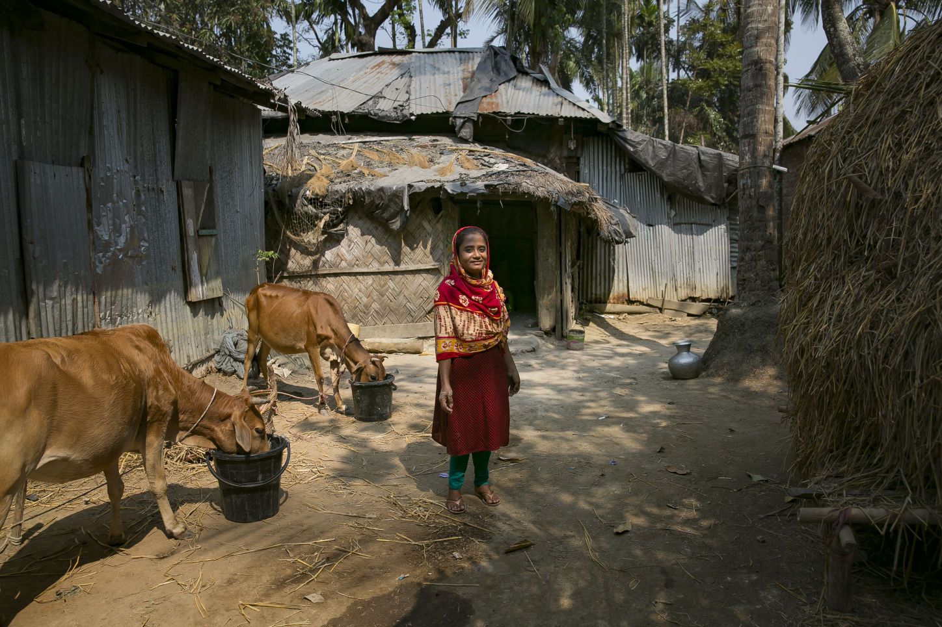
WHY GENDER MATTERS
IN PREVENTING VIOLENT EXTREMISM
SESSION
ONE

Slide 5
Introduction
What is the purpose
of this session?
This session provides an overview of the preventing violent extremism (PVE) agenda, and examines why integrating a gender perspective and promoting women’s empowerment is crucial to effective PVE.
It demonstrates how understanding the gender dynamics of violent extremism helps shed light on the peace and security challenges both women and men experience in relation to violent extremism.
It also explores how the United Nations Women Peace and Security (WPS) agenda can be used to integrate gender into PVE policy and programming.

Slide 6
Learning Outcomes
Understand what the PVE agenda
is and why mainstreaming gender is
important for effective PVE.
Understand the concerns over
integrating gender, WPS and PVE.
Understand and communicate how
promoting gender equality and
women’s empowerment are linked to PVE.
Identify and communicate the
challenges to integrating gender in
PVE policy in the South/Southeast
Asian context.
Understand measures that can be
taken to integrate gender in PVE
policies and programmes.

Slide 7
What is meant by ‘violent extremism’?
‘Violent extremism’ is often used interchangeably with the term ‘terrorism’.
There are no internationally agreed upon definitions for ‘violent extremism’ or ‘terrorism’.
Most definitions include an element of intent relating to:
unlawful violence, especially against civilians, to cause serious harm,
in the pursuit of socio-political or
ideological goals.

Slide 8
What is meant by ‘violent extremism’?
Both terrorism and violent extremism are associated with radicalization.
Radicalization is often defined as a process that moves individuals from accepting moderate or mainstream ideas to advocating extreme beliefs or ideologies.

Slide 9
What is meant by ‘violent extremism’?
Strategies to avoid terrorist or violent extremist acts have been called “counter-terrorism” (CT), “countering violent extremism” (CVE) or “preventing violent extremism” (PVE).
This handbook utilises the term PVE as it seeks to adopt a preventive approach to addressing not
only the acts of terrorist or extremist violence, but the enabling factors and environments that are conducive to such violence.

Slide 10
What is the ‘preventing violent extremism’ agenda?
According to the UN Secretary-General’s Plan of Action to Prevent Violent Extremism,
factors conducive to violent extremism include:
lack of socioeconomic opportunities;
violations of human rights and the rule of law;
marginalization and discrimination;
prolonged and unresolved conflicts;
poor governance;
radicalization in prisons.

Slide 11
What is the ‘preventing violent extremism’ agenda?
Factors that can push a person to become involved in violent extremism include:
individual backgrounds and motivations;
distortion and misuse of beliefs, political
ideologies, and ethnic and cultural differences; and
collective grievances, marginalisation,
and victimisation;
the influence of leaders and social networks.

Slide 12
Why is gender so important to effective PVE?
Consequences of gender-blind PVE
impunity for extremist violence that
deliberately targets women and girls;
failure to leverage women's leadership and
participation in identify local driven and/or
community-based solutions, including youth engagement;
a history of failure to address the complex roles of
women in countering, and in some cases perpetrating,
violent extremism
impunity for gender-based abuses taking place
in the context of national security efforts to
combat violent extremism;
inability to recognise gendered root causes
and early warning signs of violent extremism;
the absence women’s voices and gender perspective
in PVE/CT/CVE policy and decision-making.

Slide 13

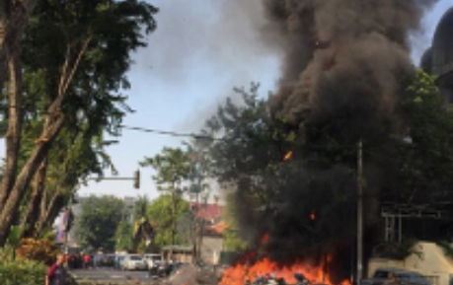
Why is gender so important to effective PVE?
Indonesia church bombings: police say one family
and their children behind attacks
The Guardian, 13 May 2018,
https://www.theguardian.com/world/2018/may/13/deaths-bomb-attacks-churches-
indonesia-surabaya

Slide 14
How does gender analysis contribute to effective PVE?
Gender analysis asks questions such as:
How does gender impact the decision
of men versus women to join or support
violent extremist groups?
What particular capacities do women and men
bring to preventing violent extremism
in their communities?
How are women and men impacted
differently by measures to counter or
prevent violent extremism?
Are the needs and capacities of women and
men equally considered in PVE policy
and programming?
What are women's roles in de-radicalisation,
rehabilitation and reintegration?

Slide 15
How does gender analysis contribute to effective PVE?
Strong correlation between intimate partner violence and political violence. Those who commit violent extremist acts are more likely to have been violent towards family members.
There is a relationship between gender-based violence and discrimination, and women’s participation in violent extremism. Some women who support violent extremism are motivated by experiences of marginalization and abuse.
The occurrence of violent extremism in a community can make women more vulnerable to sexual and gender-based violence. This includes the risk of reprisal attacks from state agencies against women in “suspect” communities, or victimisation by violent extremists themselves.

Slide 16
How does gender analysis contribute to effective PVE?
(Continued)
Narratives of masculine superiority and the promise of access to women compel some men to join extremist groups.
Women can provide alternative insights into why other women join or support such groups, in addition to influencing men in their family or social circle, and the wider community.
There are no one size fits all solutions to preventing violent extremism: what works for women may not work for men, what works in one community may not work in another.
Women victims of violent extremists need protection, but this can be difficult where women cannot access services or do not have a voice in the public sphere.

Slide 17
Integrating Gender in PVE
UN Women has continued to elevate the visibility of gender within the PVE sphere at the global level and in their regional and country programs. UN Women have adopted a four-track approach to integrating gender and empowering women in PVE:
Empowerment
Research
Participation
Policy Influence

Slide 18
Integrating gender in PVE
 | 1. Empowerment
 | Promote women’s leadership and economic empowerment to build peaceful coexistence and social cohesion, as well as strengthen resilience at the community level
 | 2. Participation
 | Increase women’s participation and leadership in efforts to prevent and respond to violent extremism.
 | 3. Research
 | Work towards a better understanding of how violent extremism impacts men and women, boys and girls differently, and how we may better prevent it using gender as an analysis tool.
 | 4. Policy Influence
 | Ensure that women’s voices, ideas and experiences are meaningfully integrated into PVE policy, program design and implementation.

Slide 19
The WPS agenda
The four pillars of the WPS agenda are:
Participation: Including women in all areas of peace and security decision-making at the local, national, regional and international levels, including on PVE.
Protection: Increase the protection of women and girls’ human and legal rights as well as protection against gender-based violence in the context of armed conflict.
Prevention: Improve strategies to prevent violence against women and increase the representation of women in mechanisms for the prevention of conflict.
Relief and Recovery: Increase the gender equality of relief and recovery measures to ensure that transitional and reconstruction processes and institutions are gender-inclusive.

Slide 20
The WPS agenda
The WPS agenda calls for states to specifically address gender equality and women’s empowerment in peace and security matters and identifies women as essential contributors to sustainable peace.
The WPS agenda is informed by 10 UN Security Council resolutions 1325, 1820, 1888, 1889, 1960, 2106, 2122, 2242, 2467, and 2493—and is bolstered by a number of related normative frameworks, which make up the broader women, peace, and security (WPS) agenda.

Slide 21
Intersectionality, gender and PVE
Intersectionality – understanding how one’s social and political identities
(gender, race, ethnicity, ability, etc.) combine and overlap
Intersectionality acknowledges that each individual has privileges and disadvantages according to their different places or roles in society.
Women are not a homogenous group.
Inclusive PVE strategies must recognised
intersectionality.
For example, a woman with a disability may face different types of discrimination to a woman without a disability.
Applying an intersectional lens helps to examine the complex challenges different women face, as “women” are not a homogenous group.

Slide 22
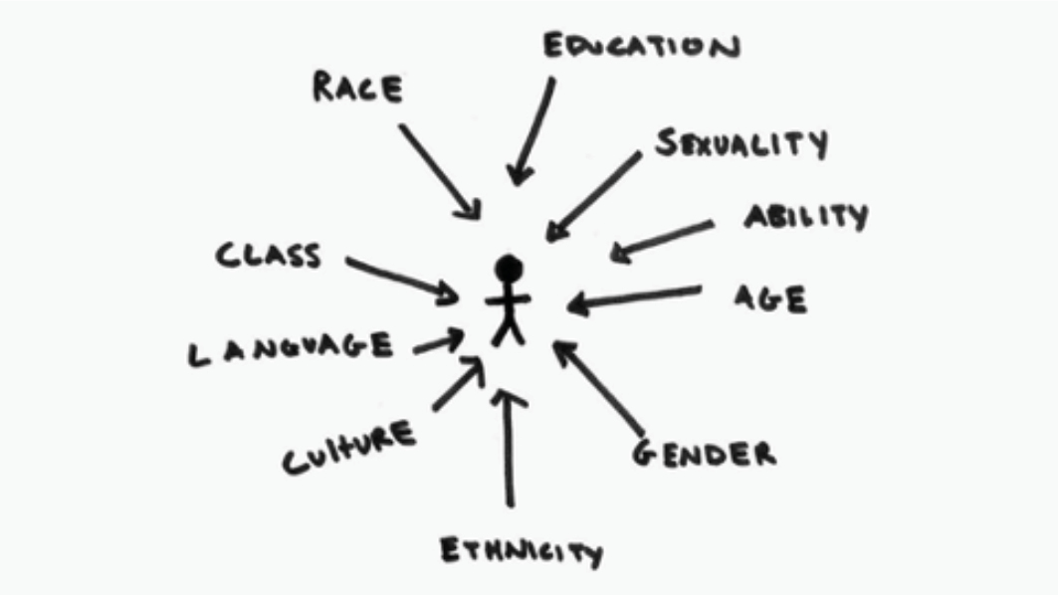

Slide 23
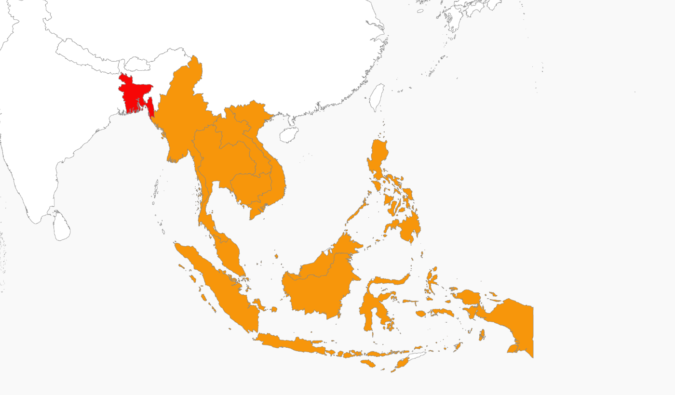
How Southeast Asian and
Bangladeshi extremism intersect
(Jakarta, 8 May 2017) Southeast Asian and
Bangladeshi extremism are becoming increasingly
intertwined, making the traditional distinction
between South and Southeast Asia obsolete,
at least as far as counter-terrorism is concerned.
The urgent task now is for governments, journalists
and NGOs across the region to better understand the
interaction and look for interventions that can
strengthen local resistance to recruitment.

Slide 24
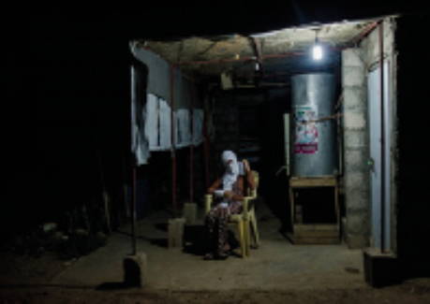
Women’s human rights, non-discrimination & PVE
The United Nations Declaration on the Elimination of Violence Against Women (DEVAW) urged that
“States should condemn violence against women and should not invoke any custom, tradition or
religious consideration to avoid their obligations with respect to its elimination”.
UN General Assembly Resolution A/48/49 (1993)
‘Freed From ISIS, Yazidi Women Return in ‘Severe Shock’
New York Times, 27 July 2017,
www.nytimes.com/2017/07/27/world/middleeast/isis-yazidi-women-rape-iraq-mosul-slavery.html

Slide 25
Individual and group exercises
General discussion

Slide 26
Key insights and takeaways
Gender analysis is a tool used to take into account how our gender-identity impacts experiences to inform more gender inclusive, effective and sensitive decision making.
Gender-inclusive strategies are needed to reduce the risk of, and harm caused by, SGBV in the context of violent extremism.
Appropriate preventive strategies and mechanisms targeting gender inequality and discrimination contribute to reducing violent extremism.
SGBV must be acknowledged as a facilitator of VE.
Coercion experienced by women who become involved as agents of VE is not always based on physical violence or threats.
Appropriate legal mechanisms that remove women from risks of SGBV and reduce the harms caused by SGBV may ultimately contribute to reducing vulnerability to VE.

Slide 27
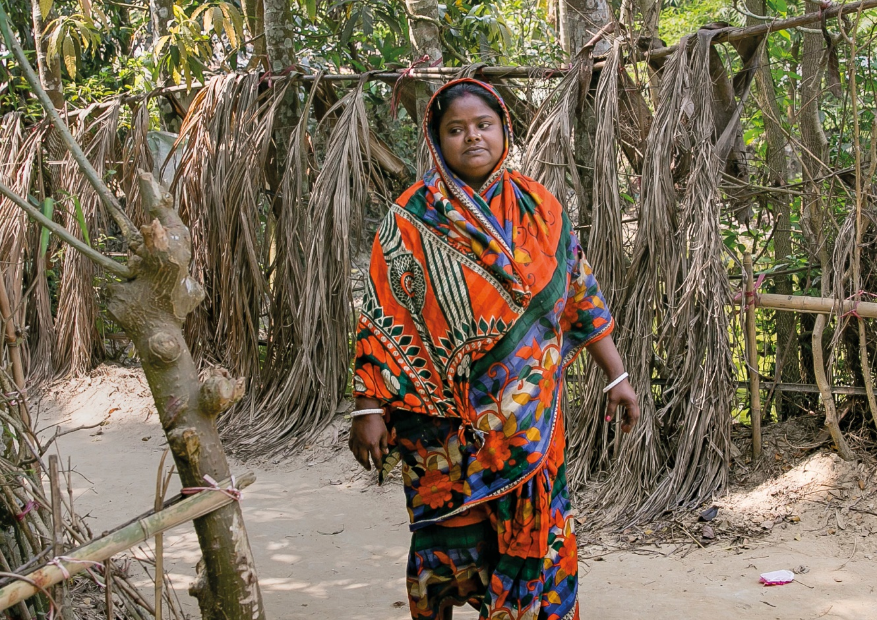
GENDER, RADICALIZATION
AND VIOLENT EXTREMISM:
CAUSES AND EFFECTS
SESSION
TWO

Slide 28

Introduction
What is the purpose
of this session?
This module looks at the intersection of gender, radicalization and violent extremism to gain insights into what drives an individual to extremism.

Slide 29
Learning Outcomes
Understand the major factors that
facilitate the turn towards violent
extremism by individuals.
Apply knowledge acquired to identify
different drivers of violent extremism.
Understand the drivers of violent extremism
through the examination of case studies.

Slide 30
How can we understand extremist behaviour?
Extremism is a process that is affected by a myriad of factors.
Examining different literature on the topics of terrorism and violent extremism, we can identify the major factors (which we call drivers) that facilitate the process of turning law-abiding citizens towards violent extremism.

Slide 31
How can we understand extremist behaviour?
 |  | Reflection:
 |  | Write down 3 factors that you think could turn a law-abiding member of your community or organisation to turn towards violent extremism:
 |  | 1.
 |  | 2.
 |  | 3.

Slide 32
How can we understand extremist behaviour?
Peter Neumann believes that radicalization is the process that leads to violent extremism.
Grievance
Needs
Ideas
People
Violence

Slide 33
Key insights and takeaways
There are a number of major factors or drivers that have been identified as contributing to and facilitating the process of turning law-abiding citizens towards violent extremism. These factors or drivers do not cause or increase the likelihood of violent extremism in every case nor in isolation to other contributing environmental factors and context.
Psychological and cognitive factors play a key role in the ways some individuals become more receptive to the messages or ideas spread by extremist groups.
The case studies examined in this session provided a number of different scenarios that highlighted how different drivers, combined with other factors can lead to violent extremism.

Slide 34
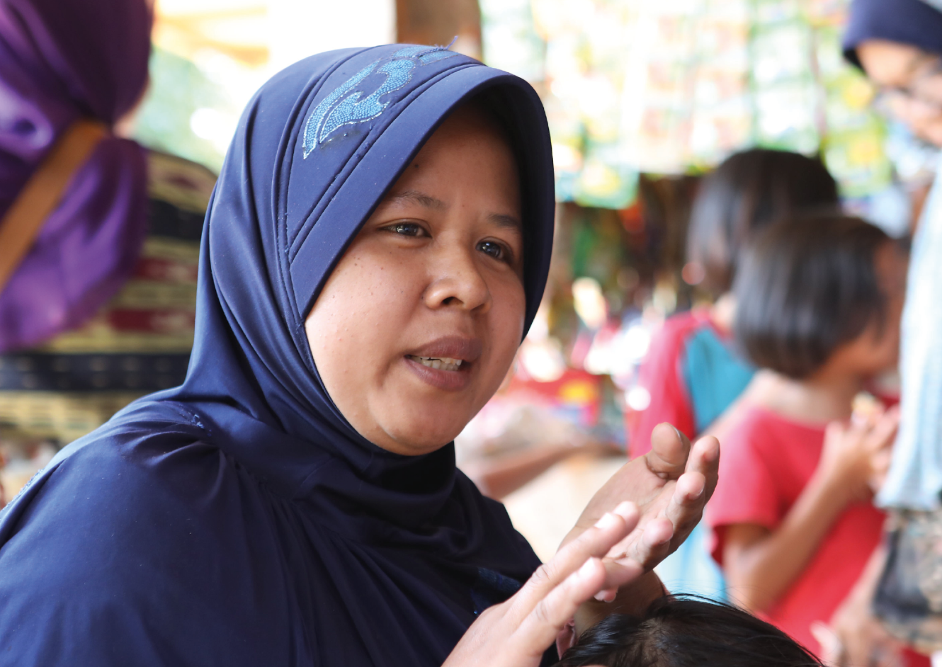
PROTECTION – LEGAL FRAMEWORKS, HUMAN RIGHTS AND PREVENTING VIOLENT EXTREMISM
SESSION
THREE

Slide 35

Introduction
What is this
session about?
In this session, the relationships between different systems of rights, rules, and principles relating to PVE/CVE are set out and explained.
In this session, we specifically refer to relevant provisions of international law relating to human rights (International Covenant of Civil and Political Rights – ICCPR), discrimination on the basis of gender (Convention on the Elimination of all Forms of Discrimination Against Women), UN Resolutions (on terrorism and WPS) and ‘soft law’ (UN Declaration relating to the Elimination of Violence against Women [DEVAW]).

Slide 36
Learning Outcomes
Recognise the tensions between human
rights and security approaches and how
these inform strategies around gender
and PVE programming.
Understand the tensions between
freedom of religion, national security
and public safety.
Understand the gendered dynamics of the
rights of women offenders in detention.
Understand that a gap often exists
between ‘law as enacted’ and law
as enforced.

Slide 37
What do we mean by protection?
Broadly defined, protection refers to ‘removing individuals from risk, threat, or a situation of violence’ as well as ‘intervening at the source of the violence to reduce or stop it’.
Protection in the context of PVE reveals many tensions between competing rights, including security versus liberty, freedom of religion and the rights of women and girls, the rights of victims and the rights of perpetrators or those suspected of violence extremism.

Slide 38
The key insight in this session is that LEGAL PROTECTION can and should be:
Harnessed to promote preventive and educational ends, and its regulatory potential need not be restricted to reactive, repressive and punitive roles.
Understood as a productive dialogue and interaction between domestic legal obligations, and international legal rights and responsibilities.

Slide 39
Gap between the ‘law in books’ and ‘law in action’
There is often a gap between the law as enacted, and the law as enforced. There are many reasons for this ‘gap’ but its consequences can be very harmful. For example, in the context of CT, the implementation of punitive measures does not necessarily result in the reduction of terrorism offences.

Slide 40
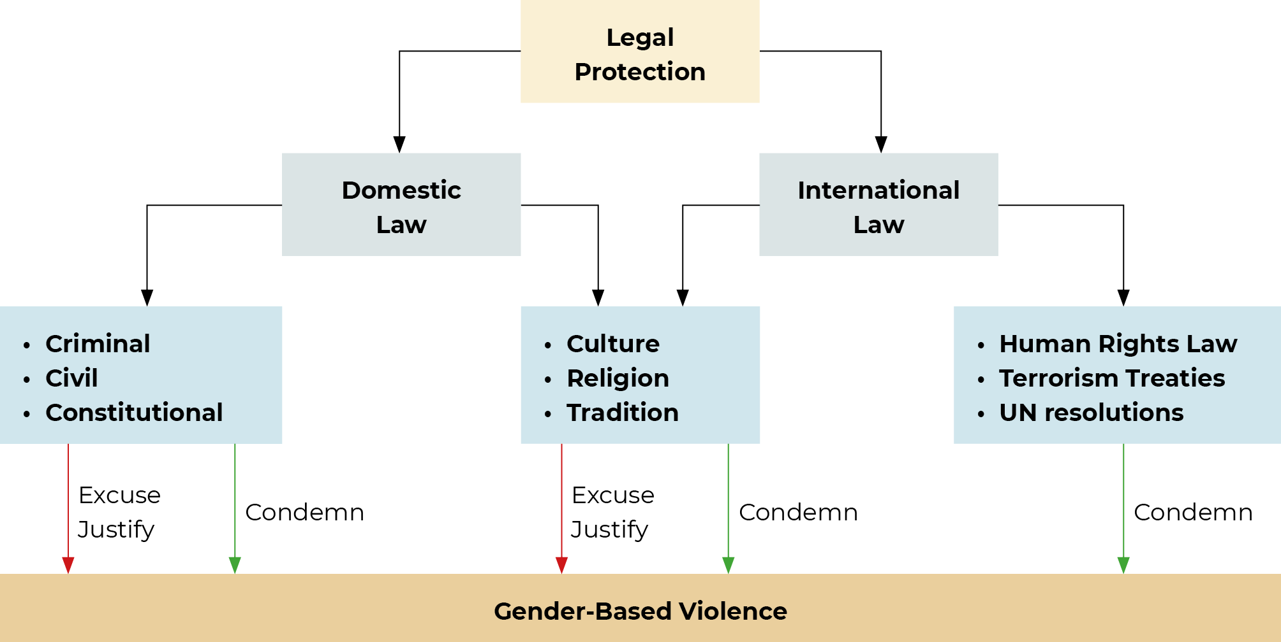

Slide 41
What do we mean by protection?
A question of balance: security versus liberty?
A key learning is that policy interventions aimed at PVE/CT should not be viewed in ‘either/or’ terms, namely to favour increased security over protection of human rights, or an inverse relationship, that is to promote greater security necessarily undermines human rights, and vice versa.
The human rights approach adopted in these materials rejects that human rights are simply ‘tradeable’ or sacrificed for security, and proposes another approach to resolving the tension: all PVE/CT CVE policy interventions must seek to promote and protect both human rights and security, to the maximum extent possible.

Slide 42
Freedom of religion versus national security and public safety
Banning of religious coverings on ‘security grounds’ is controversial, but has been introduced in some countries in public institutions (such as universities or government offices) for the safety, citizen identification or maintaining order and discipline.
 |  | Security Council Resolution 1456 (2003):
 |  | ‘[UN Security Council also] emphasizes that continuing international efforts to enhance dialogue and broaden the understanding among civilizations, in an effort to prevent the indiscriminate targeting of different religions and cultures, to further strengthen the campaign against terrorism, and to address unresolved regional conflicts and the full range of global issues, including development issues, will contribute to international cooperation and collaboration, which by themselves are necessary to sustain the broadest possible fight against terrorism’ (para 10)

Slide 43
Violent extremism and women as active participants
Considering the agency of some women as active participants in VE, it is important to ensure that the relevant international standards are taken into consideration when women suspected of violent extremism and/or terrorism are held in prisons, including the United Nations Rules for the Treatment of Women Prisoners and Non-Custodial Measures for Women Offenders

Slide 44
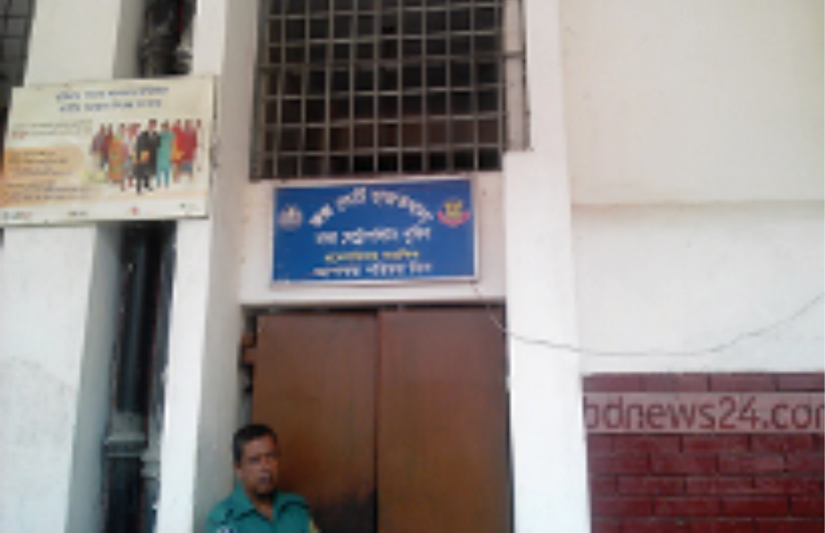
In the performance of their duty, law enforcement officials shall respect and protect human dignity
and maintain and uphold the human rights of all persons
Adopted by the UN General Assembly on 17 December 1979
The lack of separate facilities for women in Dhaka court jail
makes harassment a problem for female inmates on a
regular basis
bdnews24.com, 24 May 2018
https://bdnews24.com/bangladesh/2016/05/24/dhaka-court-jail-a-den-of-harassment-for
-women-inmates-for-lack-of-separate-cell

Slide 45
Key insights and takeaways
Broadly defined, protection in this session refers to ‘removing individuals from risk, threat or a situation of violence’ as well as ‘intervening at the source of the violence to reduce or stop it’.
Protection in the context of PVE reveals many tensions between competing rights.
There is often a gap between the law as enacted and the law as enforced. There are many reasons for this ‘gap’ but its consequences can be harmful.

Slide 46
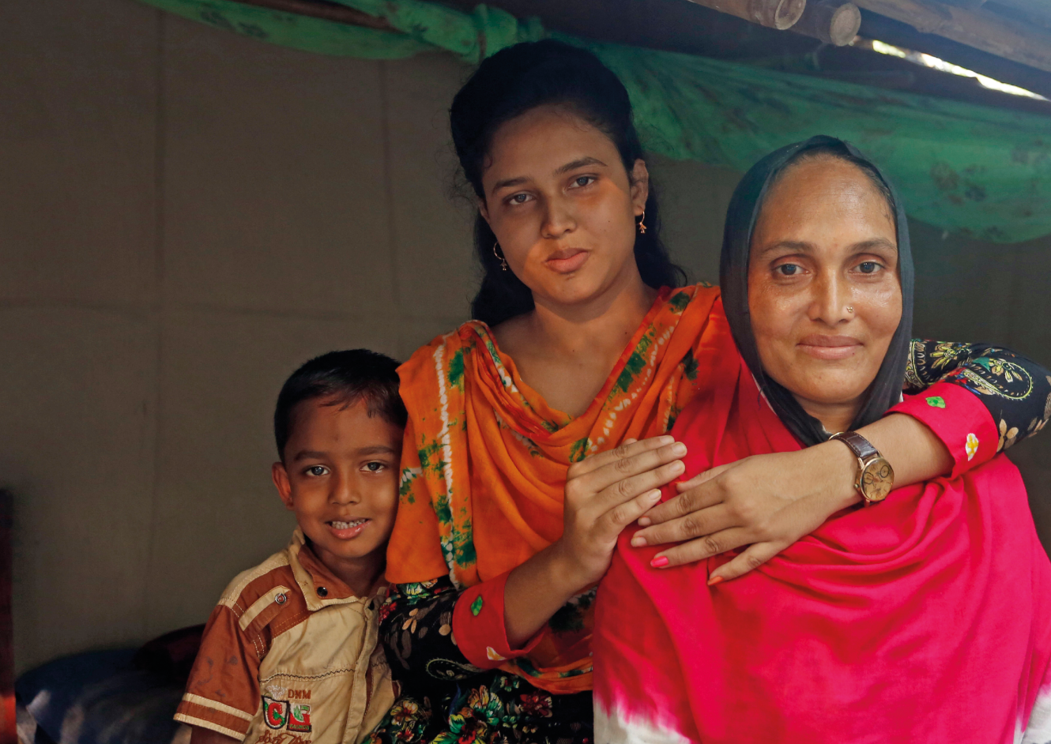
PREVENTION –
WOMEN AS PEACEBUILDERS
SESSION
FOUR

Slide 47

Introduction
What is the purpose
of this section?
This session will explore the empowerment and leadership of women within PVE. Women play an important role in preventing violent extremism from taking hold in their communities. However, their contributions are often undermined, undervalued, or under-represented in existing PVE policy.
This session will show how understanding the structural and root causes of violent extremism can help make more effective prevention strategies including the identification of early warning signs within the family and local community.

Slide 48
Learning Outcomes
Understand the many roles women
have in relation to PVE.
Interrogate the role of gender norms and
identities that can be used to develop more
successful prevention strategies.
Understand how stereotyping women’s
roles impacts women's capacity to
undertake effective PVE work.

Slide 49
Gender and prevention
Women’s participation is critical to addressing the root causes of violent extremism. If gender inequality is a risk factor in the emergence of such violent extremist groups, gender equality is also a protective factor.
Gender equality is a long-term goal that will look different in each context, but it is needed to address violence in all societies.
Gender equality can only happen when women are meaningfully involved in all levels of family and social life.

Slide 50
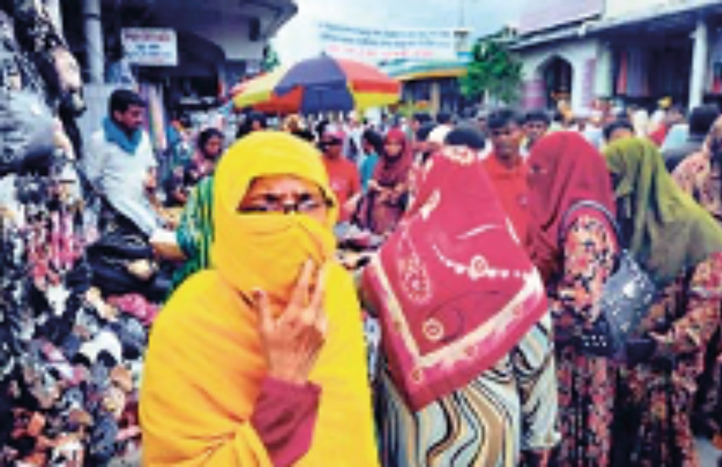
‘Veiling’ debate divides Bangladeshi women
DHAKA (AFP) - In a landmark verdict, Bangladesh's High Court ruled that "attempts to coerce or impose a dress code on women clearly amount to a form of sexual harassment".
Sunday Times, 19 May 2010
http://www.sundaytimes.lk/100919/International/int_11.html

Slide 51
Early-warning signs of violent extremism
Women are well placed to prevent violent extremism because they are often the first to be affected by extremist ideology.
Violence against women, forced marriage, restrictions on their movement, threats or acts of gender-based violence and enforced modesty are all early warning signs of radicalization that may lead to further violence, and they all disproportionately affect women and girls.
Reinforcing gender equality in the home, and promoting the involvement of women in all levels of community life can help to prevent violent extremism in the long term.

Slide 52
How can women prevent violent extremism?
Failing to recognise women beyond traditional roles (wives, mothers and daughters) neglects their agency and the powerful influence they have within their communities.

Slide 53
What measures can support women in PVE?
Family Activism: empower women to recognise the warning signs within their own families, as they are often the first to notice potentially dangerous changes in behaviour.
Empowering both women and men as parents: they are the “first teachers” and can be particularly influential on their family.
Women’s educational empowerment and leadership: examples of women leaders within the community counters extremist narratives.
Teaching critical thinking and analytical skills: empowers women and men to think for themselves, and critically assess extreme messages.
Women’s peacebuilding: capacity goes beyond family roles – they may also be leaders in the community or workplace, so we shouldn’t only see women in their roles as “mothers” or “sisters” or “wives”.

Slide 54
Complexities and challenges to empowering women in PVE
It is important to consider gender at all stages of PVE, including the roles that both men and women play. However, we must be careful when emphasising the role of women in preventing violent extremism.
PVE programmes can reinforce gender stereotypes. This can lessen women’s agency by viewing women only as mothers, sisters or wives. By relegating their role in prevention to the private, family sphere, it ignores women’s power in other areas of life (work, religious community, other groups/relationships), and the complex way in which roles interact and overlap.

Slide 55
Complexities and challenges to empowering women in PVE
It is important that by involving women at every level of PVE we do not make them entirely responsible for preventing violence. Some PVE approaches make women responsible for the actions of men in their families, and wider community. This is unfair, and it negates the accountability of men themselves.

Slide 56
Key insights and takeaways
Gender is crucial to understanding the root causes of violent extremism, the roles people play in exacerbating it, and the roles people can play in preventing it.
This is why it is important that all genders play a role in decision-making, design and implementation of PVE initiatives. This includes people from all backgrounds, education levels, ages, and professions.

Slide 57
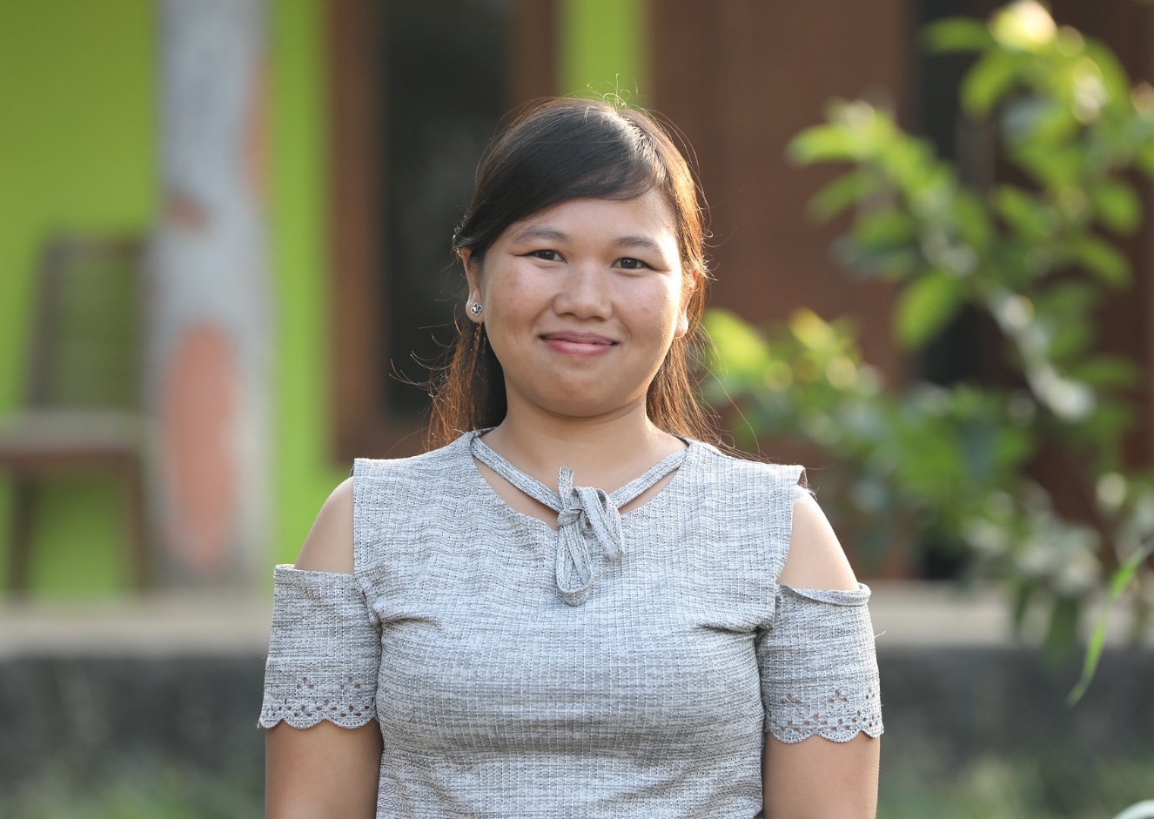
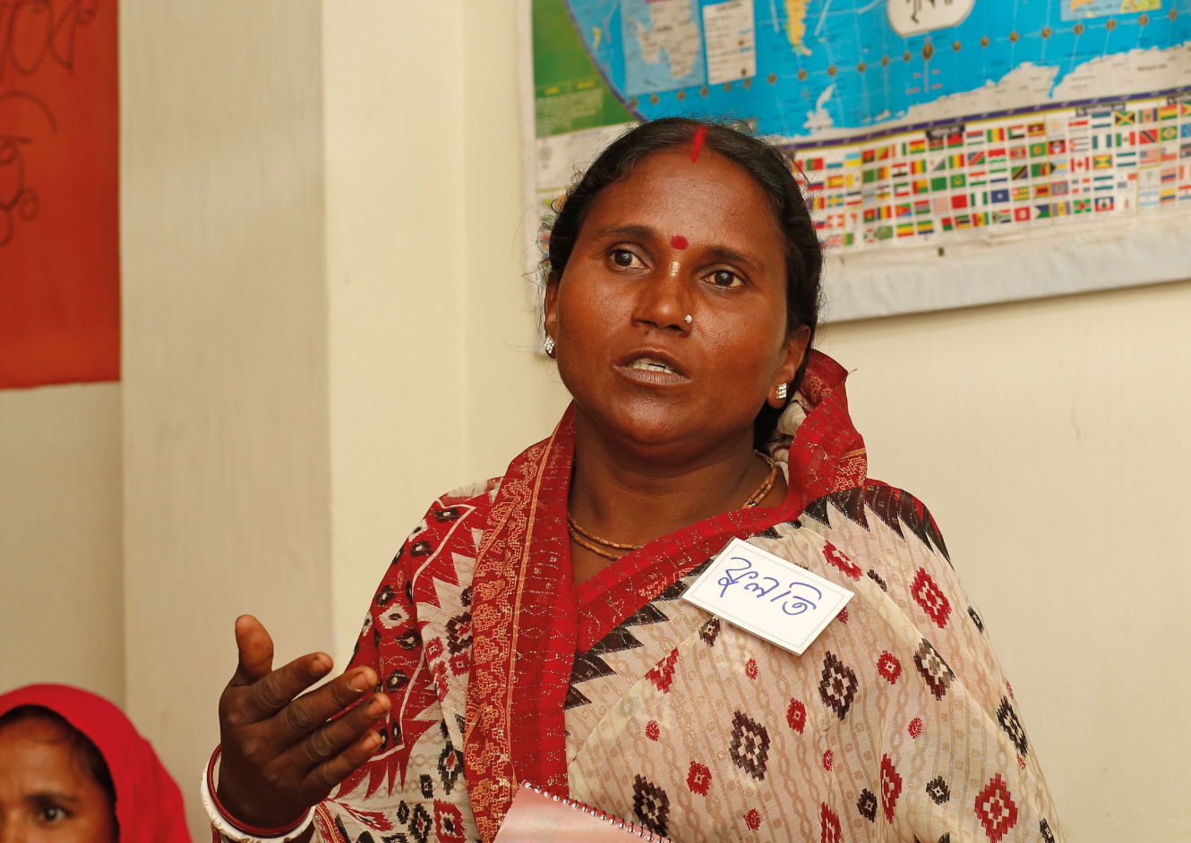
REINTEGRATION –
GENDERING PEACE
SESSION
FIVE

Slide 58

Introduction
What is the purpose
of this section?
This session will draw upon the WPS Relief and Recovery pillar to explore how persons who have engaged in acts of violent extremism can be assisted and encouraged to desist and disengage from such activities, and how individuals, communities and nations can address the harms and build resilience against violent extremism.
This material examines the various strategies, support mechanisms and services that promote the rehabilitation of perpetrators of violent extremism, facilitate the redress of harms caused at the local, national, and regional level and promote their reintegration back into the community.

Slide 59
Learning Outcomes
Understand how perpetrators, families
and communities are impacted by
violent extremism. Recognise the
different roles actors and groups can play
in facilitating the desistance and
disengagement from violent extremism and
work to promote rehabilitation and reintegration.
Identify ‘best practice’ local, regional, and
national strategies, support mechanisms
and services that help to ‘restore the
peace’, rebuild communities, repair harms,
provide redress, as well as, facilitate the
desistance, disengagement, rehabilitation
and reintegration of perpetrators of
violent extremism.
Understand the role of women, using
a gender perspective, in facilitating
effective desistance and disengagement,
reintegration and rehabilitation programs.

Slide 60
Desisting and Disengaging
Desistance is the immediate effect of ceasing from engaging in or planning acts of violent extremism.
Disengagement is longer term effect of withdrawing from the organisation or ‘thought leaders’ or online ‘influencer groups’ that promote violent extremism. In other words, disengagement is the process of the individual detaching from the violent extremist network.

Slide 61
Drivers of desistance/disengagement
Drivers of Extremism
Drivers of Desistance / Disengagement
Notes:
Drivers of Extremism
Poverty (material needs)
Identity (emotional needs)
Marginalisation (violence & grievance)
Ideas
Negative peer pressure (people)
Drivers of Desistance/Disengagement
Targeted poverty eradication programmes
Public education campaign & accepting differences
Inclusion and respect – strengthening positive ties
Promoting counter narratives
Mentorship and inclusion

Slide 62
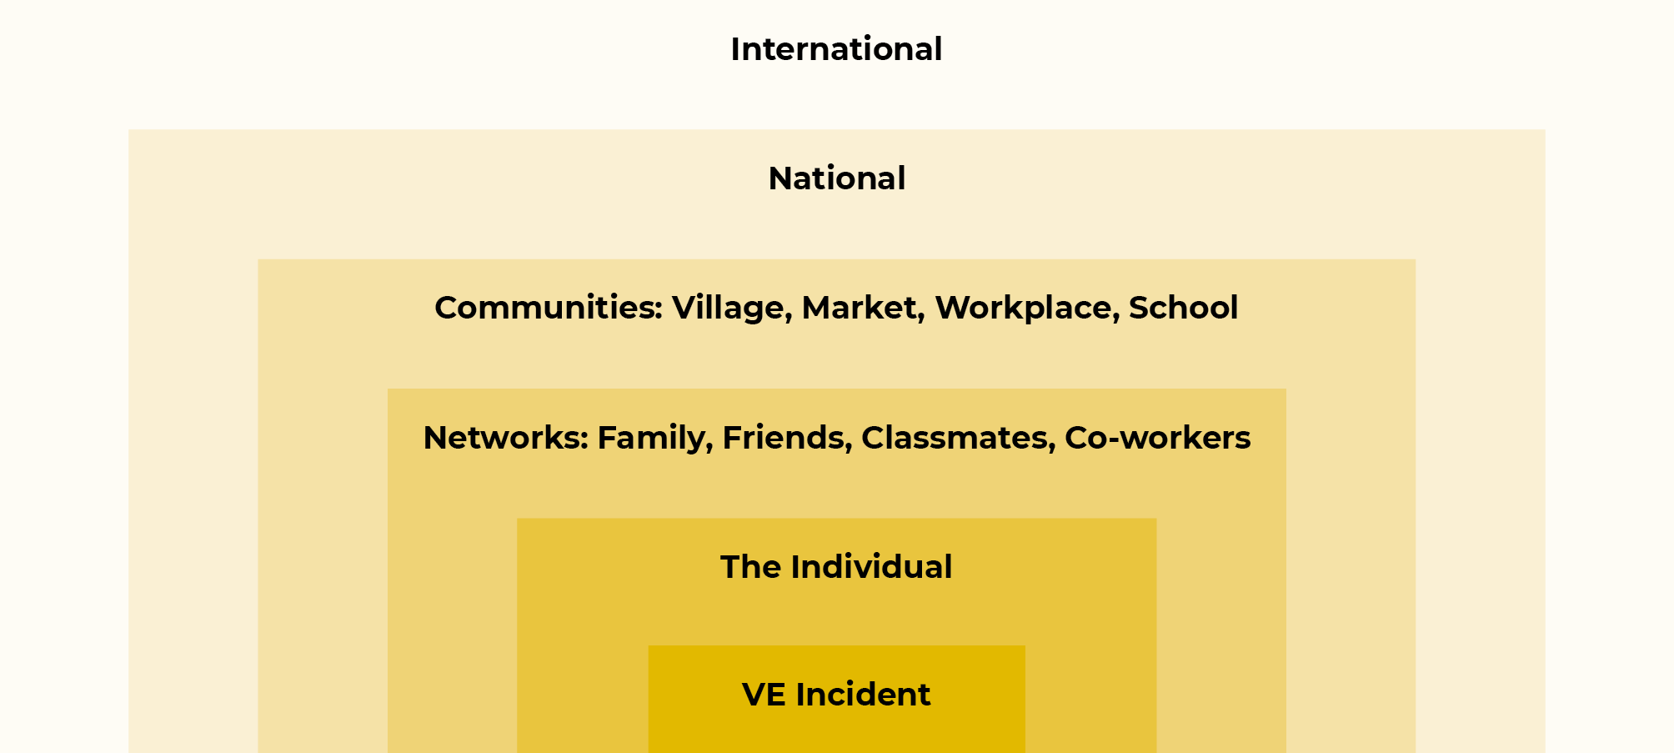
The ripple effect

Slide 63
Restoring the peace
What is Relief?
Relief is the short-term objective to help and encourage individuals and communities affected by the violent extremism immediately take step to disengage from violent groups and networks.
What is Recovery?
Recovery is the longer-term objective to help and encourage individuals and communities affected by the violent extremism to regain or create more resilience against extremist threats in future.

Slide 64
What is rehabilitation?
Rehabilitation uses a medical psycho-social model for determining the motivations and proper treatment of offenders to achieve disengagement and desistance.
Labelling offenders as ‘terrorists’ and ‘violent extremist’ can have the unintended consequence of the label become self-fulfilling, and divert attention from other interventions, including community-based measures, that can more effectively assist counter violent extremism.

Slide 65
What is restorative justice?
Restorative justice is defined as a process where parties with a stake in a specific offence or wrongdoing collectively resolve how to deal with its aftermath and its implications for the future in order to restore peace and stability in the community.
The key characteristics are:
Offenders accept responsibility for their conduct and its consequences;
Families and communities surrounding the offender play a role in reintegration and support for both the victim and the offender; and
Resolution for disputes is provided.

Slide 66
What is reintegration?
Reintegration fits within a broader model of restorative justice as discussed above.
Reintegration moves beyond rehabilitation, where interventions are aimed at the individual (offender-focused), to strategies that harness the social power of the community to restore the peace, provide redress to victims and prevent future offending.

Slide 67
Status degradation and stigmatisation
The example below demonstrates the process of status degradation based on negative stigmatic shaming directed to the individual as a person, rather than positive integrative shaming directed at the harmful acts and their effects on others.
The former type of stigmatic shame often has counterproductive effects. Labelling individuals, family and communities as ‘outlaws’ can result in a further driver of violent extremism.

Slide 68
Trauma
People who have fought in violent wars or committed violent acts, or who have lost a family member through violence, can experience strong feelings such as fear, guilt, anger, and/or grief – these feelings are indicative of trauma.
If this trauma is not acknowledged and treated, these individuals may suffer from depression and anxiety.

Slide 69

Jail is always the measure of last resort, used as a means to incapacitate the offender from causing harm to the community.
Coercion
Jail
Risk Management
Rehabilitation
Community Education
Prevention

Slide 70
What are the gender dimensions?
Women can be seen as “access points” through mitigate risks of radicalisation. This assumes that women are always peaceful and non-violent, incapable of committing and assisting extremist violence. This approach shifts responsibility for PVE committed by men onto women’s shoulders, who are viewed as ‘peacekeepers’ capable of preventing violence.
In communities recovering from the effects of violent extremism, the law enforcement and security forces may play a key ‘first responder’ role in relief efforts. There are several gender dimensions to this top-down, state-led response.
First is the make-up of the responding forces themselves – is it representative of the community? That is, are there women law enforcement and security officials?
Second is the type of security that is promoted in the aftermath of acts of terrorism and violent extremism – are only hard line security measures enforced, or is the community engaged?

Slide 71
Key insights and takeaways
Gender perspectives should be integrated into all relief and recovery policies and programming, including PVE initiatives. This means that the specific needs of women and men, girls and boys, are planned for and met and that both sexes are equally empowered in leadership and decision-making processes.

Slide 72


