Slide 5
To enable closed caption
1. CLICK LIVE TRANSCRIPT ON THE BOTTOM OF YOUR SCREEN
2. CLICK SHOW SUBTITLE

Slide 6
To enable language interpretation

Slide 7
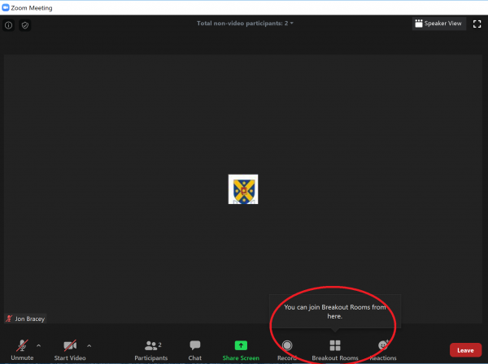
To Join Breakout Room
1
CLICK HERE
CLICK HERE

Slide 8
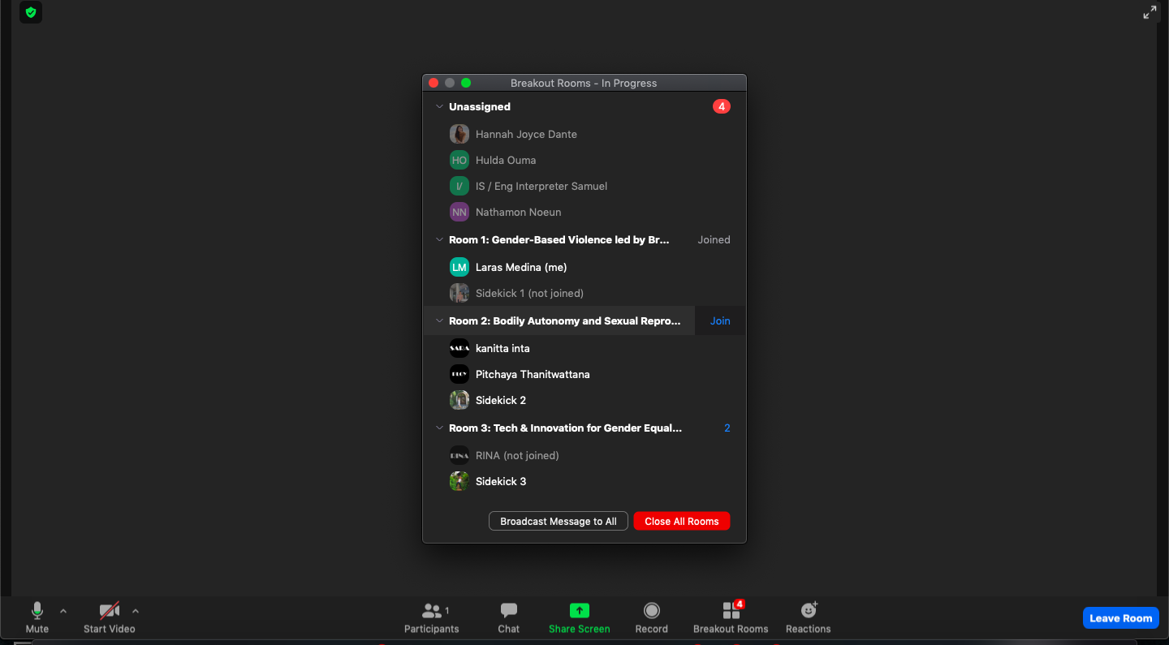
2
CLICK JOIN

Slide 9
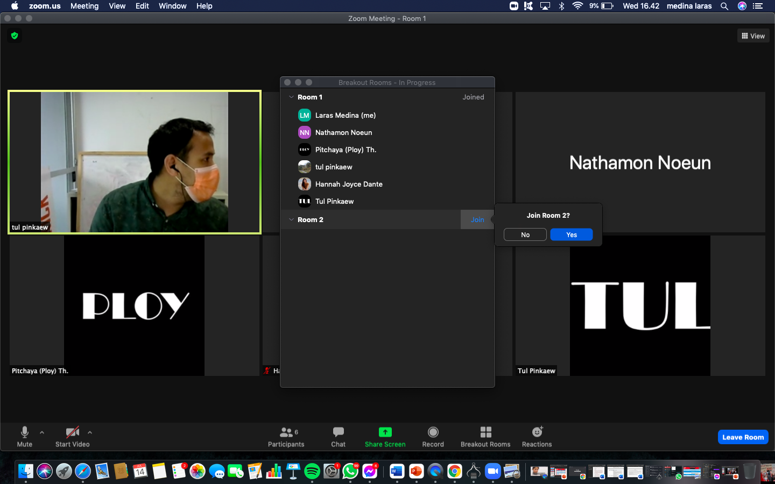
3
CLICK YES

Slide 10
1
TO SWITCH BREAKOUT ROOM AFTER 30 MINUTES
CLICK HERE

Slide 11
2
CLICK JOIN

Slide 12
3
CLICK YES

Slide 13
To enable closed caption in breakout rooms
1. CLICK LIVE TRANSCRIPT
2. CLICK SHOW SUBTITLE

