Slide 1
Legion of Stars
https://www.youtube.com/watch?v=fsZrtQQtjVQ

Slide 3
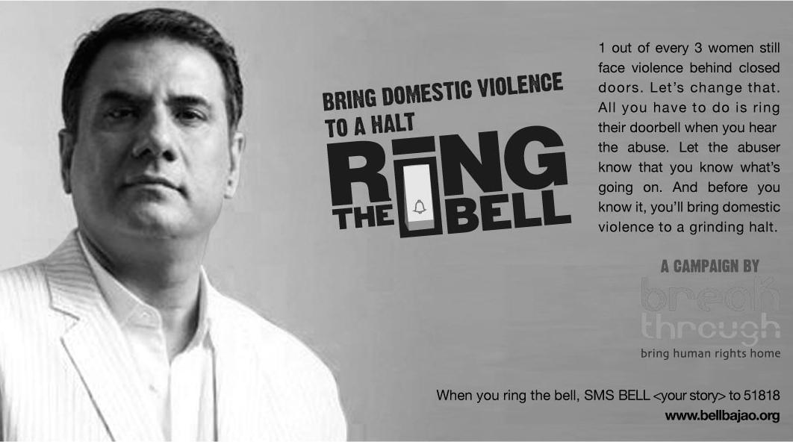
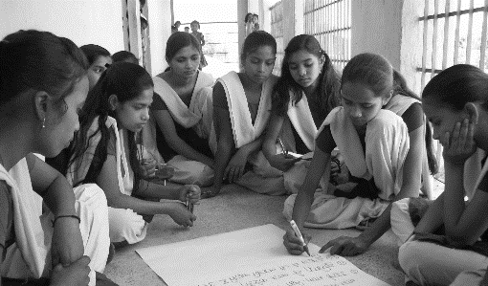
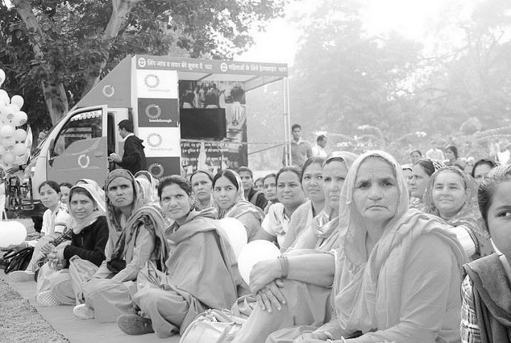
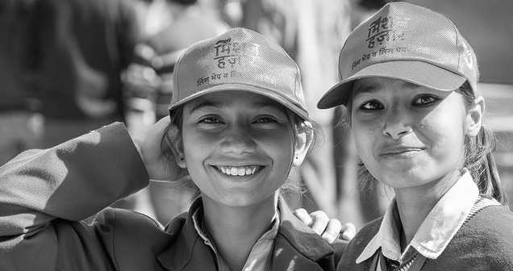
20 years of working to change the cultural norms that perpetuate violence and discrimination against women & girls
Music videos
Award winning media campaigns
School programmes
Community Engagement
Youth leaders as catalysts

Slide 4
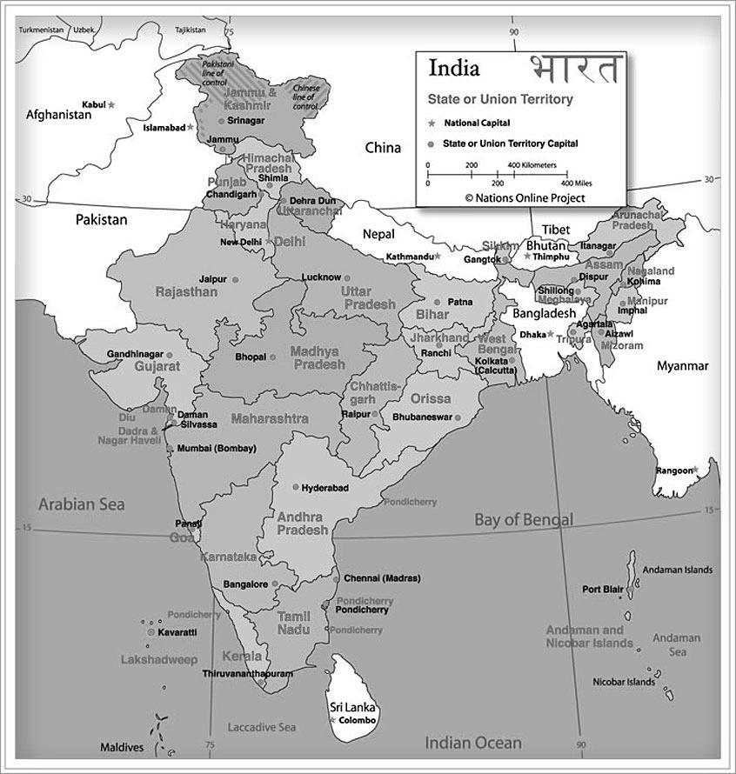
On-ground geographic reach
Haryana
Delhi
UP
Jharkhand

Slide 5
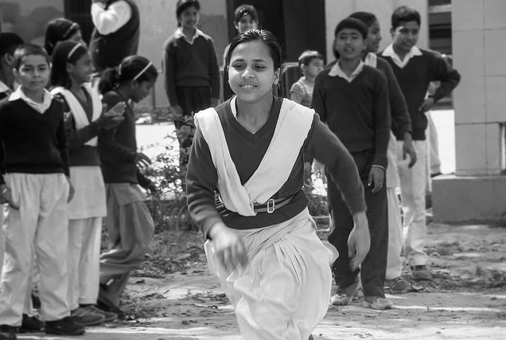
Adolescent Empowerment
Breakthrough reached out to over 604,000 adolescents across 5 states to shape their gender attitudes and behaviours in the past 4 years:
The programme comprises of:
A two –year school based gender equity programme for 11-14 year old boys & girls
Building of leadership & life skills, career counseling, sexual and reproductive health trainings for 15-18 year olds
Community and parental engagement to build an eco-system that values girls
Use of mass media, popular culture and the arts to build community dialogues around ensuring a supportive environment for women & girls

Slide 6
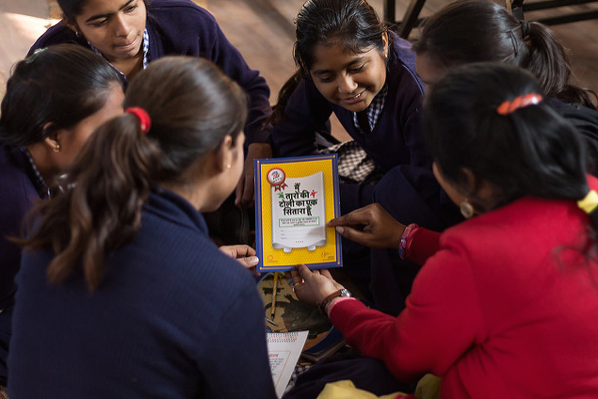
Adolescent Empowerment – Programme Outcomes
Breakthrough’s programme aims to bring change across three critical spheres:
Improved gender attitudes and behaviours of boys and girls
Increase number of years of schooling for girls
Consequently, Increase age at marriage for girls
Our adolescent programme in two randomised control trials has been proven to bring the following results:
Significantly improves the gender attitudes and behaviours of both boys and girls – J-Pal, 2016
Increase the likelihood of girls belong enrolled in school by 89% ; CMS, 2019
Increased age at marriage for girls by 1.84 years, CMS 2019

Slide 7
#TeamChange – building youth social change actors
#TeamChange is a community of people who are committed to changing how women and girls are treated in India.

Slide 8
www.inbreakthrough.org;

